Slide 1
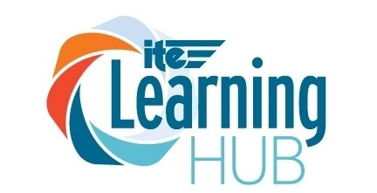
ITS ePrimer Module 16: ITS Emerging Opportunities and Challenges
ITS Professional Capacity Building Program
ITS Joint Program Office
U.S. Department of Transportation
Notes:
This module is sponsored by the U.S. Department of Transportation’s ITS Professional Capacity Building (PCB) Program. The ITS PCB Program is part of the Research and Innovative Technology Administration’s ITS Joint Program Office.
Thank you for participating and we hope you find this module helpful.

Slide 2
Instructor
Eva Lerner-Lam
Founder and President
Palisades Consulting Group, Inc.
Notes:
Founder and President of Palisades Consulting Group, Inc.
Eva specializes in the application of technologies in urban and regional transportation systems
Active member of ITE and has served in various appointed positions since early 1980's, including the ITE International Board of Direction (China Representative)
Winner of several ITE Awards, including the 1995 ITE Engineer of the Year Award and the 1991 Best Paper Award, Institute of Transportation Engineers, 61st Annual Meeting
Bachelor's degree in Economics from Princeton University; Master's in Civil Engineering/Transportation Systems from MIT

Slide 3
Learning Objectives
1. Understand how rapid developments in data, computing, and telecommunications are changing fundamental assumptions in transportation demand, supply, and operational management
2. Define ITS use cases for 4IR technologies so transportation professionals can better plan, design, engineer, and implement intelligent transportation systems (ITS) programs and projects.
Notes:
Two primary learning objectives:
1. Understand how rapid developments in data, computing, and telecommunications are changing fundamental assumptions in transportation demand, supply, and operational management. Together, they are offering more efficient and effective ways to build and operate transportation systems.
2. Define ITS use cases for 4th Industrial Revolution technologies so transportation professionals can better plan, design, engineer, and implement intelligent transportation systems (ITS) programs and projects.

Slide 4
INTRODUCTION
This module describes key "Fourth Industrial Revolution" (4IR) technologies that are presenting new opportunities and challenges for the transportation professional.
Notes:
With the Nation's aggressive new efforts at the start of the second decade of the 21st century to fix and rebuild its infrastructure, transportation professionals have a truly unique opportunity to leverage 4IR technologies to innovate smarter, more resilient, sustainable transportation systems for the future.

Slide 5
ITS is the intersection of two domains…
ITS is at the Intersection of Key Transportation Stakeholders
and Fourth Industrial Revolution Technologies
Notes:
ITS is at the Intersection of Key Transportation Stakeholders and Fourth Industrial Revolution Technologies. Not all Travelers, Vehicles and Infrastructure will need 4IR Technologies, and not all 4IR Technologies have Travelers-Vehicles-Infrastructure uses. It’s really just the INTERSECTION of the two realms that creates Intelligent Transportation Systems

Slide 6
KEY TRANSPORTATION STAKEHOLDERS
TRAVELERS
VEHICLES
INFRASTRUCTURE
Notes:
TRAVELERS, VEHICLES, AND INFRASTRUCTURE: Each has its own set of 4IR opportunities and challenges.

Slide 7
Travelers & ITS
Smartphones, smart watches, and smart glasses
Integrated traveler trip planning and decision support
Mobility payment systems
Data collected by travelers
Mobility as a service (MaaS)
Mobility on demand (MoD)
Accessible transportation technologies
Notes:
Smartphones, smart watches, and smart glasses
will continue to connect the owners of such devices as nodes on the Internet of Things (IoT).
Integrated traveler trip planning and decision support
will use artificial intelligence-based traffic and toll pricing prediction to plan multimodal navigation routes.
Mobility payment systems
will gain momentum as app-based payment systems enable a societal trend toward a cashless economy.
Data collected by travelers
will in and of itself become an asset for monetization by device manufacturers, app developers, and web service providers.
Mobility as a service (MaaS)
will provide gateways to ride hailing, ridesharing, carsharing, bike sharing, and e-scooters as well as traditional transportation services such as public transit and taxis using 4IR data, computing, and telecommunications innovations.
Mobility on demand (MoD)
will continue to evolve as integrated and multimodal transportation operators seek to interact and/or influence the supply and demand sides of transportation systems using 4IR data, computing, and telecommunications innovations.
Accessible transportation technologies
will enable wayfinding and navigation, pre-trip concierge and virtualization, safe intersection crossing, robotics, and automation functions to provide safe and reliable ITS innovations for people needing assistance with their transportation needs.

Slide 8
Vehicles & ITS
Connected and automated vehicles
Onboard data sensing, collection, processing, and transmission devices for navigation and safety
Internal combustion, hybrid, and plug-in electric automobiles, trucks, buses, trains; e-scooters, e-bikes, and urban aerial vehicles
Electric vehicles equipped with onboard alternating current (AC)/direct current (DC) inverters
Digitization and system optimization of electric vehicle charging systems
Data collected by vehicles
Notes:
Connected and automated vehicles
will rely heavily on 4IR technologies in order to operate in connected and automated ways.
Onboard data sensing, collection, processing, and transmission devices for navigation and safety
will improve vehicle operations while simultaneously serving as probes to monitor traffic and provide data and information for other ITS stakeholders.
Internal combustion, hybrid, and plug-in electric automobiles, trucks, buses, trains; e-scooters, e-bikes, and urban aerial vehicles
will all rely heavily on 4IR technologies for energy consumption monitoring and infrastructure capital investment.
Electric vehicles equipped with onboard alternating current (AC)/direct current (DC) inverters will become mobile energy storage units that can deliver energy back into the electric grid on demand.
Digitization and system optimization of electric vehicle charging systems
will help power generators and distributors manage electric grids with more robust analysis and control.
Data collected by vehicles
will become an asset for monetization by public agencies and private enterprises.

Slide 9
Infrastructure & ITS
Roadside sensing, collection, processing, and transmission for traffic monitoring and control
Digital signage for automated driver assistance systems (ADAS)-equipped and self-driving vehicles
Key elements of communications networking architecture
Notes:
Roadside sensing, collection, processing, and transmission for traffic monitoring and control
will become natural sites for edge computing of traffic and transportation management.
Digital signage for automated driver assistance systems (ADAS)-equipped and self-driving vehicles
will evolve with a strong assist from a long-awaited update of Manual of Traffic Control Devices, including a new section, Part 5 Automated Vehicles.
Key elements of communications networking architecture
will undergo enormous evolutionary changes as the sheer quantity of data will multiply to take up ever-increasing quantities of bandwidth in physically-limited frequency spectra.

Slide 10
Infrastructure & ITS, cont’d.
Urban aerial drone transport with rooftop and midlevel landing pads and loading zones
Interfacing with power companies for automated load balancing for electric power distribution and storage optimization
Realtime, digital curbside management of ridesharing and freight loading zones
Notes:
Urban aerial drone transport with rooftop and midlevel landing pads and loading zones
will reduce ground-level transportation congestion but will also create noise and wind buffering and traffic channelization challenges.
Interfacing with power companies for automated load balancing for electric power distribution and storage optimization
will be critical but the appropriate policymaking bodies have yet to be convened.
Digital signage for automated driver assistance systems (ADAS)-equipped and self-driving vehicles
will evolve with a strong assist from a long-awaited update of Manual of Traffic Control Devices, including a new section, Part 5 Automated Vehicles.
Realtime, digital curbside management of ridesharing and freight loading zones
will reduce urban street congestion.

Slide 11
Key 4IR Technologies Suitable for ITS
Data
Computing
Telecommunications
Notes:
There are three basic components to 4th Industrial Revolution Technologies that have a direct bearing on Intelligent Transportation Systems: DATA, COMPUTING, AND TELECOMMUNICATIONS.

Slide 12
Notes:
The advent of 4IR technologies greatly enhances the potential of ITS for its stakeholders because they enable travelers, vehicles, and control centers to generate, exchange, and process data.
However, as the devices and infrastructures evolve to higher levels of technological sophistication, the underlying data definitions and application programming interface standards (APIs) become ever more critical to the optimal functioning of the technologies.
True connectivity depends on standardized and harmonized data. When it comes to “the weakest link” in ITS, this is it.

Slide 13
Data
Challenges
A lot of data to collect, process, analyze, store, and use
Ensuring common definitions of ITS data and use cases
Managing cybersecurity risks
Opportunities
Updating the Manual of Uniform Traffic Control Devices
Optimizing speed and accuracy of ITS data collection
Collaborative partnerships in data access
Common data architecture, storage, and sharing
Development of U.S. DOT Security Architecture
Notes:
DATA CHALLENGES:
1. Data, data, data…lots of it, often too much of it! It has to be collected, processed, analyzed, stored, and intelligently used.
2. Data collected by different proprietary devices and systems often have unique definitions and are not usable by other devices and systems. (Think of how currencies work. Each nation has its own currency. If you want to buy something in another country, you need to EXCHANGE your currency for that country’s currency. Both buyer and seller need a mutually acceptable EXCHANGE RATE.
3. Hacking of data that is collected by ITS devices can introduce safety and security risks across ITS devices and interfaces.
DATA OPPORTUNITIES:
Good news: MUTCD is being updated! (Last update was 2009).
Computing and telecommunications are enhancing and optimizing the speed and accuracy of ITS data collection, processing, analysis, storage, and use
There are increasing numbers of collaborative partnerships across the country that are making it possible to share data.
U.S. DOT is developing a Security Architecture that addresses some of the key types of cybersecurity risks.

Slide 14
Challenges
Handling Big Data
Cloud and edge computing architectures
Cybersecurity risks
Latency effects
Opportunities
Increased CPU processing speeds
Common IoT protocols and addressing schemes
Efficient handling of big data with new advances in computation and data storage methods
Emergence of Machine Learning Technologies
Augmented Reality
Virtual Reality
AI Technologies
Notes:
COMPUTING CHALLENGES
1. Mostly due to the enormous amounts of data (“Big Data”) collected by sensors throughout a transportation system
Cloud and edge computing architectures can help but haven’t yet been thoroughly worked out.
2. Hacking of computing systems can lead to cybersecurity risks.
3. Minimizing latency is essential to certain types of ITS computing, e.g., calculating distance-to-impact for two moving vehicles headed toward each other at an intersection.
COMPUTING OPPORTUNITIES
Faster computer processing chips can reduce latency.
Internet of Things protocols and addressing schemes are being rapidly developed.
New advances in computing and data storage methods are improving the efficiency of big data handling.
New machine learning technologies such as Augmented Reality, Virtual Reality, and Artificial Intelligence technologies are improving the efficiency of CPUs.

Slide 15
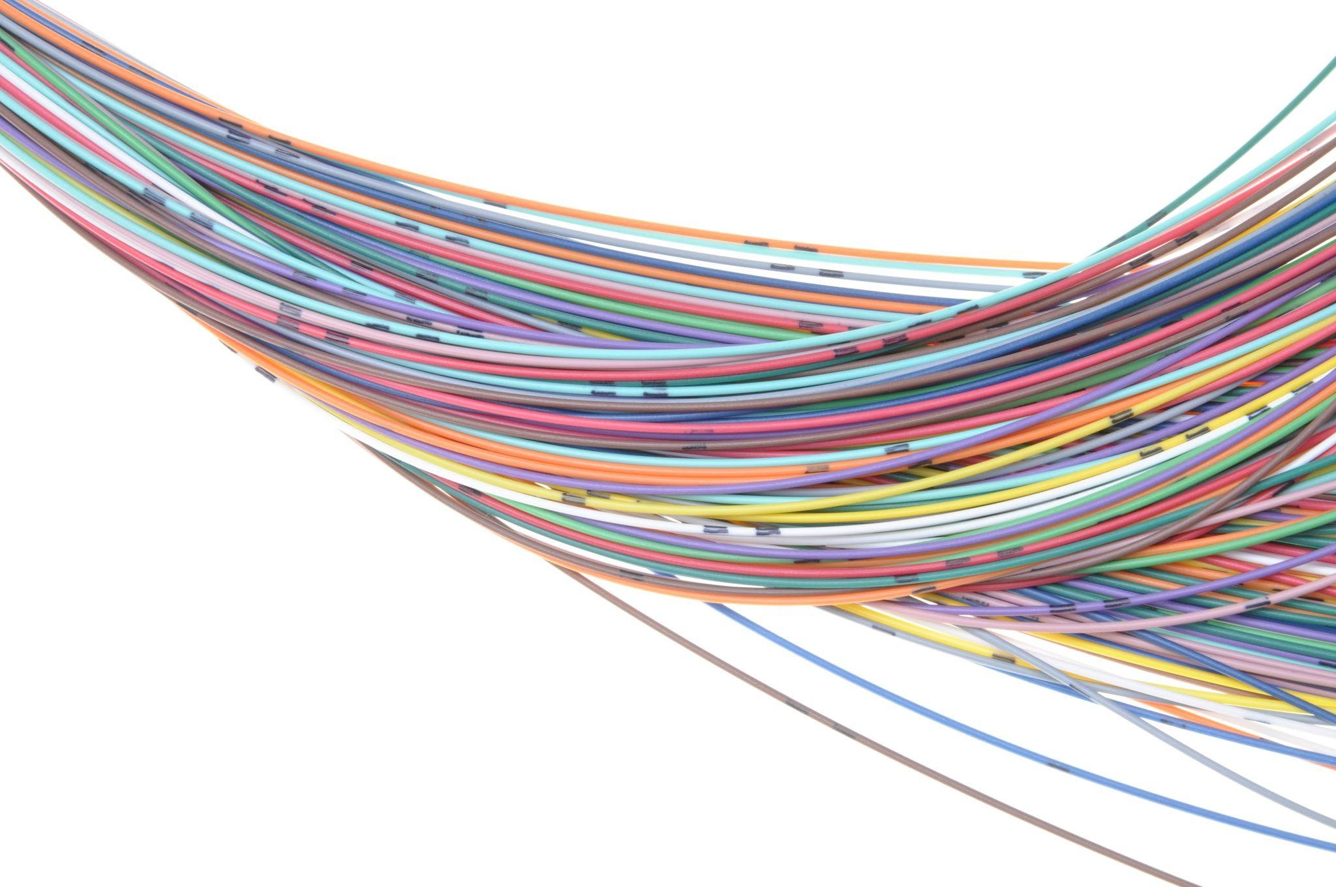
Challenges
DSRC and C-V2X policy uncertainties related to frequency spectrum allocations
Cost and health risk uncertainties of building new 5G networks and base stations
Opportunities
Evolution of 5G mobile networks
Integration of 5G networks and communication systems for use by first responders
Notes:
TELCO CHALLENGES
Uncertainties related to frequency spectrum allocations (battle between Dedicated Short-Range Communications and Cellular Vehicle-to-X).
The health risks of 5G technology are not well-studied. Because they are based on “beam-forming” and are, by definition, “short-range,” they are physically much closer to people than prior generations of telecommunications, and more base station units and installations are required than for prior generations.
TELCO OPPORTUNITIES
The sheer momentum of 5G mobile network expansion is indisputable.
First responders will be the first to rely on 5G for emergency communications, and their 5G capabilities will evolve quickly to enhance their intelligent transportation operations.

Slide 16
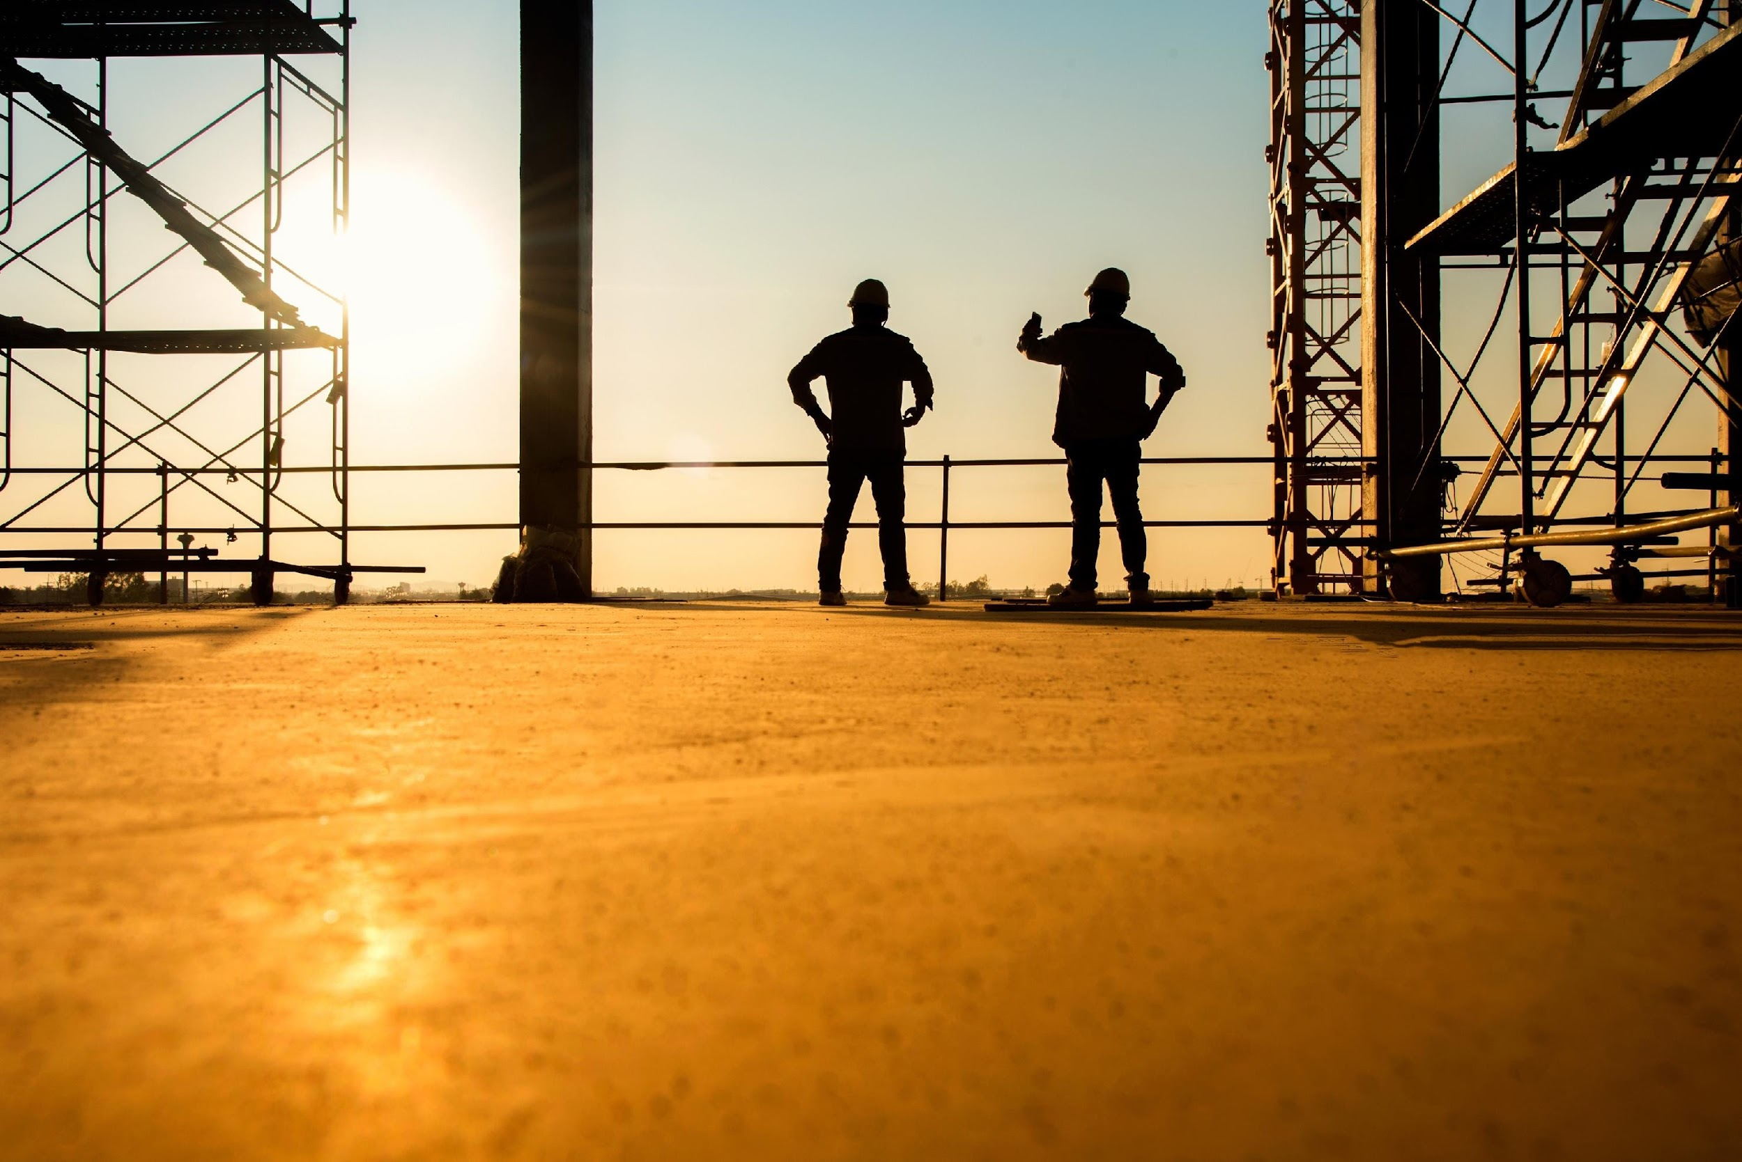
General Challenges and Opportunities
Challenges
Despite rapid developments in 4IR, successful adoption in ITS use cases depends on multiple, collaborative interactions among multiple disciplines and entities
Many obstacles to standardizing data and application programming interfaces
Interoperability / integration with existing (legacy) communication systems
Deteriorating infrastructure and lack of stable sources of funding
National security threats from collection of data by ITS devices
Opportunities
Multidisciplinary understanding
Strengthen the weak links
New legislation for infrastructure projects
Follow the money
Help make the use of available funding count
Notes:
“Challenges and Opportunities” = “Yin and Yang” = “two sides of the same coin”
-Interoperability, integration, standards, investments in infrastructure, protecting against national security threats are key to successful ITS deployments
“Follow the money”
Important for transportation professionals to help make the use of that money count
Many 4IR companies and investors are technology-oriented and not domain experts in ITS; the new techs attract large investments, so it’s important for transportation professionals to get a seat at that table and add your experience and voice to the conversation.

Slide 17
Summary
ITS professionals must:
Stay up-to-date with progress in 4IR technologies
Be willing to engage in public-private partnerships to help leverage the private sector’s 4IR technology investments and society’s best interests in applying those investments in ITS
Ramp up efforts to protect against privacy and cybersecurity risks (domestic and foreign)
Monitor and plan for post-COVID-19 pandemic shifts in urban density and traffic patterns
Invest in capacity building (training and education) in both the domain elements of transportation (Travelers, Vehicles, and Infrastructure) and the 4IR technologies that directly affect how they operate together (Data, Computing, and Telecommunications) in order to truly achieve “intelligent” transportation systems.
Notes:
ITS professionals must:
Stay up-to-date with progress in 4IR technologies
Be willing to engage in public-private partnerships to help leverage the private sector’s 4IR technology investments and society’s best interests in applying those investments in ITS
Ramp up efforts to protect against privacy and cybersecurity risks (domestic and foreign)
Monitor and plan for post-COVID-19 pandemic shifts in urban density and traffic patterns
Invest in capacity building (training and education) in both the domain elements of transportation (Travelers, Vehicles, and Infrastructure) and the 4IR technologies that directly affect how they operate together (Data, Computing, and Telecommunications) in order to truly achieve “intelligent” transportation systems.

Slide 18
Key References
Module 16 contains more than 75 references, mostly related to standards and how they can help to integrate “Travelers, Vehicles and Infrastructure” with” 4th Industrial Revolution Technologies.”
Of particular note:
The Manual on Uniform Traffic Control Devices for Streets and Highways (MUTCD)(2021)
National Transportation Communications for Intelligent Transportation System (ITS) Protocol (NTCIP)
ISO 14817-2:2015 ITS central data dictionaries
5G Automotive Association (5GAA)
“Adoption of Transit Communications Interface Profiles in the Transit Industry,” Intelligent Transportation Society of America (2016)
Notes:
Module 16 contains more than 75 references, mostly related to standards and how they can help to integrate “Travelers, Vehicles and Infrastructure” with” 4th Industrial Revolution Technologies.”
Of particular note:
The Manual on Uniform Traffic Control Devices for Streets and Highways (MUTCD)(2021)
National Transportation Communications for Intelligent Transportation System (ITS) Protocol (NTCIP)
ISO 14817-2:2015 ITS central data dictionaries
5G Automotive Association (5GAA)
“Adoption of Transit Communications Interface Profiles in the Transit Industry,” Intelligent Transportation Society of America (2016)

Slide 19
Questions?
Eva Lerner-Lam
elernerlam@palisadesgroup.com

