Slide 1

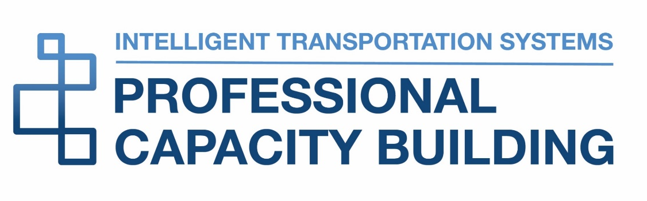

ITS ePrimer
Module 5: ITS to Support Travelers
ITS Professional Capacity Building Program
ITS Joint Program Office
U.S. Department of Transportation
Notes:
This module is sponsored by the U.S. Department of Transportation’s ITS Professional Capacity Building (PCB) Program. The ITS PCB Program is in the ITS Joint Program Office (ITS JPO), within the Office of the Assistant Secretary for Research and Technology (OST-R).
Thank you for participating and we hope you find this module helpful.

Slide 2

Instructor
Alex Skabardonis
Professor
University of California, Berkeley
Berkeley, CA,
USA

Slide 3
Learning Objectives
Learn the capabilities, features, and limitations, of ITS technologies for multimodal transportation
Understand deployment opportunities and constraints for ITS technologies for all travelers
Understand emerging and future trends in ITS technologies for all travelers
Notes:
ITS technologies offer an array of applications and enhancements for multimodal transportation; from real time information to safety applications and driver conveniences. This updated module explores current and emerging applications that enhance traveler experience and safety.

Slide 4
Outline
Traveler Information
Parking Information
Mobility on Demand
Mobility as a Service (MaaS)
Driver Assistance Systems
Traveler Comfort and Convenience
Personal Rapid Transit
Urban Aerial Mobility
Connected and Automated Vehicles
Notes:
ITS systems and impacts:
Real-time travel information on mode, routing, arrival time, parking
Aggregation and integration of public and private modes and services
Drivers assistance systems to improve safety, comfort and convenience
Emerging transport modes: personal rapid transit and aerial vehicles
Emerging technologies: connectivity and automation

Slide 5
Real Time Travel Information
Information types and impacts
Pre-Trip
Trip departure time
Mode of travel
Route choice
En-Route
Change route
Change mode (if alternate mode with parking available)
Expected arrival times
Notes:
Travel information can be pre-trip and/or en-route
Here shown the key impacts under each category
Note that options depend on the availability of alternate modes and routes

Slide 6
Real Time Travel Information
Dissemination (1)
World Wide Web
  Every state DOT offers traveler information website
  Pre-trip information
  Wide geographic area coverage
  Images from CCTV cameras on real-time conditions
511 Phone System
  Over 46 511 systems (include websites)
  Highest usage under major events
    Extreme weather
    Major road closures
Notes:
The Internet World Wide Web is the predominant form of traveler information
511 systems provide free phone service
511 include websites that can be customized for individual trips (Bay Area 511)
6

Slide 7
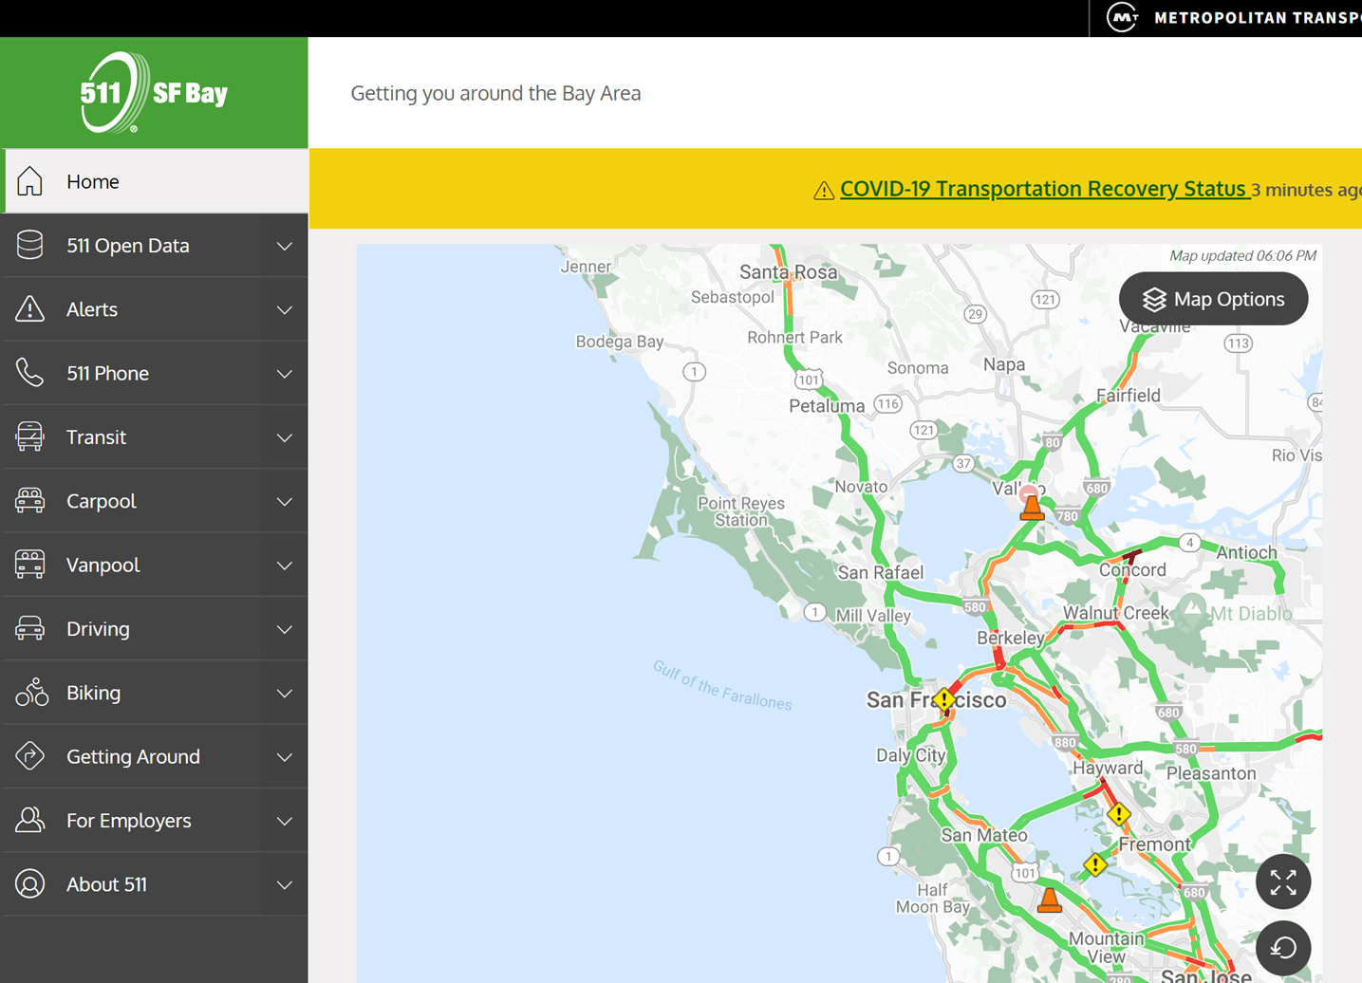
Real Time Travel Information
Dissemination (2)
San Francisco Bay Area 511
http://www.511.org
Notes:
San Francisco Bay Area 511 Website screen shot
Color coded speed maps
Includes Transit Information
7

Slide 8
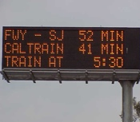
Real Time Travel Information
Dissemination (3)
Variable Message Signs (VMS)
  Expected travel times to destinations
  Alerts on incidents, inclement weather, other events
  Location important (prior to decision point)
  Emergency Messages
    AMBER alert
    LEO alert
    SILVER alert
VMS Implementation in Michigan DOT
https://www.youtube.com/watch?v=tUNgPSx0rxk
Notes:
VMS signs are implemented on most urban freeways
Typically located prior to major interchanges (for choosing alternate routes)
Compliance to messages depends on information accuracy from past experience
Shown a VMS in the San Francisco Bay Area
Link to video on VMS usage (West Michigan TMC)
8

Slide 9
Real Time Travel Information
Dissemination (4)
Mobile applications and social networking
Handheld devices
In-vehicle navigation systems
Email/text
TV/Radio
Highway Advisory Radio (HAR)
Notes:
Predominant use of mobile apps and social networking signs
Screen shots of two apps
TV/radio and HAR mostly utilized in disadvantaged areas

Slide 10
Real Time Travel Information
Benefits
Improve Traveler Decision Making
Make accurate and timely decisions
  Routing
  Time of departure
  Mode
  Not make the trip
Sense of ‘self control’ to traveler
Reduce Frustration and Irrational Behavior
Improve perceived level of service
Notes:
Benefits to individual drivers
Depend on the availability of routes, modes for the particular trip
Depend on the flexibility of departure time
Drivers value more travel time reliability information, especially under incident conditions
10

Slide 11
Real Time Travel Information
Benefits
Spread or Reduce Peak Traffic Demand
Over space: alternative routes
Over time
Alternative modes
Eliminating discretionary trips
Field Evaluation Results
Traveler information users perceive time savings
In-vehicle travel time savings are small
Notes:
Transportation system benefits due to traveler information
Note that the best route for the traveler may not be the best for the system
Highest benefits under non-recurrent congestion
All field tests show that travelers perceive time savings from traveler information systems
Independent measurements of travel times show small savings
11

Slide 12
Real Time Travel Information
Data Sources (1)
Fixed sensors approximately 0.5 mile apart in each travel lane (e.g., loops, radar, video)
Event information from incident management teams, police patrols
CCTV
Probe vehicles
  ETC transponders
  Cell phones
  Bluetooth readers
Notes:
Data from fixed sensors are typically collected every 20-30 sec and aggregated every 5 minutes
Sensor failures create data errors and gaps
Information from mobile sources can fill gaps and provide information for highway links without fixed sensors through data processing and fusion
CCTV cameras are the primary source for incident verification
12

Slide 13
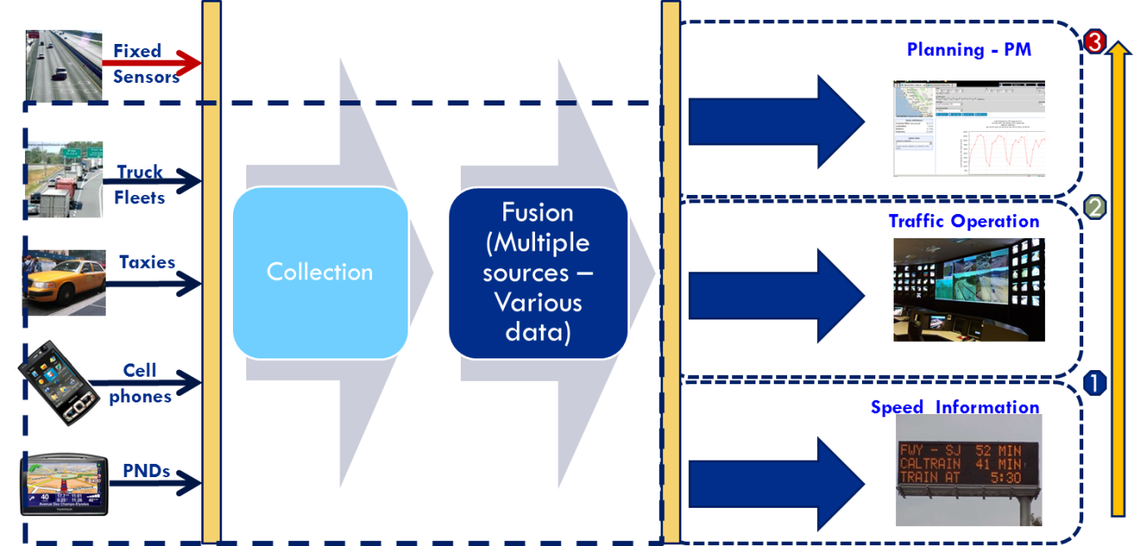
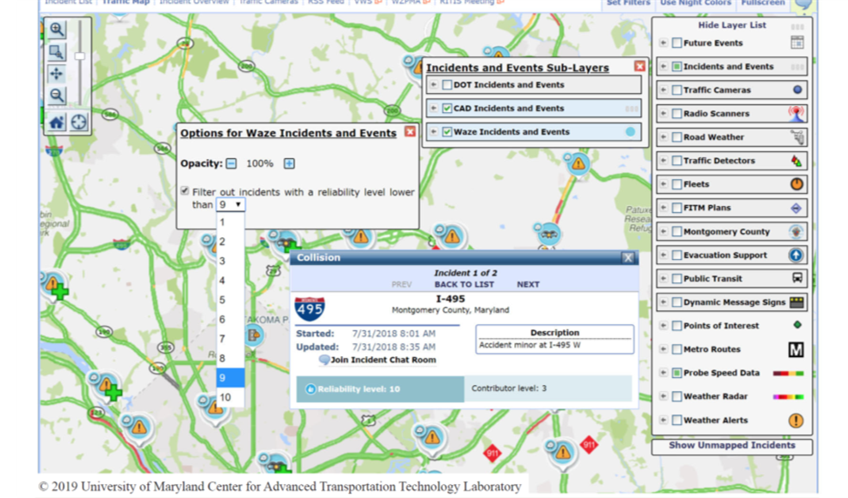
Real Time Travel Information
Data Sources (2)
Data Fusion from Multiple Sources improves coverage and accuracy
Crowdsourced data integrated with TMC data
Notes:
Illustration of data collection from multiple sources, data processing, and fusion and possible data uses including transportation planning (trends in volumes), traffic operations (control, incident management) and traveler information
Crowdsourced data can be integrated with TMC detector data to improve the accuracy of the incident detection algorithms (RITIS system and Waze Data Integration)
13

Slide 14
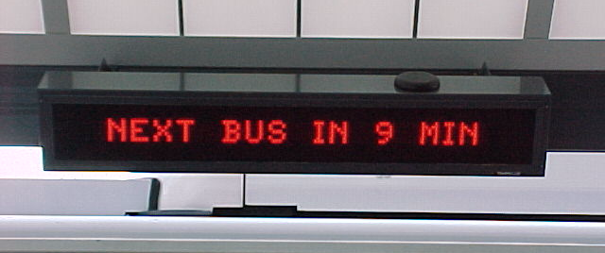
Real Time Travel Information
Transit
Dissemination
Web
Mobile Applications
Station/Transit Stop Displays
In-Vehicle Displays
Content
Maps/schedules
Expected arrivals real-time
Transit vehicle tracking (AVL)
On-line Trip Planner
Notes:
Most transit systems provide websites with maps, schedules and expected arrival times
Websites linked or part of the 511 websites
Station information of arrival times through audio/displays
Data
The Google Transit and the General Transit Feed Specification (GTFS)
Open source platform: Open Trip Planner
14

Slide 15
Mobility on Demand (MOD)
MOD vision for safe, reliable travel for all users
MOD enables consumers to access mobility, goods, and services on demand by using shared mobility, delivery services, and public transportation solutions through an integrated and connected multimodal network
Notes:
MOD is a multimodal program to study emerging mobility services, public transportation networks and operations, and goods delivery services.
MOD is based on the principle that transportation is a commodity where modes have economic values that are distinguishable in terms of cost, journey time, wait time, number of connections, convenience, and other attributes.
FHWA, “Mobility on Demand: Operational Concept Report,” Report FHWA-JPO-18-611, Washington DC, September 2017.
15

Slide 16
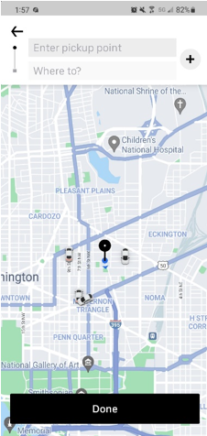
Mobility as a Service (MaaS)
Mobility aggregation and submission services
Access to several transportation modes
Transportation Network Companies (TNC)
Offer on-demand rides by private vehicles
Short trips in dense areas during off-peak periods
Alternative Transit Services
Paratransit, microtransit on demand transit
Partnerships with TNC
First & last mile, on call-and ride
Notes:
Screenshots of smart phone applications for companies offering on demand rides
Efforts underway to develop GTFS-Flex as a data standard for on-demand services that may be operated by a transit agency or TNC.
16

Slide 17
Mobility as a Service (MaaS)
Carsharing
Car availability without car ownership
Designed for occasional car users
Provided by private companies through membership
Benefits
  Reduction in auto ownership, VMT
  Reduction in fuel consumption/emissions
Bikesharing
Bikesharing systems integrated into existing transportation systems
Bicycle stations often at transit hubs
Complete street designs improve bicycle travel and safety
Notes:
There are 1.5 million vehicles and more than 15,000 available in the United States. (2018)
Web-based or smart phone applications permit the reservation of vehicles at selected locations, choice of vehicles (gasoline or electric), parking at destination, payment, and other transactions.
The availability of one-way trips provides a first-mile and last-mile access to transit stops
There are more than 30 million bikesharing users in the United States. Bikesharing systems increased mobility, increased flexibility, low implementation and operational costs, increased health benefits, and greater environmental awareness.
17

Slide 18
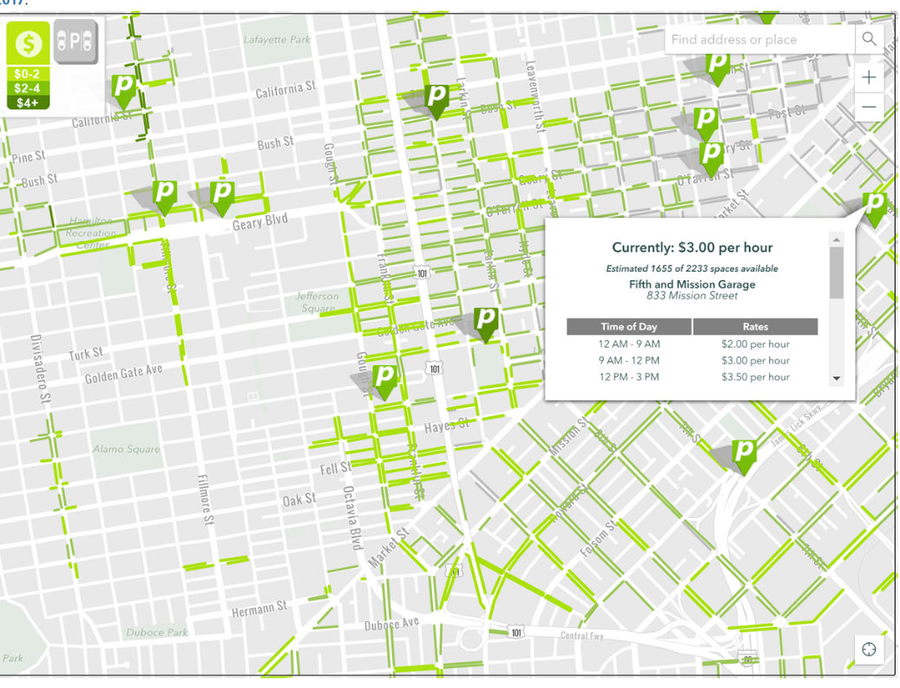
Parking Information
Public Agencies/Operators
Maps with Parking Facilities
Information on the Web: location, space availability
Private Service Providers
Web / Mobile Applications
Real-time Parking Availability
Online Reservation/Payment
Advanced Systems (SF, DC)
Real-time data on parking occupancy
Parking pricing set to maximize utilization
Information on Web and smartphones
San Francisco parking
Notes:
Deployment of wireless sensing enables accurate information on parking availability
Parking pricing schemes try to maximize utilization and minimize block circling
Typical max occupancy 85 percent

Slide 19
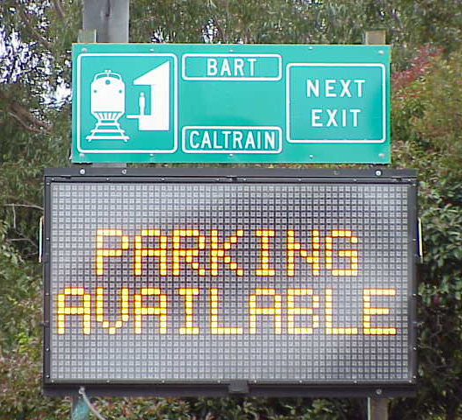
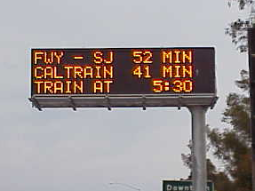
Parking Information
Multimodal Information
Driving Times
Parking Availability at Transit Stations
Transit Information
  Departure/Arrival Times
Influences Mode Choice
  Travel Time Savings
  Perceived Congestion
Notes:
Field tests show that drivers can park and ride transit if the expected travel time is shorter than drive time
8 percent of drivers switched modes when the time savings were greater than 20 minutes
Source:
Mortazavi, A. et. al, “Evaluation of Displaying Transit Information on Changeable Message Signs,” Research Report UCB-ITS-CWP-2009-2, University of California Berkeley, September 2009.
19

Slide 20
Driver Assistance Systems
Intersection Collision Warning Systems (CWS)
Pedestrian Automatic Emergency Breaking Systems
Lane Departure Warning System
In Vehicle Vision Enhancements
Blind-Spot Detection Information Systems (BLIS)
Wrong Way Driving Warning
Forward Collision Warning (FCM) Systems
Rollover Warning Systems
Driver Impairment Monitoring
Adaptive Cruise Control (ACC)
  Adjust speed to maintain preset headway (minimum 1 min)
Advanced Driver Assistance System
https://www.youtube.com/watch?v=5vuKvW_5QVM
Notes:
These systems designed for improving safety
Developed mostly by auto manufacturers
Some systems for busses and commercial vehicles developed under the USDOT Integrated Vehicle-Based safety System (IVBSS)

Slide 21
Traveler Comfort and Convenience
In-Vehicle Navigation and Route Guidance Systems
GPS based
Turn-by-turn directions
May include real time traffic information
Additional Information (Parking, Yellow Pages)
Autonomous or through Subscription
Transit Fare Payment Systems
Smart Cards for multiple transit lines/agencies
Mobile Phones
Mobility Payment Integration (MPI): Shared payment media transit + mobility providers (TNCs, bikeshare, microtransit)
Notes:
Systems designed to ease the travel experience
Most of the basic functions of in-vehicle systems are available on smartphones
Transit payment systems for multiple agencies with complicated fare structures take considerable time to implement due to technical and institutional constraints
As of 2018, 34 locations around the country had deployed automated fare collection (AFC) in their transit systems. Eighteen of these systems are implementing mobility payment integration (MPI) systems to incorporate shared payment media across transit agencies and mobility providers (bikeshare, TNCs, and microtransit).
USDOT Volpe National Transportation Systems Center, “Mobility Payment Integration: State of the Practice Scan,” FTA Report No 0143, October 2019.
21

Slide 22
Traveler Comfort and Convenience
Electronic Toll Collection (ETC)
Toll paid though transponders without stopping
ETC increases toll lane capacity four times
ETC transponders may operate across States/facilities
ETC mandatory for congestion pricing implementation
Open Road Tolling (ORT): toll collection at highway speeds
  Higher capacity
  Improved safety
  Reduced fuel and emissions
Notes:
Drivers without transponders are billed based on license-plate recognition technology
Open road tolling (ORT) does not utilize toll booths
ORT reduce accidents by 24-60 percent based on field studies
Increasingly tolled facilities are converted to only ETC/ORT
22

Slide 23
Personal Rapid Transit (PRT)
Alternative to Conventional Transit in Low-Density Areas
Small driverless vehicles (up to 15 passengers)
Dedicated tracks/offline stations
High capacity (2-second headways)
Point-to-Point service/passenger comfort
Feasibility Studies
“Last Mile” solution for transit systems
Major employment centers/business parks
San Jose International Airport-ground access
Notes:
Concept originated in late 1950s with numerous designs in late 1960s and early 1970s
Morgantown at West Virginia University system has been implemented and is in continuous operation since 1975 with 99 percent reliability
Capacity (min headway) is constrained by requirement to avoid collision under all cases (brick-wall)
Typical speeds of 30 mph (reported speeds up to 150 mph)
Recent implementations of PRT
-Short distances, small (personalized) vehicles
-Average waiting time 10 sec (ULTRA system)

Slide 24
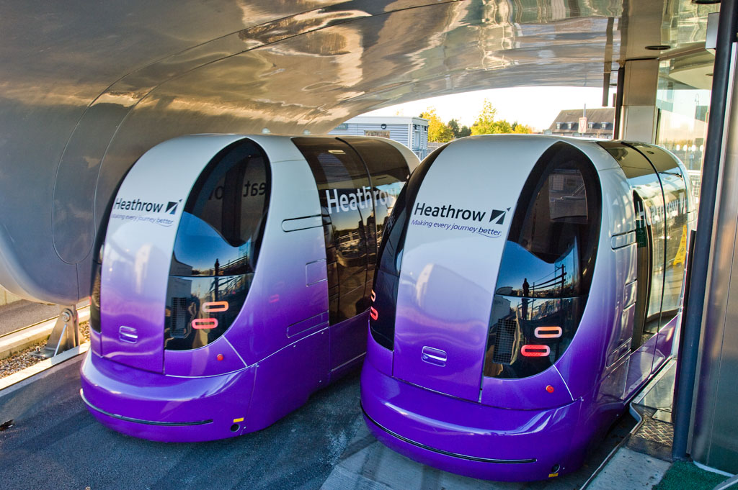
Personal Rapid Transit (PRT)
Recent Implementations
ULTRA Heathrow Airport (2.4 miles, 21 vehicles)
2getthere Abu Dhabi (1.1 mile, 13 vehicles)
ULTRA PRT system
http://www.ultraglobalprt.com/
Notes:
Sources:
Overview of PRT systems and links to PRT websites. Maintained by J. B. Schneider.
http://faculty.washington.edu/jbs/itrans/prtquick.htm.
Cottrell W.D. and O. Mikosza, “New-Generation Personal Rapid Transit Technologies: Overview and Comparison,” Transportation Research Record, Journal of the Transportation Research Board, No. 2042, Washington DC, 2008, pp. 101–108.
24

Slide 25
Urban Aerial Mobility
Unmanned Aerial Vehicles (UAV)
Commercial Applications
Package Delivery
Mapping and Surveying
Infrastructure Inspections
Surveillance
Passenger Transport
VTOL airplanes
“Flying Taxis”
Notes:
The commercial UAV U.S. market expected to grow to about $13.6B by 2025.
Safe and cost-efficient passenger carrying UAVs for the public appear to be into the future subject to market, land use, and regulations.
Potential scenarios:
Short-term passenger transport VTOL (vertical take-off and landing) aircraft service along specific “air routes”
Longer term VSTOL aircraft serving hub operations
Air Taxi service further into the future
Cohen A.P., S. Shaheen, E.M. Farrar, “Urban Air Mobility: History, Ecosystem, Market Potential and Challenges,” IEEE Transactions on Intelligent Transportation Systems, Volume 22 (9), September 2021

Slide 26
Vehicles, Internet, Phone and the Future
Cooperative Vehicle-Infrastructure Systems
Vehicle-to vehicle (V2V)
Communications
  DSRC
  Mobile devices
Cooperative Adaptive Cruise Control (CACC)
  Shorter gaps
Active Safety Systems
  Reduce crashes by 80 percent
  Driver Alerts (Queue Warning)
Notes:
Communications media
Dedicated Short range Communications (DSRC) and cellular networks depending on the applications
Minimal exchange of information: location, heading, speed
CACC: Field tests shown that drivers comfortable in accepting shorter gaps from 1.5 sec under ACC to 0.7 sec under CACC
Shorter gaps increase freeway capacity, from 2,000 veh/hr/lane to 3600 veh/hr/lane subject to vehicle penetration
Nowakowski, C., et al. Cooperative Adaptive Cruise Control: Testing Drivers’ Choices of Following Distances. California PATH Research Report for FHWA Exploratory Advanced Research Program Cooperative Agreement DTFH61-07-H-00038. January 2011.
https://merritt.cdlib.org/d/ark%3A%2F13030%2Fm5h70d3r/2/producer%2F775593226.pdf
26

Slide 27
Vehicles, Internet, Phone, and the Future
Connected Vehicles (V2V)--Queue Warning
Notes:
Illustration of Queue Warning under Connected Vehicles V2V Communications
Source:
Nowakowski, C., et al., “SafeTrip 21 Initiative: Networked Traveler Foresighted Driving Field Experiment Final Report,” Research Report UCB-ITS-PRR-2011-05, University of California Berkeley, June 2011
27

Slide 28
Vehicles, Internet, Phone and the Future
Cooperative Vehicle-Infrastructure Systems
Vehicle-to Infrastructure (V2I)
SPaT Message
Applications
  Safety
  Mobility
Improved traffic signal control
Dynamic route advisory
Environment
Speed advisory for minimum fuel/emissions
Notes:
V2I: Ability to wirelessly exchange information about vehicles (position, speed) and infrastructure
Example: Status of the traffic light: Signal phase and timing (SPaT)
Applications:
Yellow extension to avoid red light running
Adaptive control of signal settings (green times and offsets) to minimize delay based on real-time demands and O-D patterns
Given signal status and road characteristics calculate vehicle speed to minimize fuel consumption and emissions
28

Slide 29
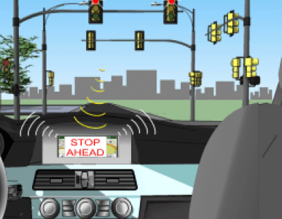
Vehicles, Internet, Phone, and the Future
Vehicle-to Infrastructure (V2I)
Dynamic Speed Advisory (Source: BMW)
SPaT message transmitted to the vehicle
Signal status and recommended speed on driver speedometer
Notes:
Sources:
ITS JPO Connected vehicle initiative: www.its.dot.gov/connected_vehicle/connected_vehicle.htm
BMW of North America, “Advanced Traffic Signal Control,” Final Report, prepared for the FHWA Exploratory Advanced Research Project, July 2012.
29

Slide 30
Automated Vehicles (AV)
Levels of Automation
More than 30 private companies developing AV technology
Emphasis on Level 4
Waymo is the only automated private vehicle in operation
Nuro is an AV mini car for package deliveries in neighborhoods
Notes:
SAE Levels of automation
0: no automation 5: all tasks automated
USDOT, NHTSA, “Automated Driving Systems 2.0: A Vision for Safety,” DOT HS 812 442 , September 2017
https://www.nhtsa.gov/sites/nhtsa.gov/files/documents/13069a-ads2.0_090617_v9a_tag.pdf
Information on Waymo autonomous vehicles:
https://waymo.com/
Information on NURO autonomous vehicles:
https://www.nuro.ai/
30

Slide 31
Summary
Traveler Information
Predominant use of mobile devices for data sources and information dissemination
Multimodal applications
Mobility on Demand (MOD)
Safe, reliable travel for all users
Connected multimodal network
Mobility as a Service (MaaS)
Emerging Applications
Driver safety and convenience systems
Connected Vehicles Technologies (V2V, V2I)
Automated Vehicles
Notes:
Real-time travel information assist travelers prior to their trip or while end route. Mobile devices are predominantly used for data sources and information dissemination
Mobility on Demand (MOD) is a framework to enable consumers to access mobility, goods, and services on demand by using public transportation facilities, shared mobility, delivery services through an integrated and connected multi-modal network.
Emerging vehicle technologies focus on cooperative vehicle infrastructure systems, vehicle-to-vehicle (V2V) and vehicle to infrastructure (V2I) communications, and automated vehicles (AV).

