Slide 1

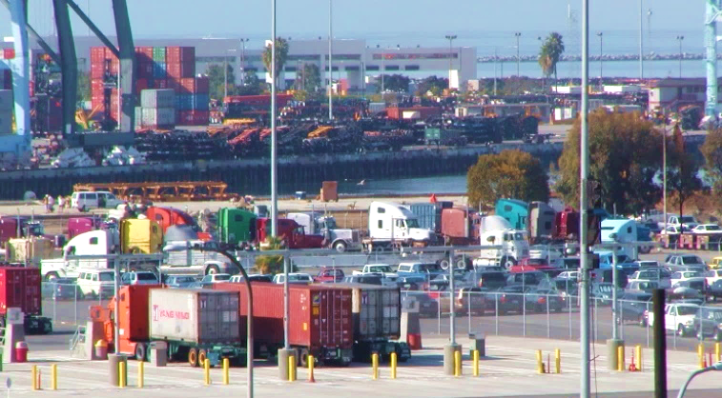
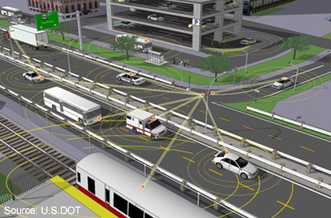
Intelligent Transportation Systems Applications for Ports
May 2, 2019

Slide 2
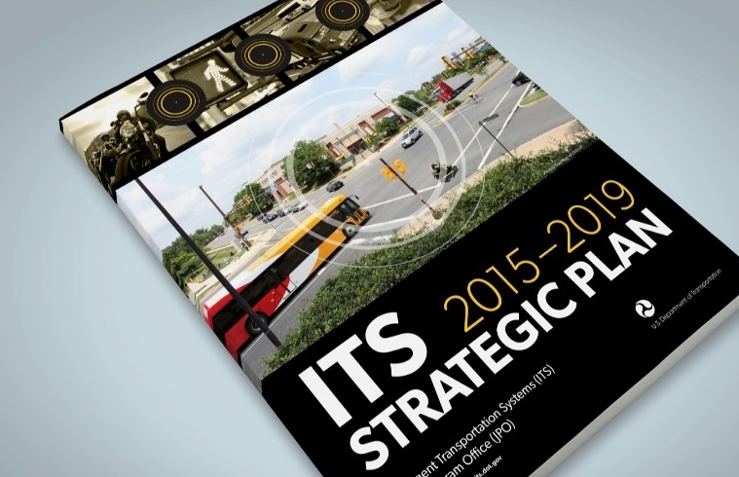
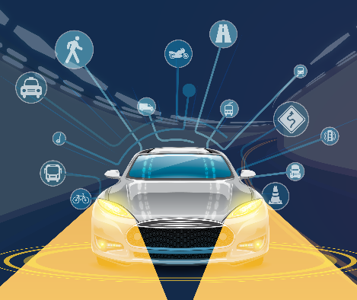
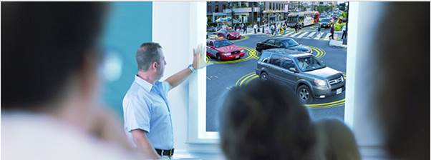
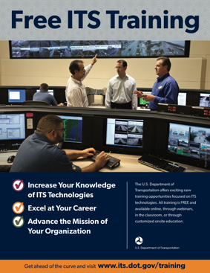
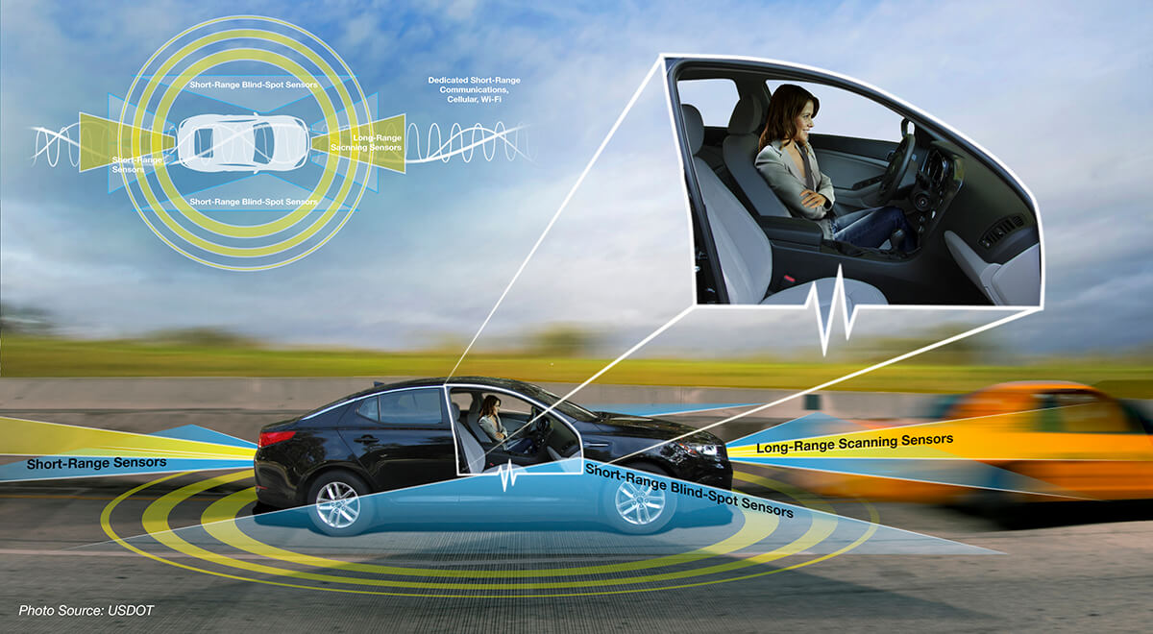
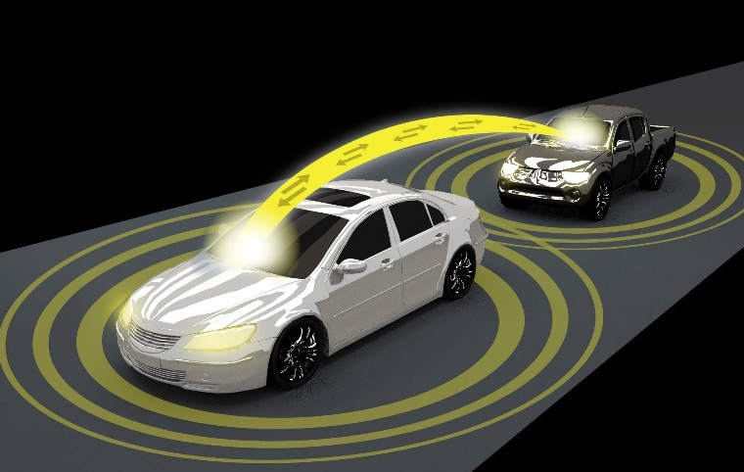
ITS Professional Capacity
Building Program
Michelle Noch
ITS Joint Program Office
U.S. Department of Transportation

Slide 3
ITS PCB Program Background
Part of USDOT ITS Joint Program Office (JPO)
1996: Authorized by Congress
2010: Reauthorized by MAP-21
2016: Reaffirmed by FAST Act
The ITS PCB Program supports a variety of ITS learning opportunities to accelerate ITS deployments and encourage more efficient operations

Slide 4
Program Strategy
Vision: Prepare a dynamically knowledgeable community of transportation industry professionals for a connected automated transportation system
Mission: Provide a multimodal and multi-disciplinary capacity building program for all levels of current and future transportation professionals to accelerate preparation for and the deployment of innovative ITS

Slide 5
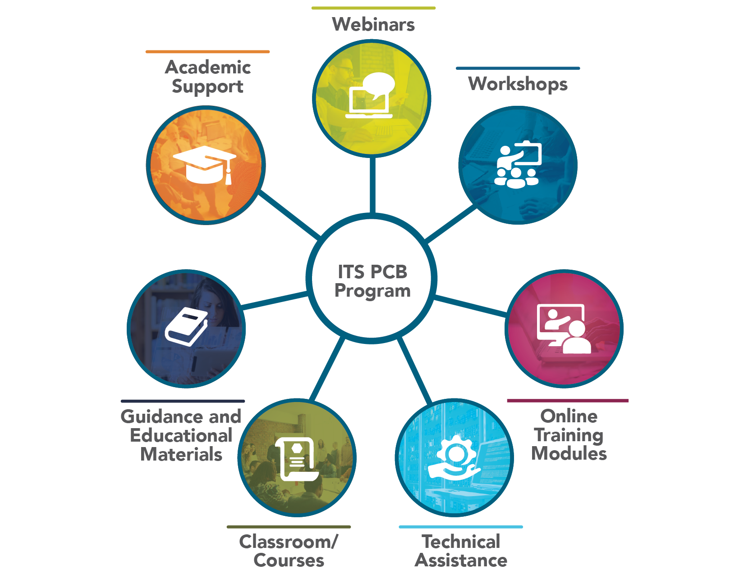

ITS PCB Program – Portfolio of Products
ITS PCB Program

Slide 6

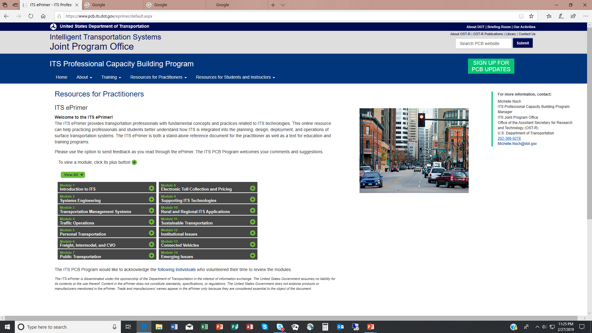
ITS ePrimer
ITS PCB Program –
Resources for Practitioners Tab

Slide 7
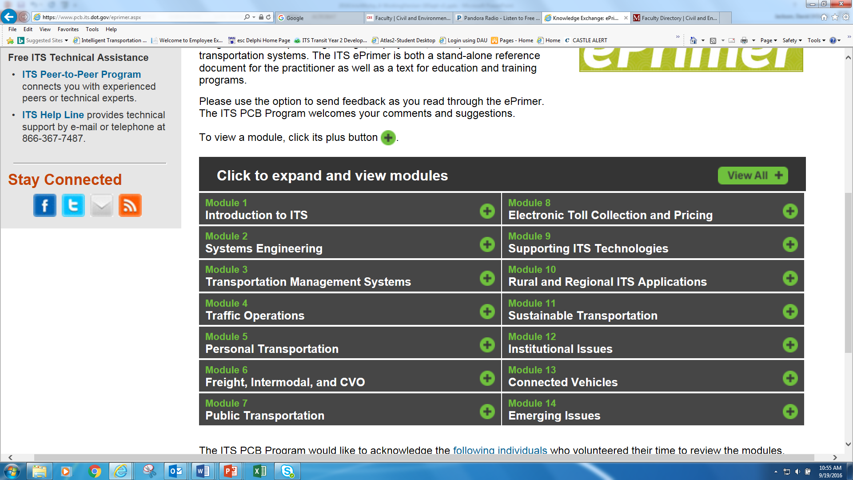
ITS ePrimer
Updated 2016
Updated 2016
2019-20
2019-20
2019-20
2019-20
2019-20
2019-20
Updated 2016
2019-20
Updated 2016
Updated 2016
Updated 2016
Updated 2016
(https://www.pcb.its.dot.gov/eprimer/default.aspx)

Slide 8

U.S. Maritime Administration
MARAD seeks to increase cargo capacity and reliability of freight moving through ports
Challenges & Issues
  Marine terminal congestion is an ongoing challenge in the U.S.
  Economic growth driving cargo volume growth
  Exacerbated by larger container ships, infrastructure improvements – channel deepening, air draft clearance projects, Panama Canal expansion
  Complexity of multi-modal port operations
Maritime Administration Strategic Plan (2017-2021) … Strategic Goal #5: Maritime Innovation
ITS MARAD Truck Staging Study (joint project with ITS JPO, FHWA, and FMSCA) – Webinar available at https://ops.fhwa.dot.gov/freight/fpd/talking_freight/index.htm by June 2019

Slide 9

American Association of Port Authorities
The unified voice of the seaport industry in the Americas, representing more than 130 public port authorities in the U.S., Canada, the Caribbean and Latin America.
AAPA events, resources and partnerships
  connect, inform and unify seaport leaders and maritime professionals
  promotes the common interests of the port community
  provides advocacy and effective public outreach to influence seaports’ most urgent public policy issues
  Information Technology Committee
  The AAPA Information Technology Committee focuses on electronic data interchange, management information systems and other automation initiatives. The Committee is open to all members of the Association, including corporate (port) members and sustaining (port industry solution providers) members.
  Information Technology Awards Program
  The AAPA Information Technology Awards highlight port technology accomplishments in the areas of “Port Operations and Management Systems” and “Improvements in Intermodal Freight Transportation.” Participation is open to all corporate members of the association.

Slide 10
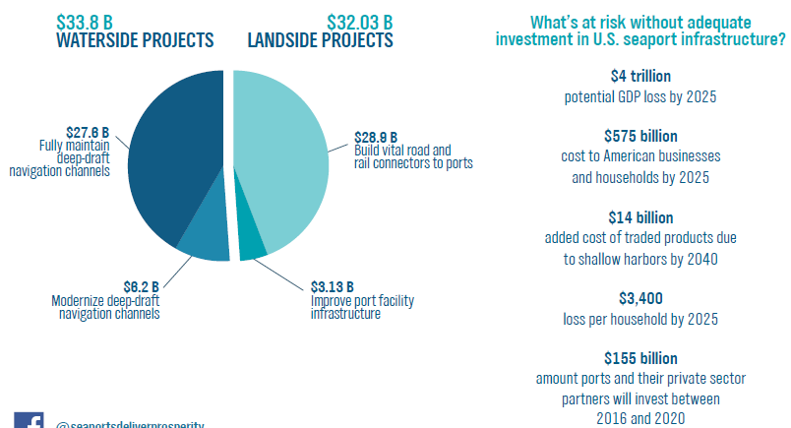
Needed Port Investments – ITS Opportunities
$66 Billion Investment Needed For Port Infrastructure –
44% Could Include ITS Solutions

Slide 11
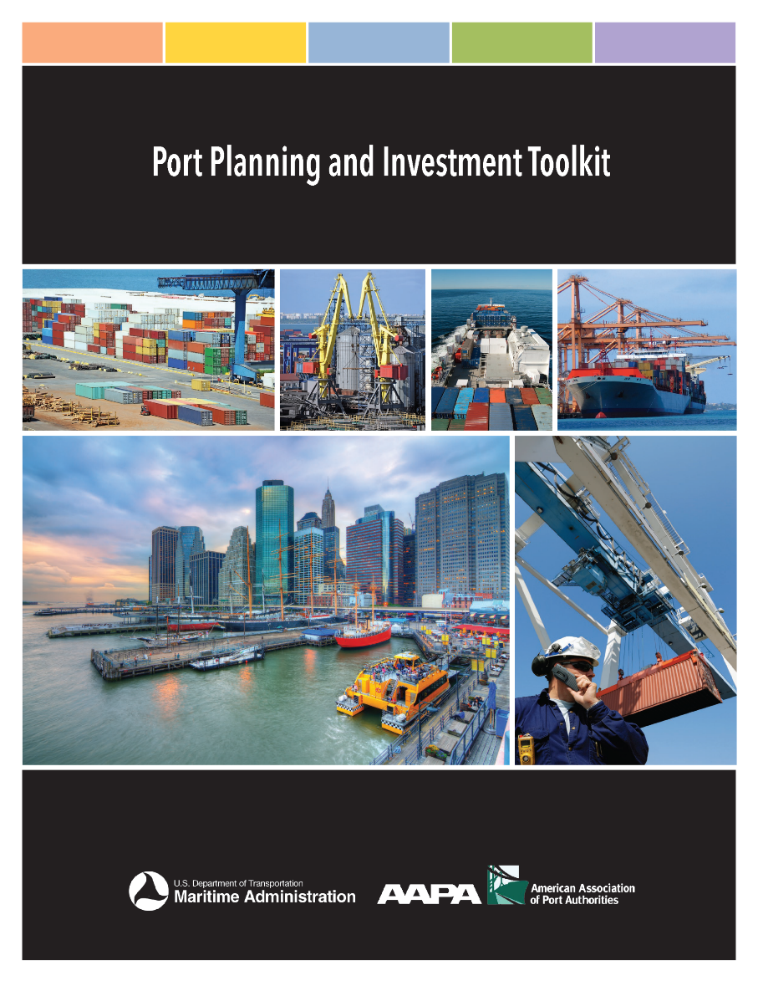
Port Planning & Investment Toolkit (PPIT)
Led by:
  AAPA
  MARAD
  64 Port Staff, PPM Candidates, Consultants
Goal is to assist Ports:
  Develop capital plans that clearly identify future needs;
  Determine the most cost-effective, sustainable and efficient solutions to port challenges;
  Position port projects for federal funding such as BUILD, INFRA and MPO grants;
  Get port infrastructure projects into MPO and state transportation programs to qualify for other government funding; and
  Obtain private sector funding to support their infrastructure projects.

Slide 12
PPIT and ePrimer Modules
PPIT information, updates, and resources are available at:
  AAPA website at http://www.aapa-ports.org/PPIT
  MARAD website at https://www.maritime.dot.gov/ports/port-planning-and-investment-toolkit
ITS Professional Capacity Building Program – ITS ePrimer Modules at https://www.pcb.its.dot.gov/eprimer/default.aspx
PPIT and ePrimer ITS for Port Operations Module available June 2019

Slide 13
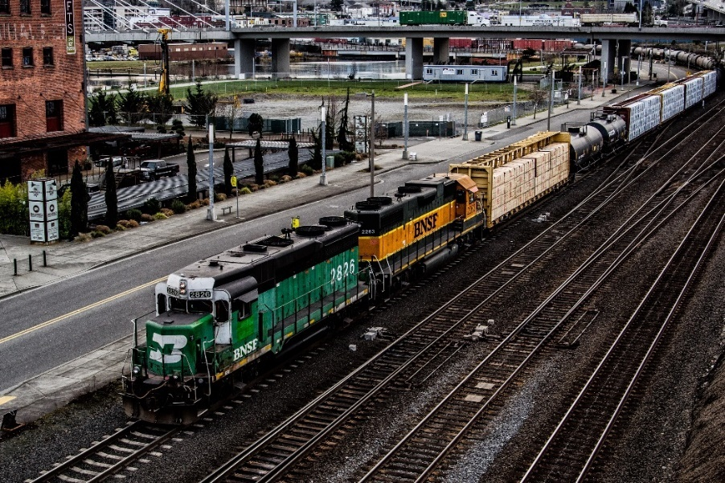

Intelligent Transportation Systems
An engineering discipline that encompasses the research, planning, design, integration, and deployment of systems and applications to:
  Manage traffic and transit,
  Improve safety,
  Provide environmental benefits, and
  Maximize the efficiency of surface transportation systems.

Slide 14

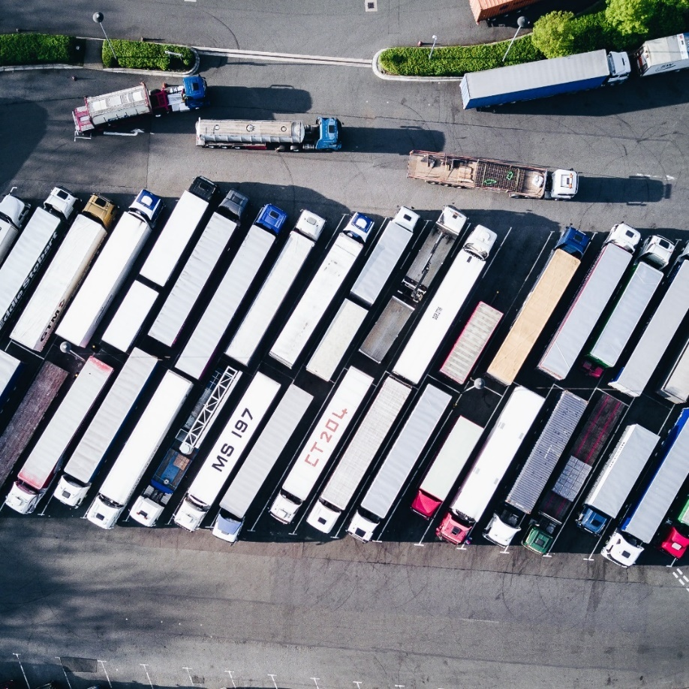
ITS in the Port Context
Traditional Focus:
Port + ITS Focus:
Moving vehicles, on an open public network without transactions under limited regulations for public stakeholders
Moving trucks and trains on a bounded network, accessing private spaces, for commercial transactions under tight regulations for private stakeholders

Slide 15
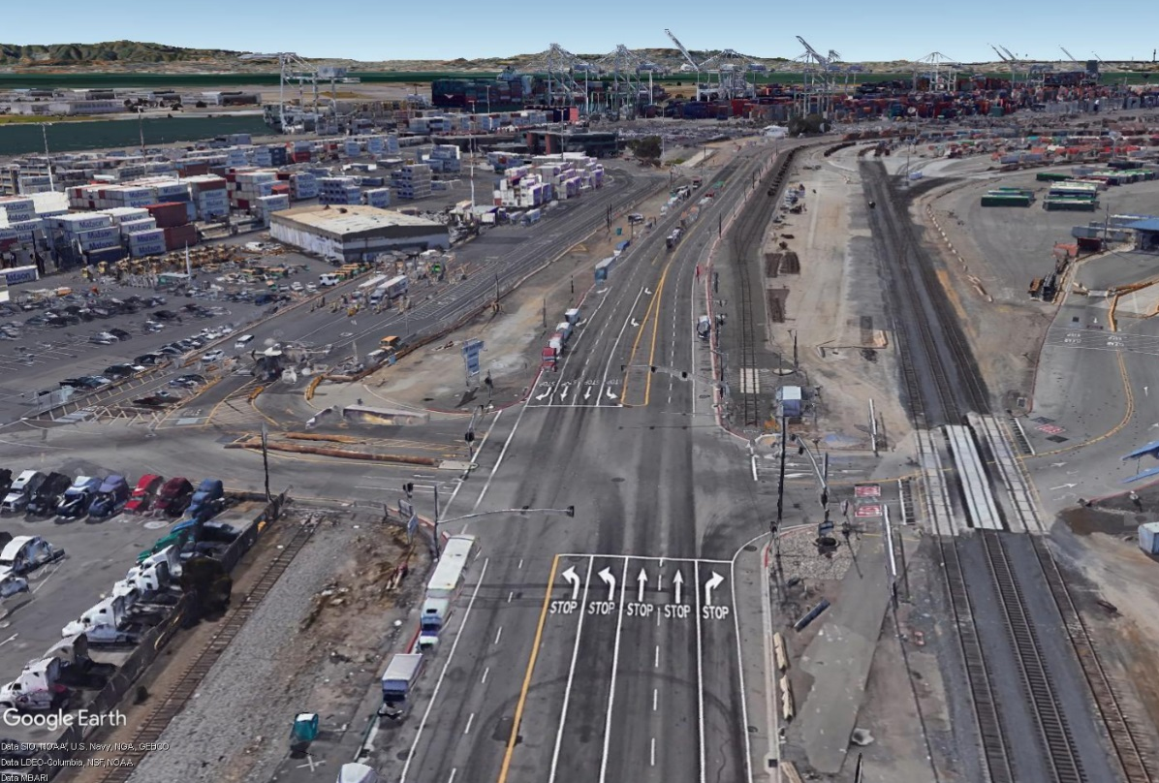
ITS in the Port Context
Local/regional – Applications of ITS for the surrounding road and rail network that indirectly impact port operations. This could include the provision of freight signal priority (FSP) on road and rail interchanges in proximity to a terminal.
Port specific – Applications of ITS for the port area transportation network, such as terminal roadways, gate access management, and reservation systems.
Combination – Applications of ITS that addresses port operations, the port area transportation network and the region. This could include a truck staging and parking application that provides staging information at the terminal, and detailed route information for efficient and timely access to the facility.

Slide 16
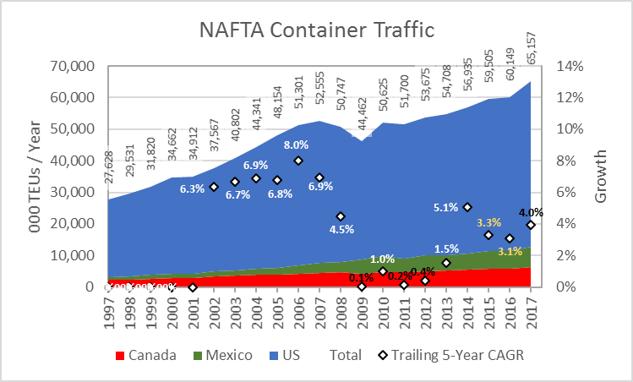
The Need for ITS in Ports
Demands and Constraints
Alternatives
52 M TEUs / year in 2017
114 M by 2040: +118%
Demand is spikier
Port road and rail systems are static
Build new ports
  Flat Land + Deep Water:
  Rare and Constrained
Build more roads in ports
  Cities have expanded toward
  their ports, hemming them in
Shift traffic off of roads
  Intermodal rail has similar issues
Build smarter roads
Use resources more efficiently

Slide 17
Potential Benefits for Ports
Service Element | Benefits
Safety and Reliability | Avoid port-area collisions, goods movement accident losses, hazardous material releases.
Resilience | Mitigate the impact of disruptive events.
Cargo Visibility, Reliability | Improve the reliability and timeliness of cargo transport. Improve the responsiveness of service providers.
Vehicle Efficiency and Mobility | Reduce travel time, queuing and idling. Maintain network fluidity. Improve transport workforce efficiency.
Gate Efficiency | Reduce queuing. Improve accuracy, avoid transaction failure. Improve gate transaction speed, extend hours, and optimize labor.
Terminal Yard Efficiency | Improve density and velocity. Improve cargo handling equipment deployment. Reduce cargo rehandling.
Port Efficiency | Balance load between terminals. Respond to congestion events.

Slide 18
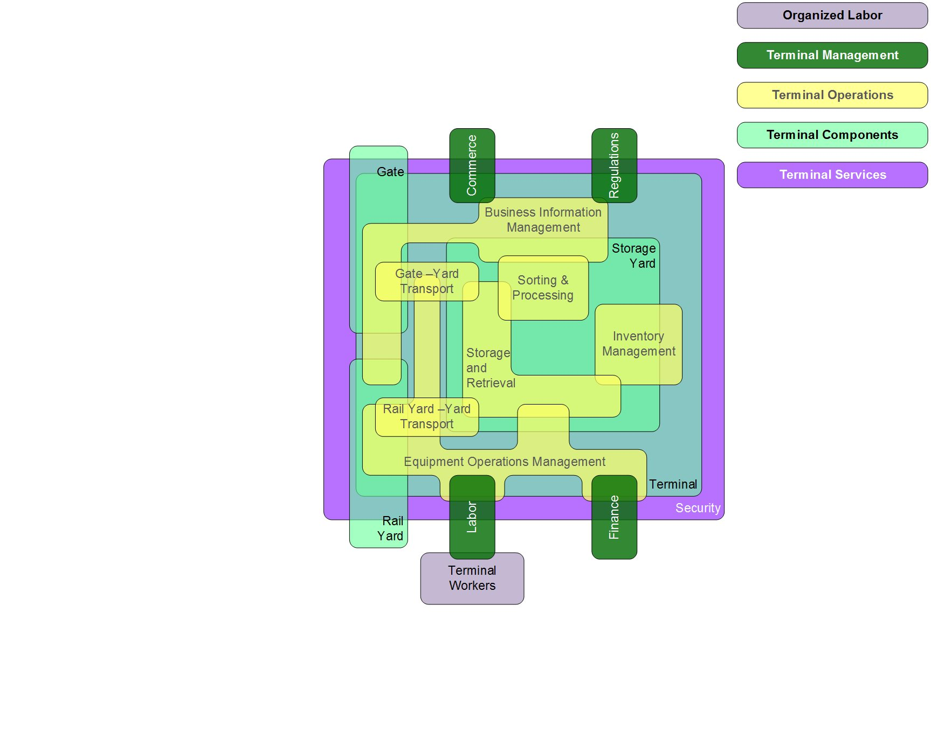
Not a Simple Playing Field - Terminals

Slide 19
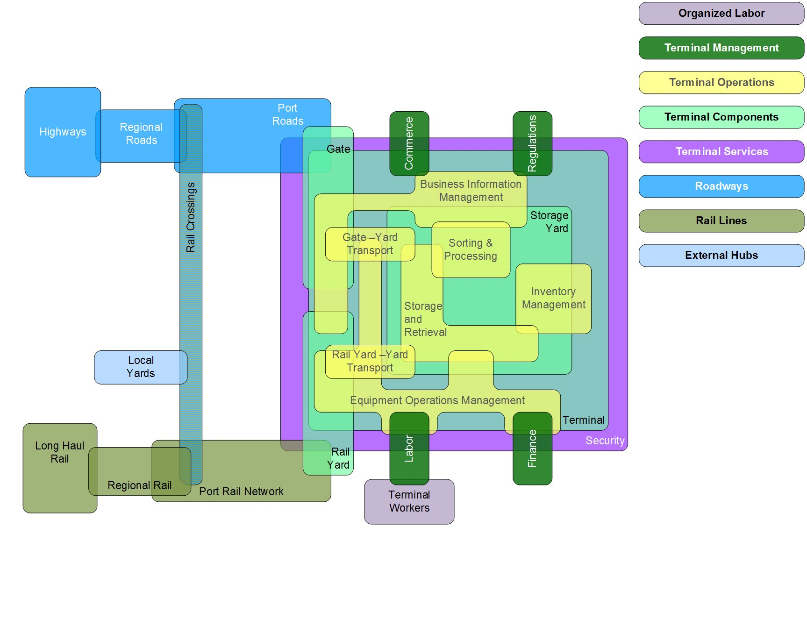
Not a Simple Playing Field – Networks

Slide 20
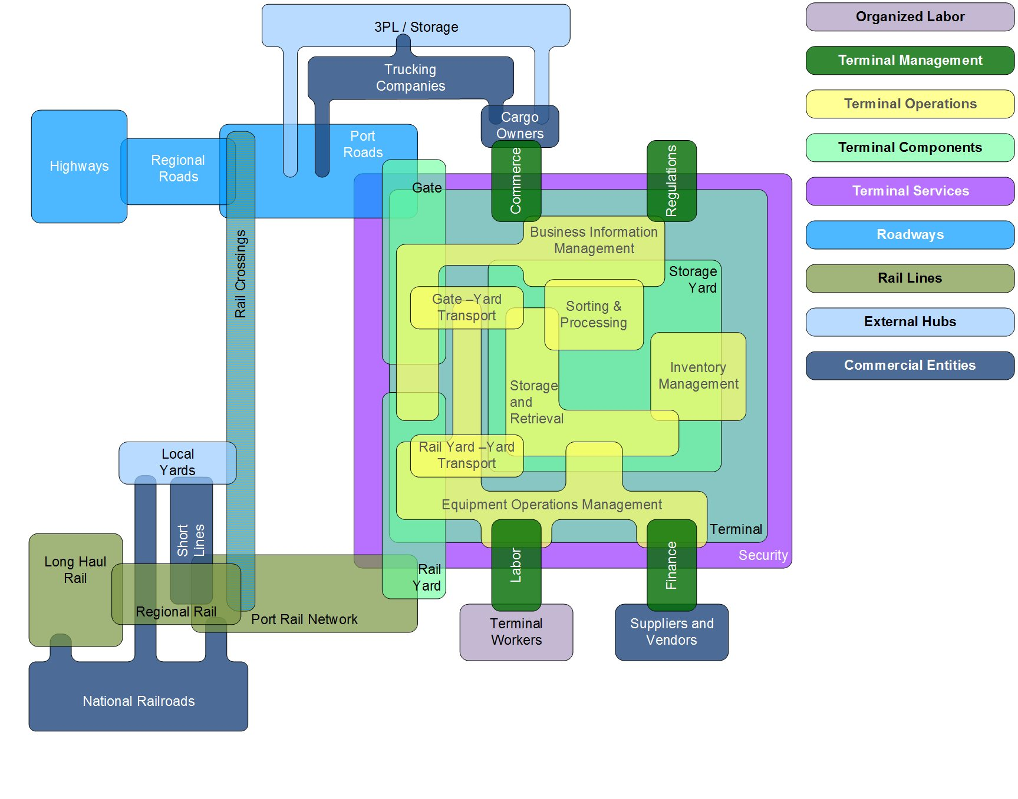
Not a Simple Playing Field - Commerce

Slide 21
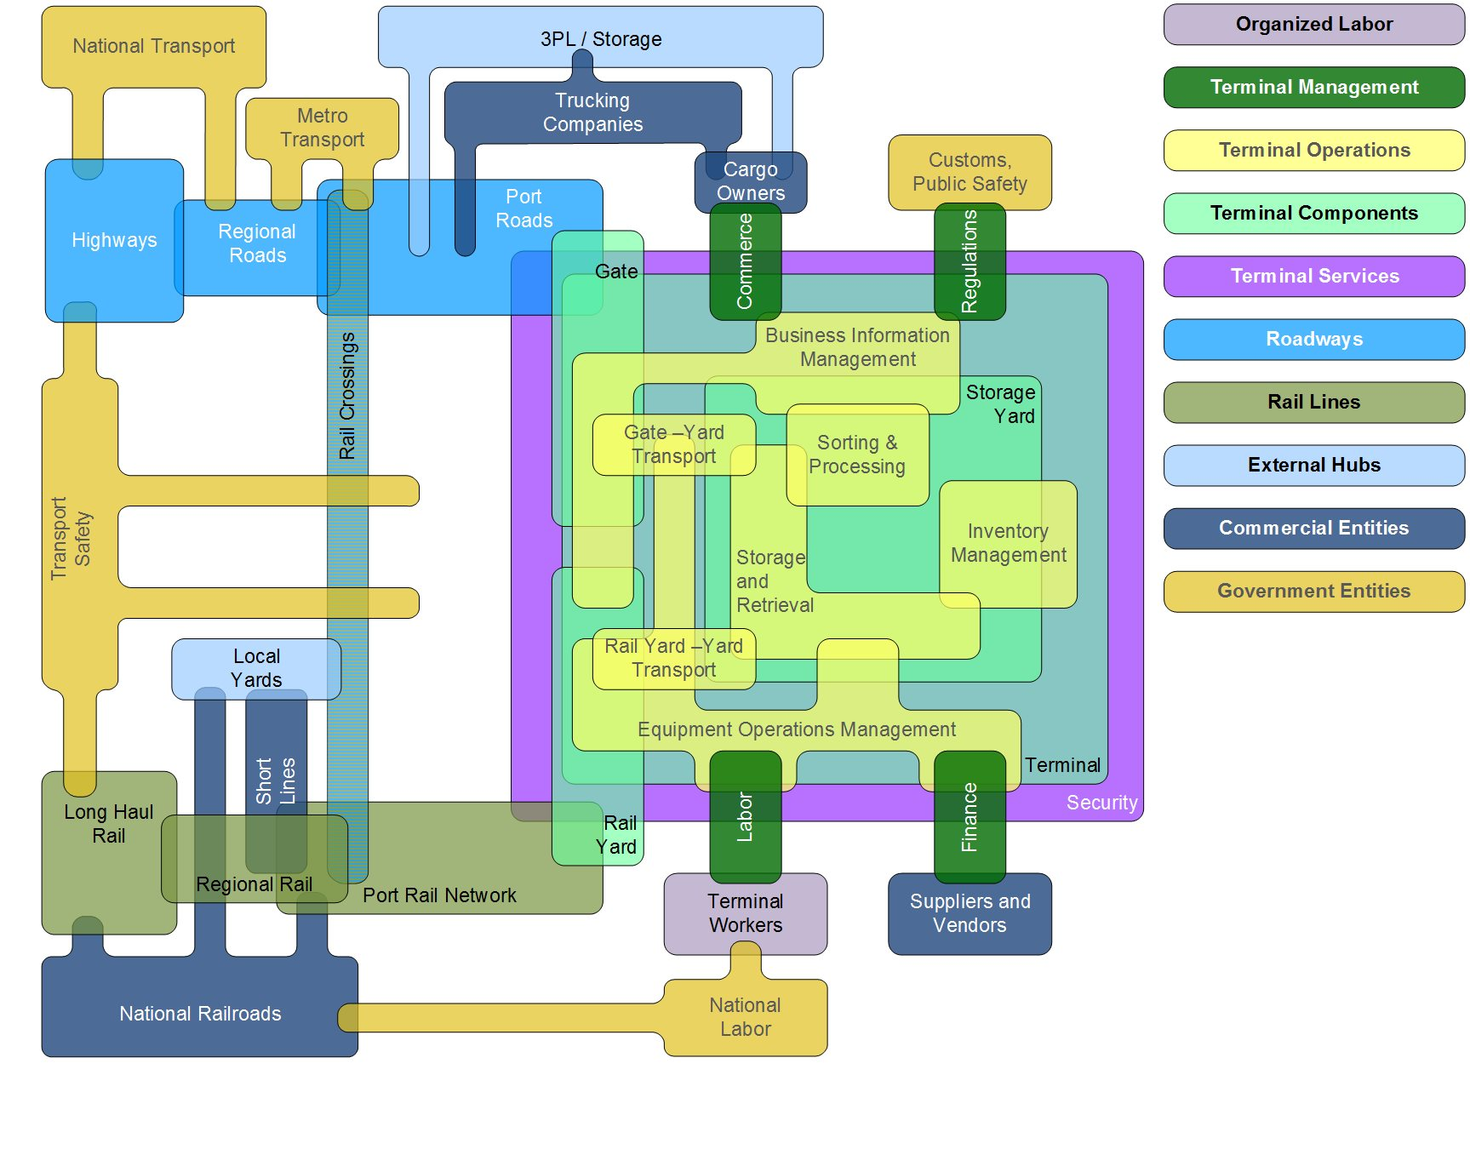
Not a Simple Playing Field - Governance

Slide 22
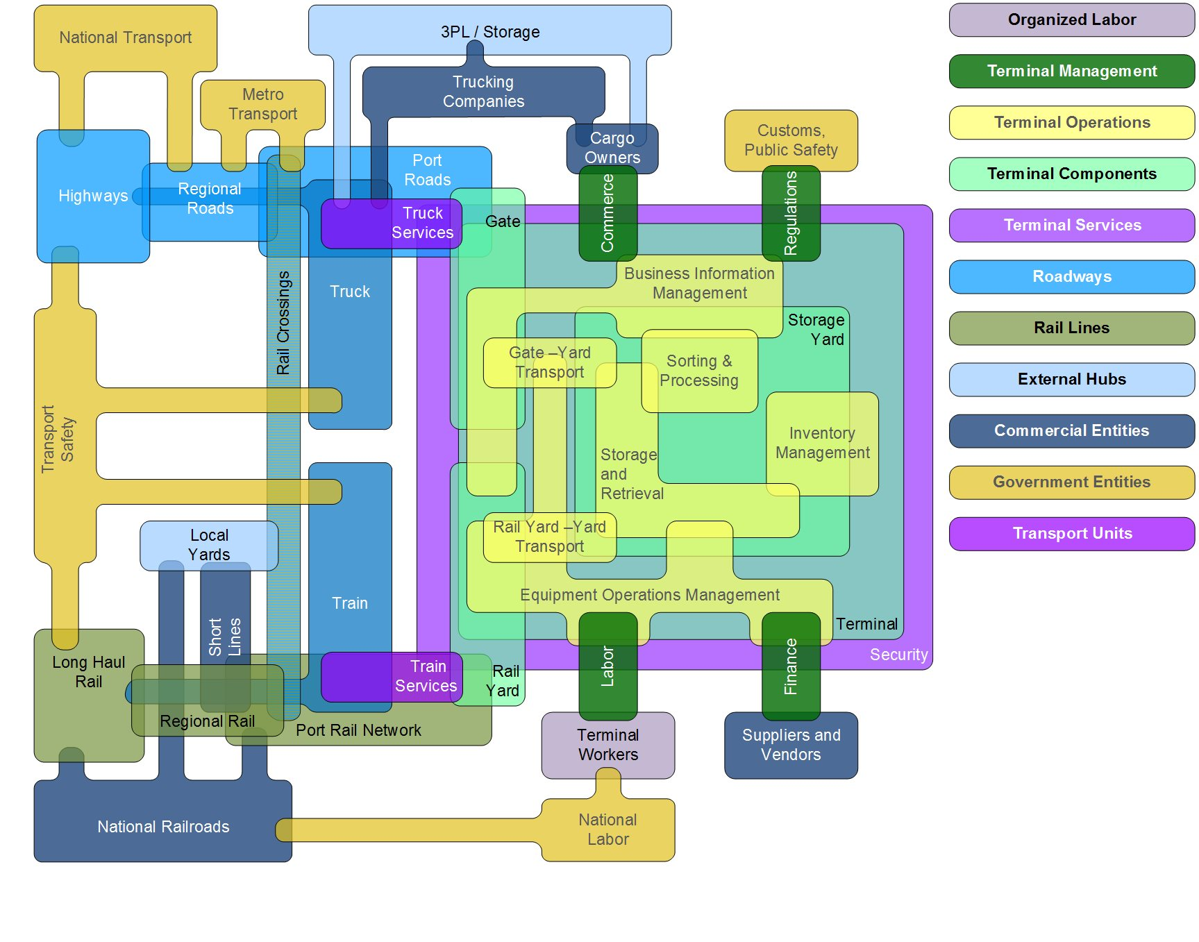
Not a Simple Playing Field - Transporters

Slide 23


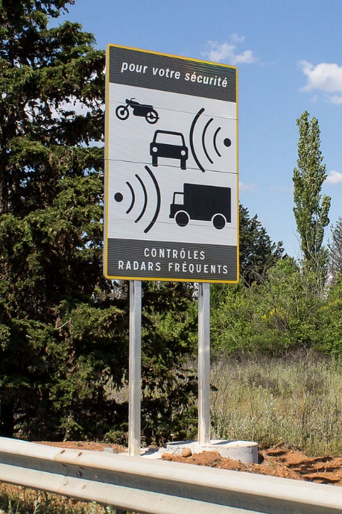
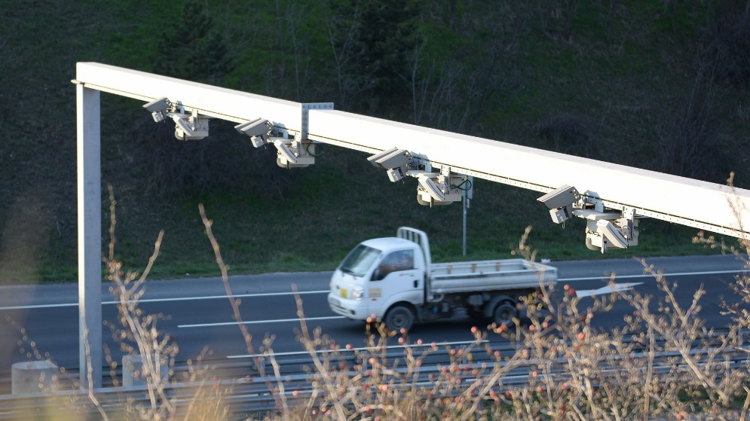
Enabling Technologies
Smart Cameras
Laser / Infrared Scanners
Radio Detection and Ranging
RADAR
Light Detection and Ranging
LIDAR
Optical Character Recognition - OCR
License Plate Recognition - LPR

Slide 24


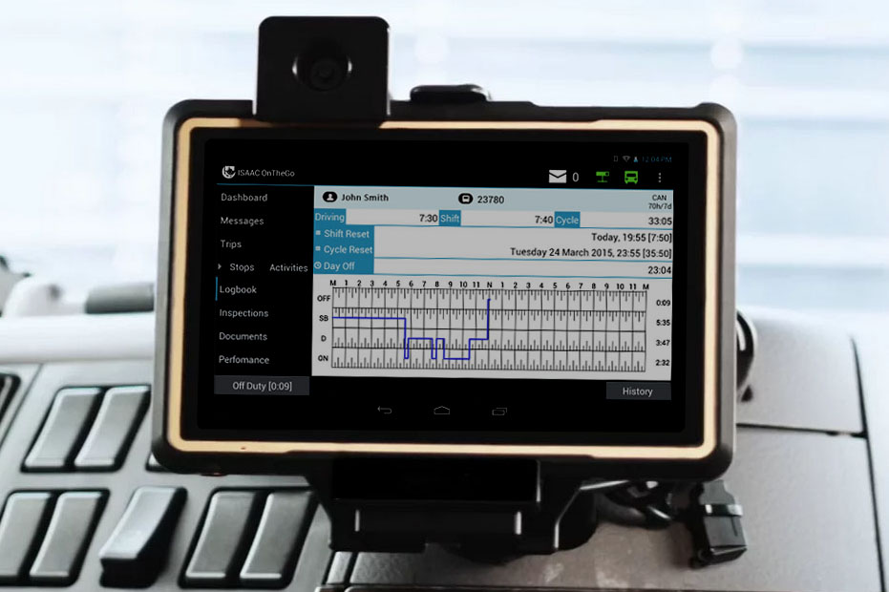
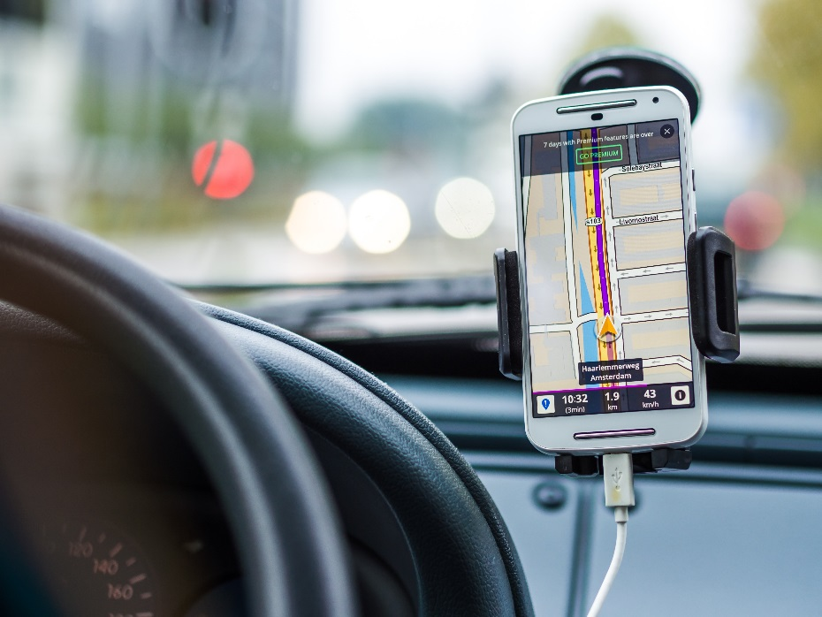
Enabling Technologies
Weigh-in-motion - WIM
Vehicle Telematics
Electronic Logging Devices - ELD
Radio Frequency Identification -
RFID
Geographic Positioning System - GPS
Differential GPS
Bluetooth Tracking

Slide 25




Enabling Technologies
Cellular Communication -
4GC, 5GC
Dedicated Short Range Communications
Electronic Data Interchange - EDI
Internet of Things - IOT
Cloud Data and Processing
Blockchain

Slide 26
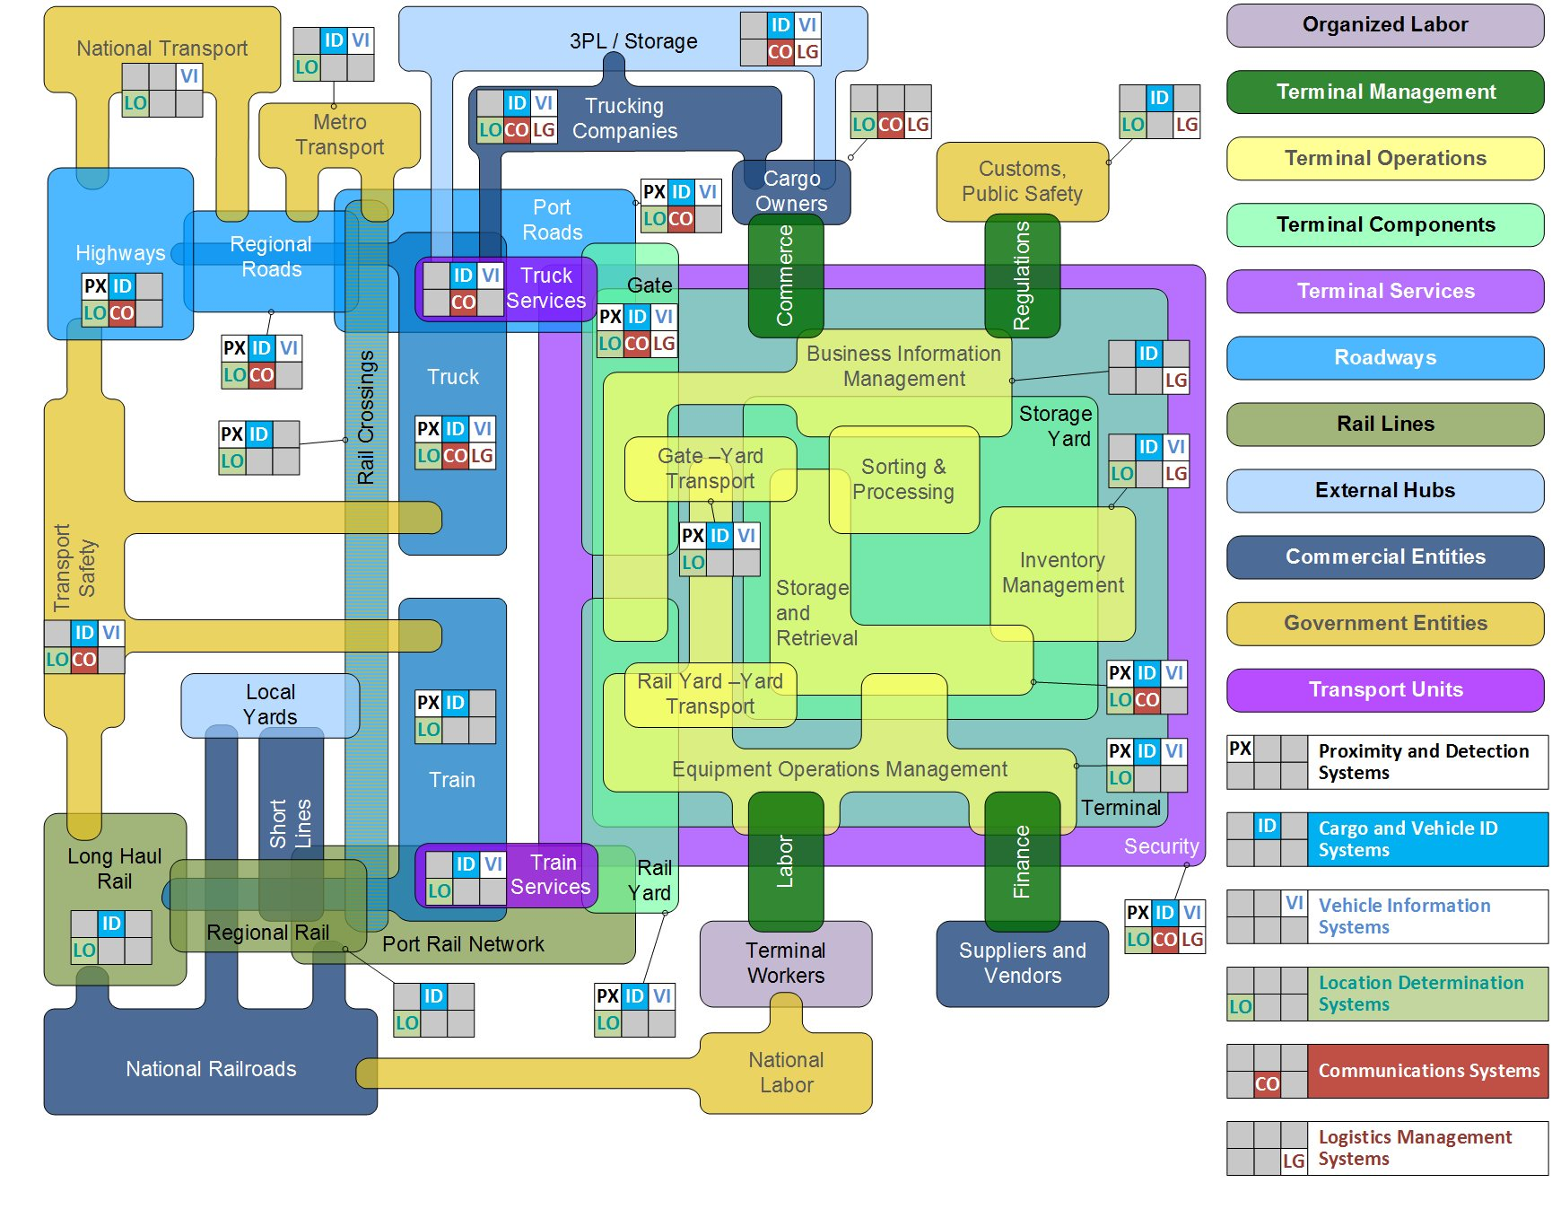
Technology Interactions

Slide 27
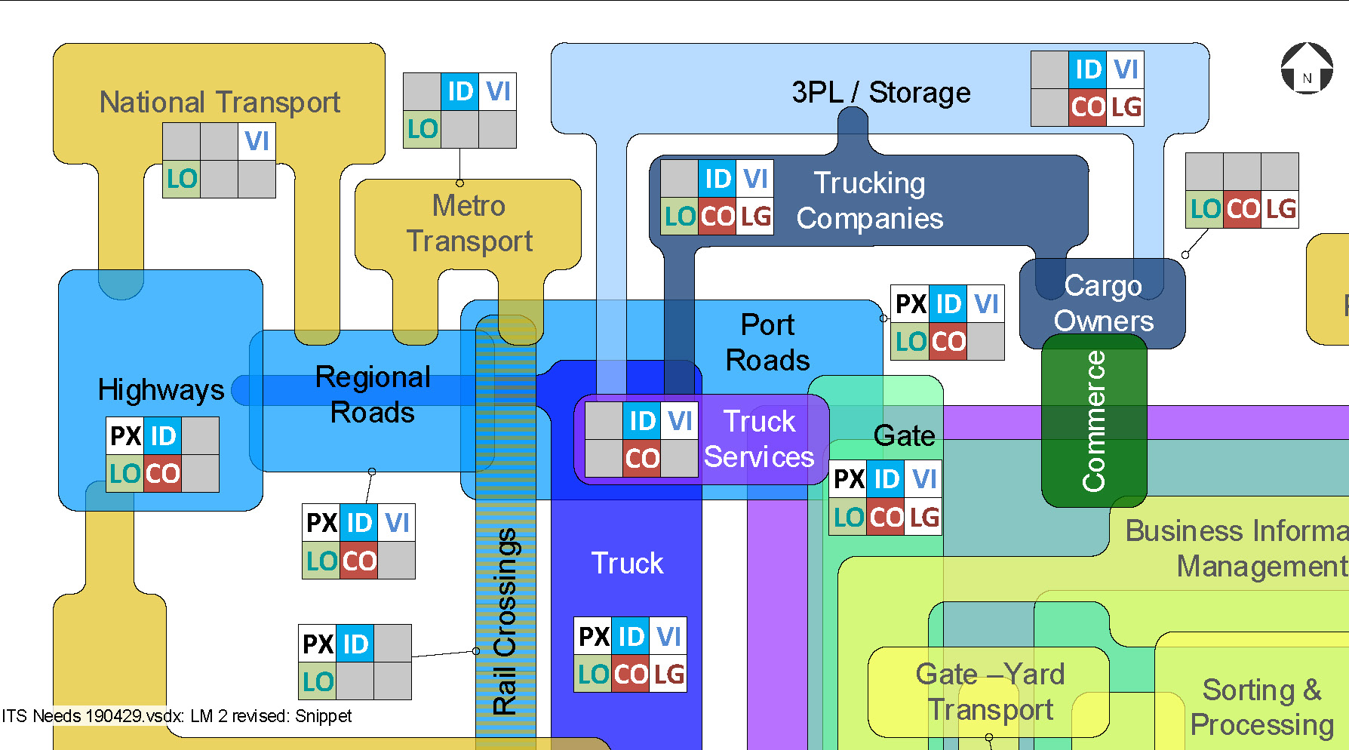
Technology Interactions – Road and Gate

Slide 28
ITS Applications
Local/Regional
Port-Specific
Connected, Automated and Autonomous Vehicles
Platooning Systems
Route Guidance
Intelligent Recognition and Imaging Software
Equipment Tracking System
Terminal Operating System
Gate Operation System
Terminal Status Reporting
Gate Queue Reporting
Truck Appointment Systems
Street Exchange Systems
Automated Work Flow
Combination
Geo-Fencing
Freight Signal Priority
Rail Yard Integration
Integrated Community Portal
Freight Advanced Traveler Information System (FRATIS)
Traveler Information Reporting

Slide 29
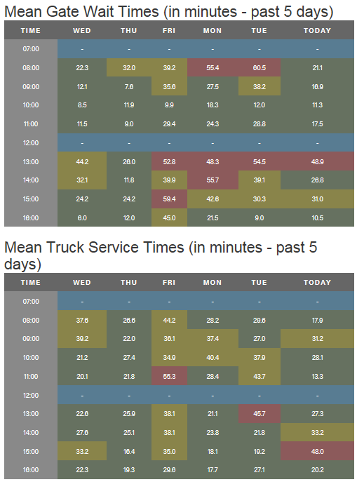
A Recent Example
A port authority bought extra bridge toll tag (RFID) readers and placed them at:
  Tail of entry gate queues
  Entry into the container yards
  Exit from the terminals
Time stamp readings for each tag, and some filtering, produced gate queue and truck service times
Mean results are dynamically updated, in public, on the port’s website

Slide 30
Vehicle to Everything (V2X) and IOT Communications
Service Improvement | V2X and IoT Communications Technology
 | Vehicle / Vehicle | Vehicle / Infrastructure | Vehicle / Device | Vehicle / IoT | IoT Platform
Safety & Reliability | Avoid port-area collisions, goods movement accident losses, hazardous material releases.
 | Port equipment position and routing. | Speed constraints, variant road conditions, construction areas, queue conditions, congestion, weights in motion. | Downstream congestion, speed reduction warnings, signal conditions, rail crossing condition, truck trailer basic safety message. | Trip timing or routing to avoid incidents, hazardous material conditions, expected rail movements and road blockages. | Vehicle maintenance tracking, inspection tracking and reporting, driver / vehicle qualifications.
Resilience | Mitigate the impact of disruptive events, such as extreme weather or geological events.
 | Engine conditions / flooding, mass vehicular stalls, emergency vehicle movements / warnings, utility vehicle proximity. | Road, rail, tunnel, and bridge closures; route damage; route reversals / alternatives. | Freezing / icing, stream conditions, power grid conditions, signal system disruption. | Rerouting directions, evacuation warnings, loss-of-service messages, emergency transport protocols. | Impact predictions, weather paths, flood surge modeling, seismic damage mapping.
Cargo Visibility & Reliability | Improve the reliability and timeliness of cargo transport, and improve the responsiveness of service providers.
 | Peloton / convoy, multi-shipment manifest coordination, trailer size/ configuration. | Weights and weight limitations, construction areas, operational conditions that increase delays, truck parking tracking. | Vehicle characteristics, shipment location, transport unit location and condition, geofencing, net velocity, driver safety conditions, truck parking info. management system (TPIMS) availability. | Route recalculation, scheduled route interruptions, vehicle / signal synchronization, variable priority movements, TPIMS synchronization. | Congestion tracking and projection, route balancing and load sharing, dynamic proactive route optimization, TPIMS optimization.
Vehicle Efficiency & Mobility | Reduce travel time, reduce queueing and idling, maintain network fluidity, and improve transport workforce efficiency.
 | Peloton coordination, driver load splitting, driver team condition / coordination. | Signal pattern reporting, speed monitoring, geofence population tracking, dedicated lane / route indication. | Signal coordination conditions, speed enforcement, geofenced population management, dedicated lane / route utilization. | Queueing information, congestion reporting, priority path use, dynamic tolling, congestion pricing. | Dynamic modeling of transport space, movement optimization, congestion avoidance.
Gate Efficiency | Reduce queueing, improve accuracy, avoid transaction failure, gate transaction speed, extend hours, and optimize labor.
 | Multi-unit manifest coordination, team-wide transport monitoring and coordination. | Transaction-driven directional signage, queue entry/exit recording, queue-driven signal controls. | Vehicle / equipment ID OCR, RFID, LPR; dynamic tare + fuel for weighing; digital hazmat placard; digital seal; dead vehicle in queue; reefer temperature / condition. | Automatic transactions, off-terminal pre-processing, shift from “push” to “pull” processing, dynamic vehicle prioritization. | Align “pull” transactions to terminal resource availability, paperless liability controls, paperless manifest, transactions.
Terminal Yard Efficiency | Improve density and velocity, improve cargo handling equipment deployment, reduce cargo rehandling, reduce congestion.
 | Equipment queue management, report truck wait times, eliminate over-stows of moves in the queue. | Area closures, area restrictions, dynamic routing signage. | Mobile data terminal integration, geofenced density reporting, proximity to assigned equipment or location. | Dray-off yard areas for pre-lodged transactions, dynamic intra-terminal route management, internal queue management. | Equipment assignment optimization, awareness of upcoming moves to avoid over-stows, remote control operations.
Port Efficiency | Improve the efficiency of total port visit, balance load between resources, respond to congestion events.
 | Train positioning and routing, vessel-lift bridge coordination. | Equipment pool conditions, port-wide routing, terminal populations, rail crossing closures, train locations and movements. | Bridge deck weight sensors, rail crossing equipment, lift-bridge conditions, berth utilization, rail yard utilization. | Equipment inventories and demands, storage inventories, space available, transactions cleared for pickup, double-cycle opportunities. | Port wide chassis management, empty management, rail car management, train scheduling and vehicle move timing.
Improvement | Vehicle ↔ Device
Cargo Visibility & Reliability | Reliability, timeliness, responsiveness
 | Vehicle characteristics, shipment location, transport unit location and condition, geofencing, net velocity, driver safety conditions, truck parking info. management system (TPIMS) availability.

Slide 31
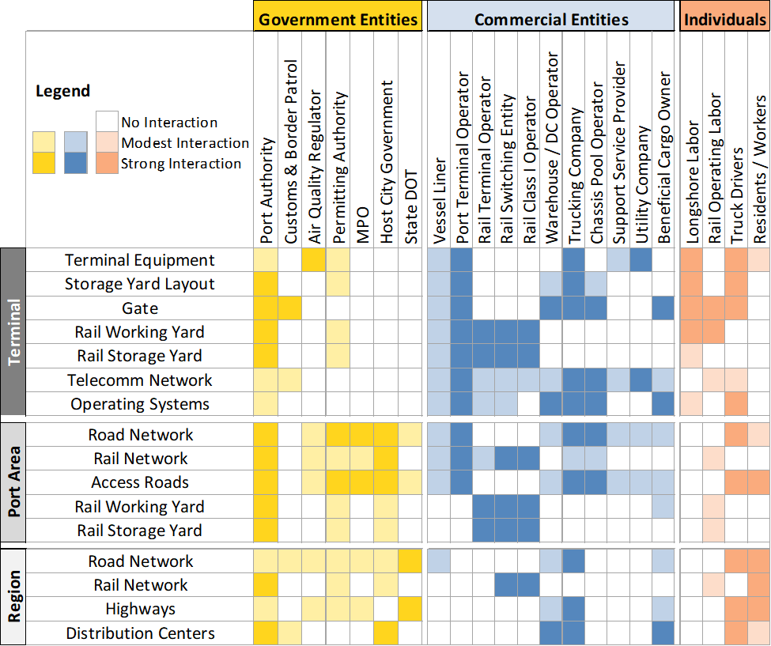
Stakeholder Matrix

Slide 32
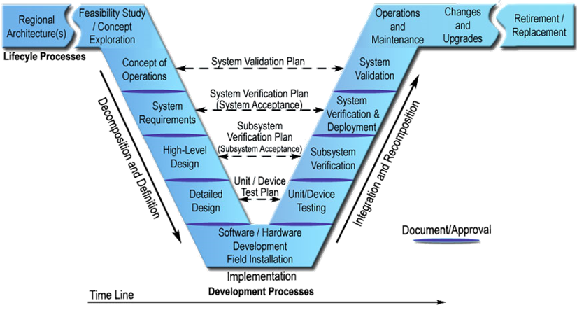

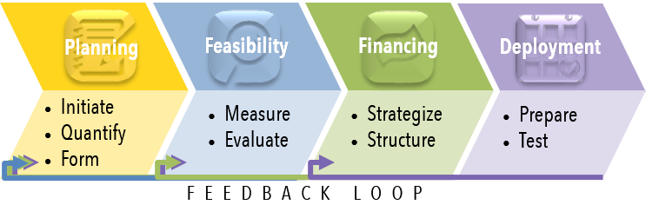
A Systems Engineering Approach

Slide 33

Planning
Initiate
  Set Goals and Objectives
  Collect Data
  Engage Stakeholders
Quantify
  Map Existing Conditions
  Identify Needs and Drivers
Form
  Develop and Refine Alternatives
  Analyze and Compare

Slide 34
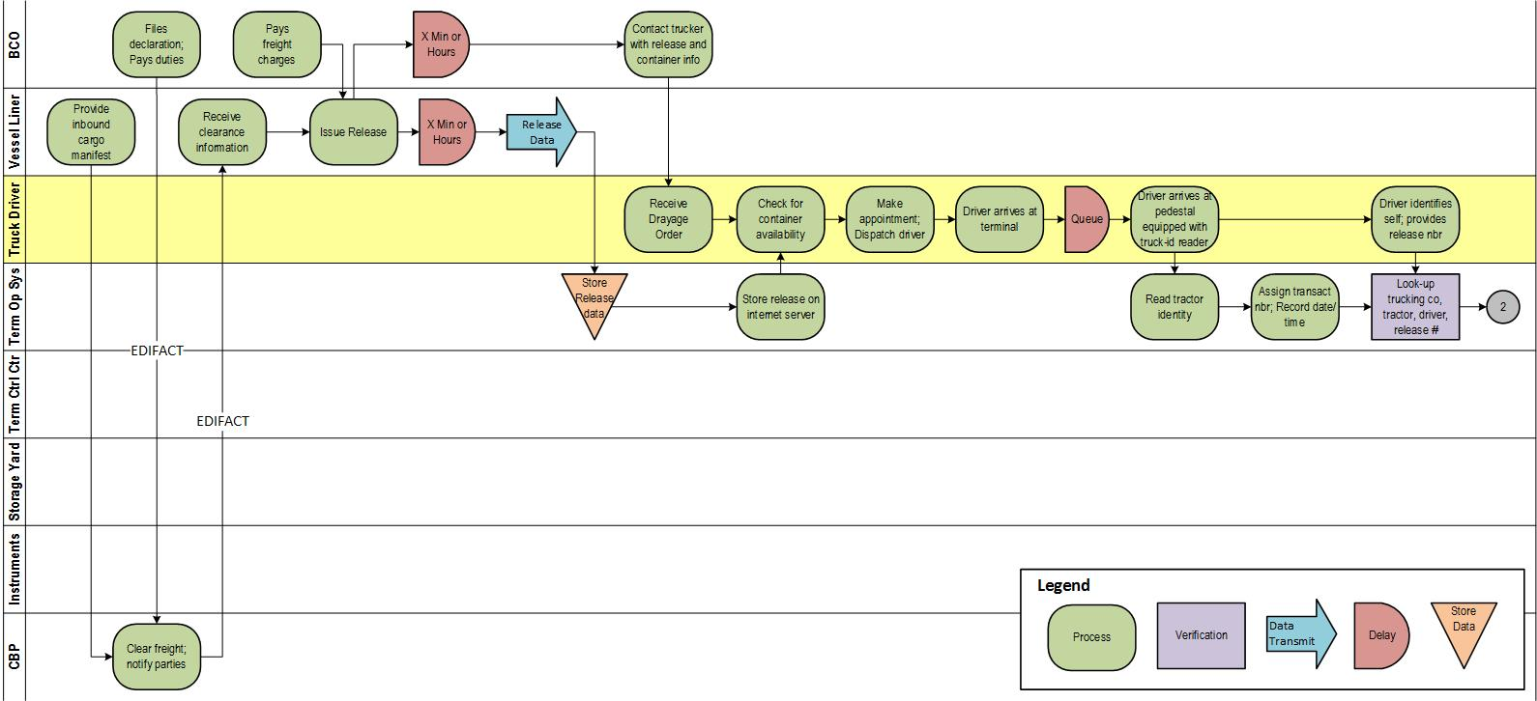
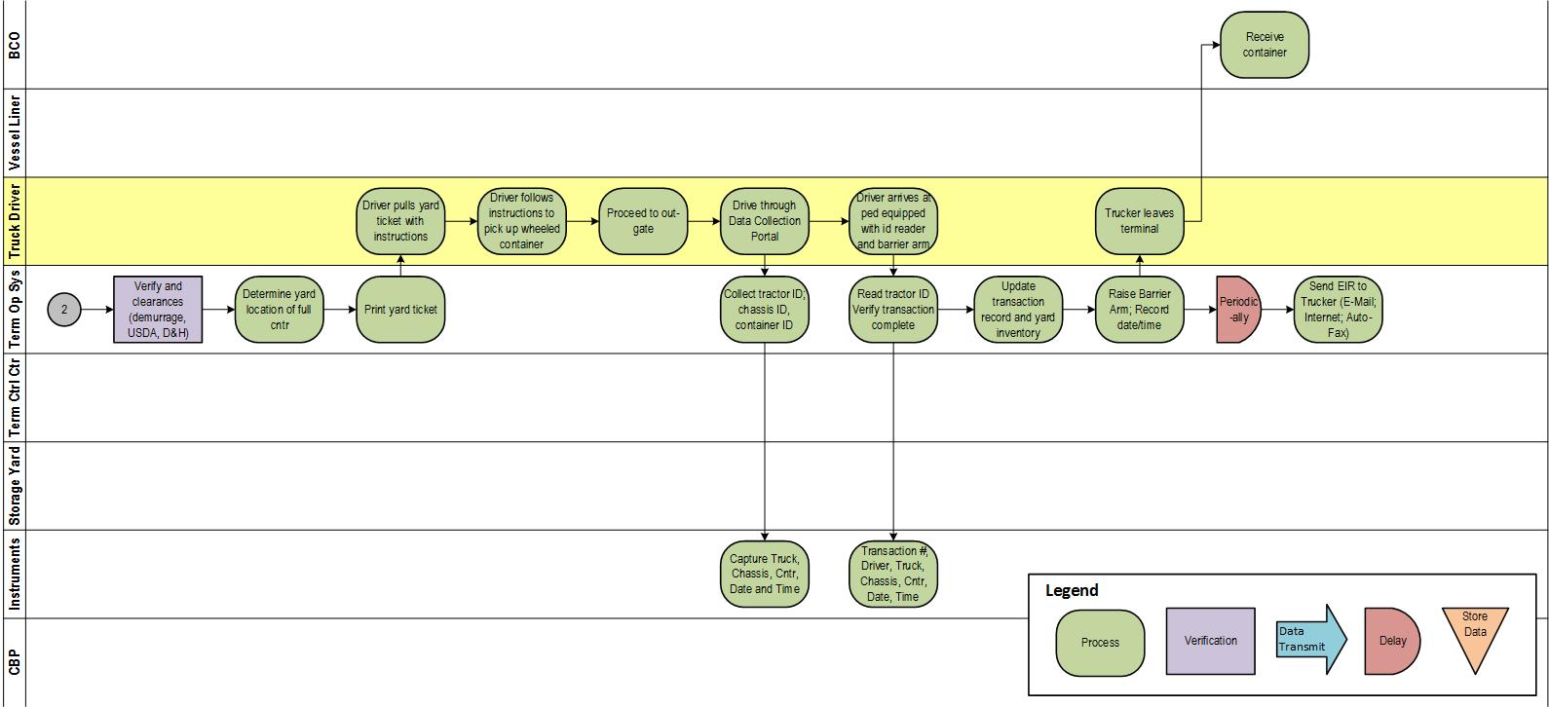
Cross-functional flow diagrams

Slide 35
Feasibility
Assess
Evaluate
Potential Performance
Human Resource Needs
Impacts
Risks
Criteria
Prioritization
Scoring & Selection

Slide 36
Port ITS Considerations
Responsibility & Authority
  Many stakeholders
  “Ownership” keeps shifting
  Many drivers, few controls
Random Demand
  Ports serve the fickle sea
  The landside isn’t much better
Transactional Error
  Freight moves neither faster nor better than its supporting data
Labor
  Bound by contract
  Bound by tradition
  Imbalances in power, control
Freight Security
  Avoid theft, damage, pilfering
Transportation Security
  Keep the Bad Guys out
  Keep the Bad Stuff out
  Find the Bad Stuff before it becomes Really Bad Stuff
Cybernetics
  Who ARE those Bad Guys?

Slide 37
Cybersecurity and Resiliency
Vehicle – NHTSA
  Harden the vehicle’s electronics against potential attacks and ensure appropriate response.
Infrastructure – NIST + USDOT
  Framework for Improving Critical Infrastructure Cybersecurity
Integration – USDOT ITS JPO et al
  Research, develop, and educate on cybersecurity technical and policy mitigations.
  Pursue a unified approach to vehicle, device, and infrastructure security for connected vehicles
Navigation – USCG
  Information, resources concerning maritime cybersecurity:
  USCG Homeport ‐ Cybersecurity.
Vessels and Ports – ABS
  Guidance Notes on cybersecurity & resiliency matters.
  FCI Cyber Risk™ algorithm at
  ABS Maritime Cyber Security.
Ships at Sea – IMO
  Recommendations on maritime cyber risk management for shipping:
  Guidelines on Maritime Cyber Risk Management
Homeland - DHS
  US Computer Emergency Response Team (US‐CERT)
  Industrial Control Systems Cyber Emergency Response Team (ICS‐CERT)
  US‐CERT Resources, ICS‐CERT Resources.
Maritime - MARAD’s
  Office of Security coordinates to issue US Maritime Alerts and US Maritime Advisories

Slide 38
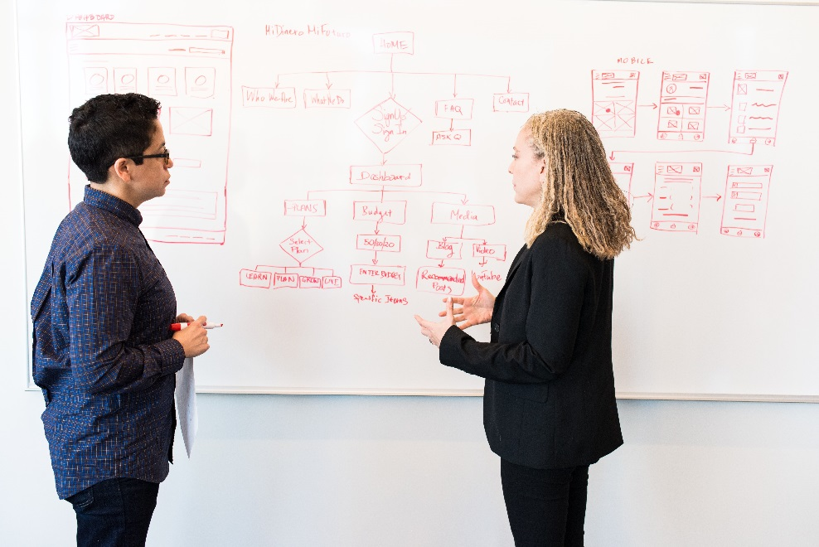
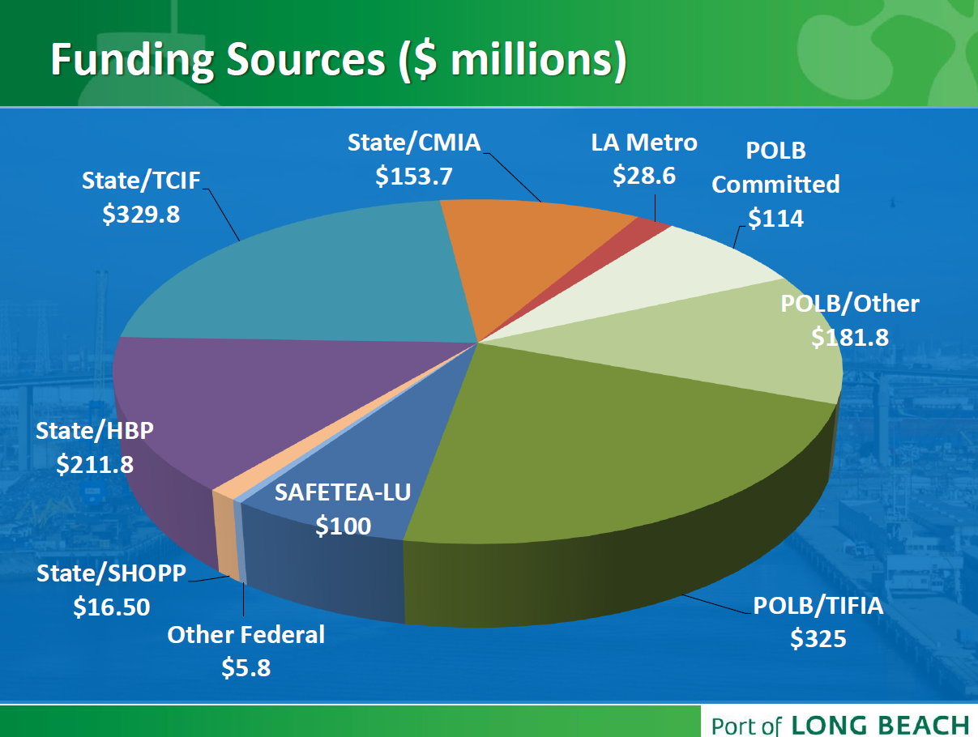
Financing
Strategize
  Low cost, high return on investment
  Identify funding opportunities and alternatives
Structure
  Federal funding sources
  State and local sources
  Private funding sources

Slide 39
External Funding Sources
Federal Programs
  Discretionary Grants
  Federal-Aid Grants
  Federal Loans
  Private Activity Bonds (PAB)
State, Regional, Local
Private
Govt. Program | Summary Description
ATCMTD | Competitive grant for deployment of deploy advanced transportation and congestion management technologies.
ITS | Funding for the development of ITS infrastructure, equipment, and systems; and ITS research initiatives, exploratory studies, and a deployment support programs.
BUILD | Competitive grant for enhancement of surface transportation infrastructure at local and regional level.
INFRA | Competitive grant or credit assistance for highway and freight projects of national or regional significance.
STBG | Formula funding for States and MPOs for priority transportation projects.
NHFP | Formula funding for States to improve movement of freight on National Highway Freight Network.
CMAQ | Formula funding for States, MPOs and local governments for transportation projects and programs to help meet the requirements of the Clean Air Act.
TIFIA | Financing assistance for ITS and surface transportation projects, certain freight rail projects, intermodal freight transfer facilities, and certain projects inside a port terminal.
RRIF | Financing assistance for railroad equipment, facilities and infrastructure including positive train control systems.
PABs | Tax-exempt financing issued through a public conduit for privately developed infrastructure.

Slide 40

Deployment
Prepare
  Procurement Method
  Deployment Plan
Verify
  Field Operational Tests
  Key Performance Indicators
  Demonstrations
  Go-Live Checklist

