Slide 1
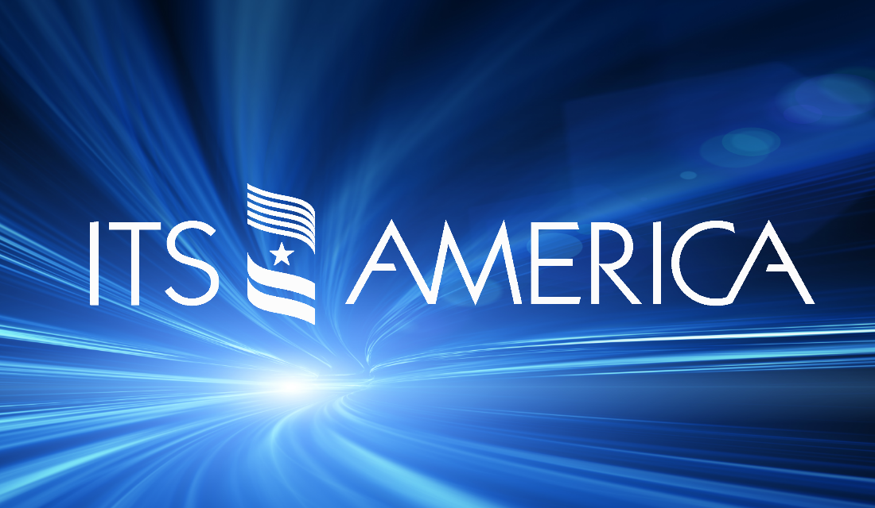
Carlos Alban
ITS PCB Academic Workshop – March 27, 2019

Slide 2
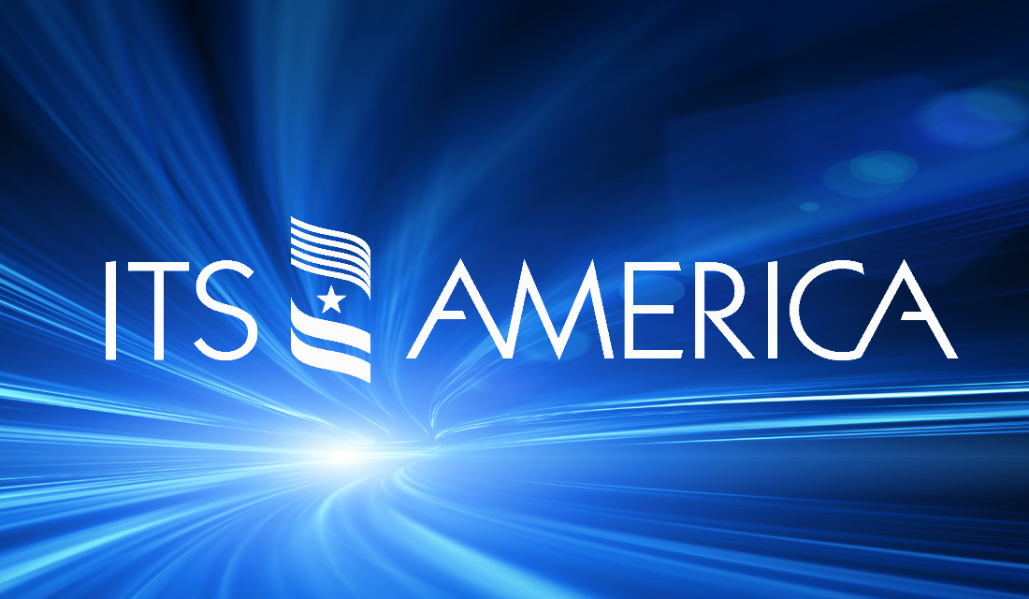
Who We Are
Our Vision:
  A better future transformed by intelligent mobility. One that is Safer. Greener. Smarter.
Our Mission:
  We advance the research and deployment of intelligent transportation technologies to save lives, improve mobility, promote sustainability, and increase efficiency and productivity by:
    Convening leaders from the public sector, private companies, academia, and research organizations to create an environment that fosters innovation.
    Promoting a legislative and regulatory environment that supports investment in and the deployment of intelligent systems.
    Conducting research, educating stakeholders, and building awareness of advancements in smart transportation technologies.
Our Members:
  Are involved in all facets of Intelligent Transportation Systems (ITS) research, planning, development and deployment. State DOTs, regional and local transportation and planning agencies, private companies providing ITS products and services, auto manufacturers and suppliers, research organizations, academic institutions and transportation associations all derive benefit from their interaction through ITS America.

Slide 3
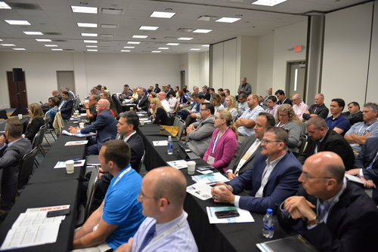
The PCB Program
ITS America State Chapter Trainings:
  ITS America has a long standing partnership with the U.S. Department of Transportation (USDOT) ITS Professional Capacity Building (PCB) Program.
  Through our ITS America State Chapters, we have been able to deliver trainings to over 3,000 transportation professionals covering a total of 40 states.
  This partnership enables state and local, public and private sector professionals the opportunity to receive training and information about critical issues in the ITS Industry. Recent course topics include Assessing Readiness for CAVs, Improving Highway Safety with ITS, and Cybersecurity Basics.
ITS University & Community College Workshops:
  ITS America has hosted and participated in several ITS University/Community College workshops.
  Educators and practitioners have learned what ITS training products are currently available, worked together to identify the ITS educational needs of their students, and developed strategies to meet those needs.

Slide 4
State Of The ITS Workforce
ITS Workforce Framework:
  ITS America was tasked with developing an initial conceptual framework that would facilitate the analysis of the relevant knowledge, skills, and abilities (KSAs), as well as tasks, job titles, and educational requirements for the ITS workforce.
  ITS America conducted a series of interviews with various ITS industry representatives to qualitatively determine what knowledge, skills, and abilities ITS professionals valued most on a daily basis, which KSAs will be of particular value in the near future, and what issues face the ITS workforce generally.
Highlighted Findings:
  The interdisciplinary nature of ITS industry positions creates challenges for employers and employees seeking to fulfill their organizations’ needs.
  The current educational system does not adequately prepare students for entry into the ITS workforce. For example, candidates who are trained in traffic engineering are not usually trained in the basics of other engineering disciplines that are relevant to ITS, such as electrical or network engineering.
  Public and private organizations expend significant resources training entry- and junior-level employees on the job.
  Concerns about how to maximize currently available technological tools trump concerns about forthcoming technological trends.
  “Soft” skills – especially communication skills – are increasingly valued by the industry.

Slide 5
State Of The ITS Workforce (Cont.)
Public sector feedback:
  Many public sector interviewees openly acknowledged that the ITS labor pool suffers from a lack of highly qualified entry- and junior-level candidates.
  While candidates may possess impressive resumes, many simply do not have interdisciplinary engineering training or experience with the design, deployment, or operations of ITS devices or systems.
  There a thin experience base in the labor pool from which public agencies can recruit.
  Due to these constraints, public agency hiring managers tend to emphasize the importance of “real world” experience on a candidate’s resume, as opposed to emphasizing coursework or grades. For instance, interviewees indicated that they consider internships or co-ops at DOT offices or transportation operations centers to be particularly valuable.
Private sector feedback:
  Private sector interviewees stated that like public sector agencies, their companies require ITS professionals with interdisciplinary knowledge.
  Internships, co-ops, real-world research, part-time jobs, or any other evidence of the initiative needed to learn and gain technical experience is valued.
  Traffic engineering is foundational, but other disciplines are becoming ever more pertinent; in particular, telecommunications and network engineering are increasingly important for private sector interviewees.
  In general, private sector interviewees also reported that communications skills are of paramount importance. Unfortunately, these interviewees felt that the industry’s communications skills are not sufficiently developed.

Slide 6
Upcoming Topics Of Interest
ITS America Annual Meeting – Washington, DC (June 4-7, 2019):
  Several sessions focused on Workforce Development, including sessions led by USDOT.
  Student Essay Competition:
    ITS America and Southwest Research Institute (SwRI) are once again partnering for the 10th annual 2019 ITS Student Essay Competition.
    This competition serves as an opportunity for today's transportation, engineering, and public policy students to apply their knowledge in a thought-provoking manner for a chance to win scholarship money, while building awareness of the high-tech transportation industry as a limitless career path.
    The winner receives one full complimentary registration to attend ITS America, where they will have the opportunity to learn, discuss, and network with the nation's top transportation and technology leaders.
    Flight and hotel expenses will also be covered for the winner.
ITS America Student Chapters:
  We are currently coordinating with our State Chapters to see how the Student Chapters can become more active and far stretching.
  We are looking to solicit feedback from students, professors, and practitioners as to ways we can provide more information and exposure to ungraduated and graduate level students in the ITS Field.

Slide 7
Stay In Contact
Please feel free to reach out to discuss further opportunities for collaboration:
Carlos Alban
Vice President, Technical Programs
calban@itsa.org
202-721-4223

