Slide 1
TSMO:
What it is and How it Impacts our Future Technology Workforce

Slide 2
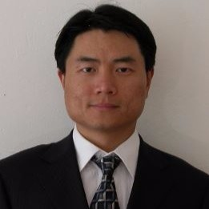
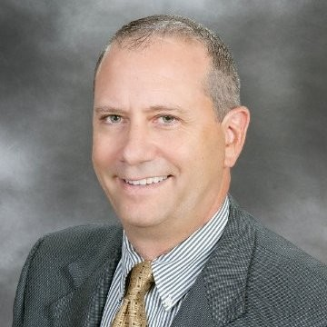
ITE Transportation Systems Management & Operations Council
Kris Milster
Traffic Technology Services
Council Chair
Yang Tao
City of Madison, WI
Council Vice-Chair
Anthony Castellone
Pennoni & Associates
Council Secretary
Purpose:
To share the TSMO Council’s goals and to gain nationwide volunteers to join and contribute to the Executive Committee’s focus areas.

Slide 3
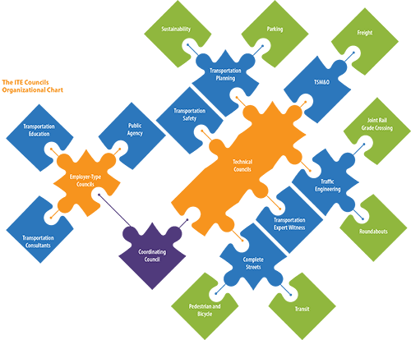
ITE Transportation Systems Management & Operations Council
2019 Focus Areas
Smart Communities
Connected and Autonomous Vehicles
Urban Goods Movement
Outreach & Work Force Development

Slide 4
Past (challenges)
TSMO (Evolving)
Future
What is TSMO?
Transportation Systems Management and Operations

Slide 5
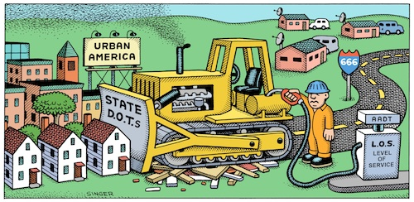
What is TSMO?
“Those who don’t know history are [doomed] to repeat it.”

Slide 6
What is TSMO? “We cannot build our way out of congestion”
“Study after study about what causes [traffic] jams shows that it is a fallacy to believe that if you add more highway capacity, you get more throughput – in reality, the opposite happens.”
Jim Hackett, CEO of Ford Mobility Company, Freakanomics Podcast Ep. 357

Slide 7
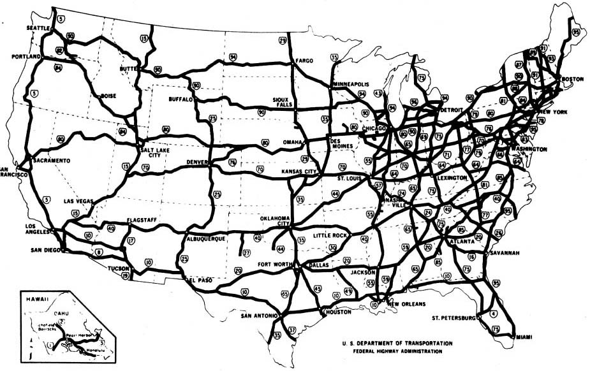
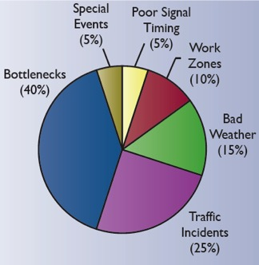
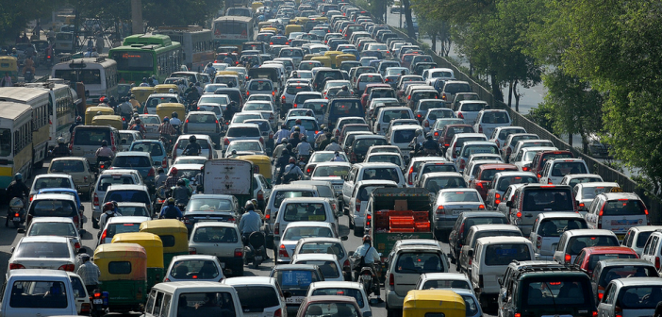
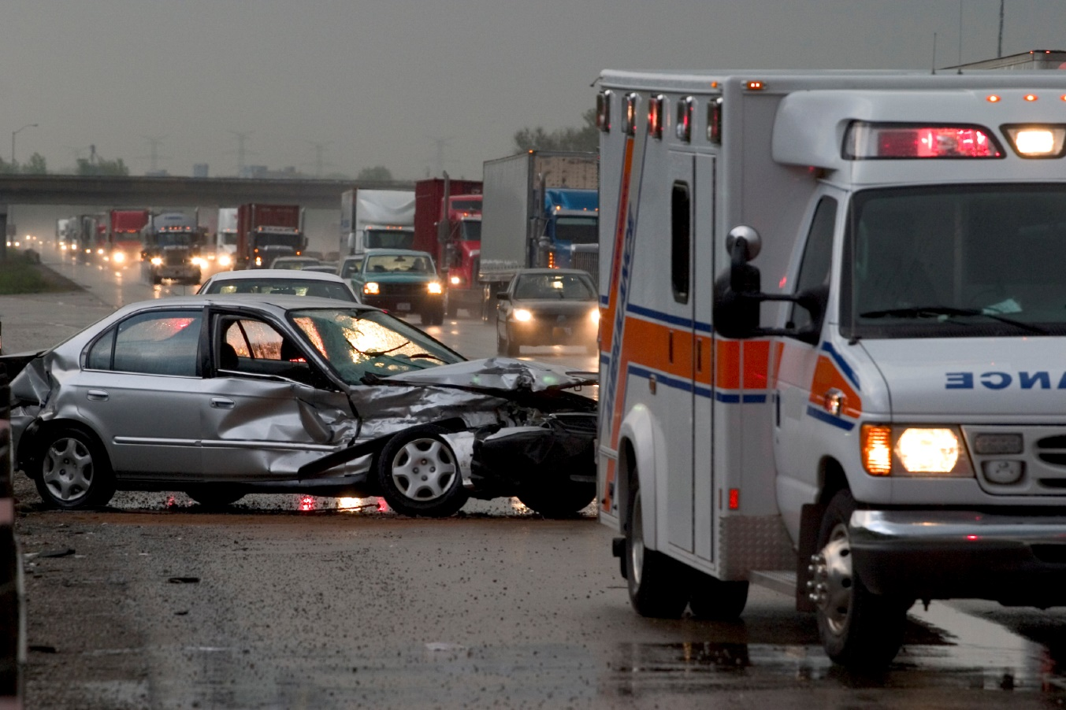
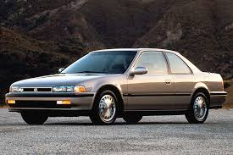
Past (challenges)

Slide 8
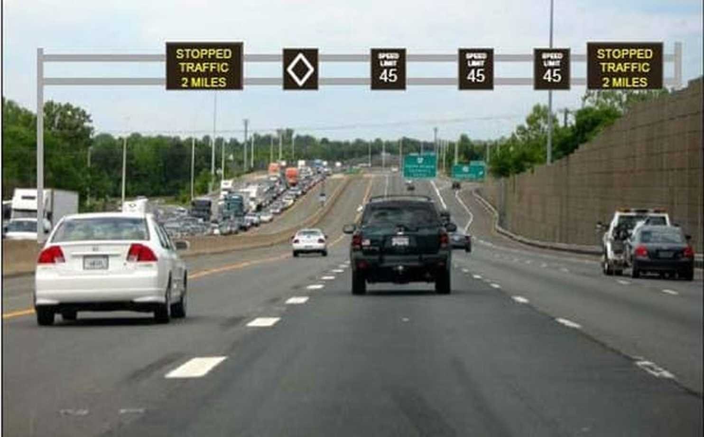
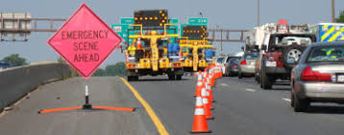
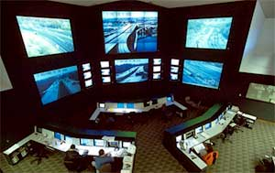
TSMO (Evolving)
Work Zone Management
Traffic Incident Management
Service Patrols
Special Event Management
Road Weather Management
Transit Management
Freight Management
Connected & Automated Vehicle Deployment
Traffic Signal Coordination
Traveler Information
Ramp Management
Managed Lanes
Active Traffic Management
Integrated Corridor Management
Access Management
Improved Bicycle & Pedestrian Crossings

Slide 9
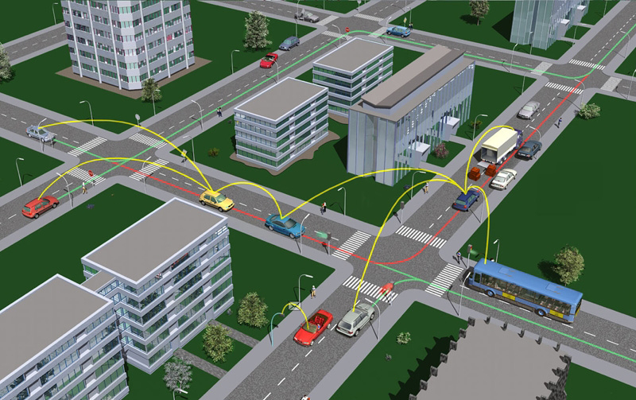
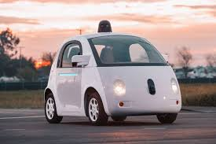
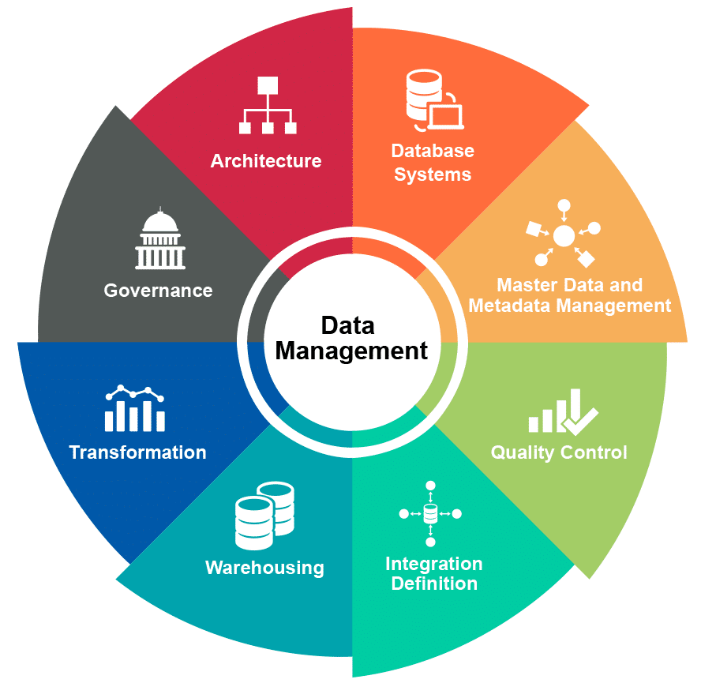
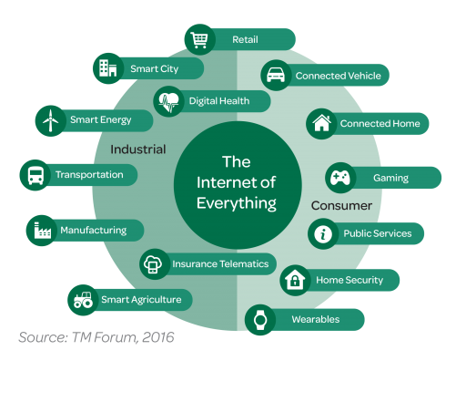
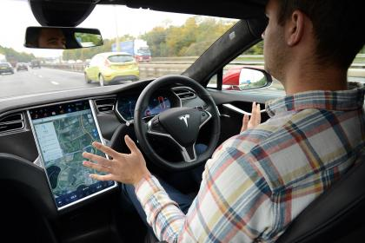
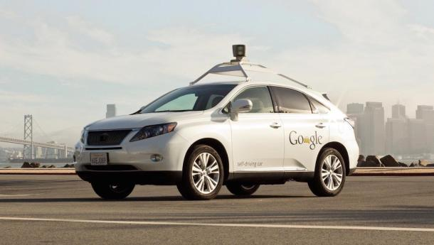
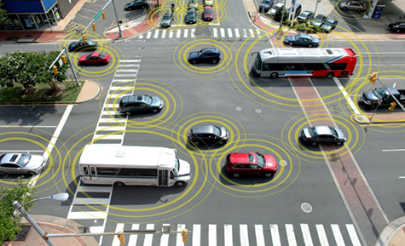
Future

Slide 10
So What Does our Future Transportation Technology Workforce Look Like?

Slide 11
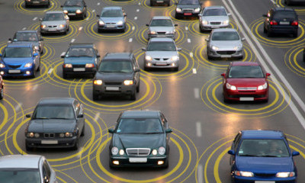
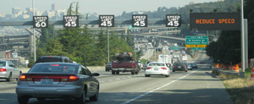

Slide 12
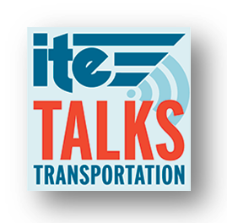
Develop your Career: Listen to ITE Podcasts
Smart Communities Series
Vik Bhide (Tampa, FL)
Karina Ricks (Pittsburgh, PA)
Peter Koonce (Portland, OR)
Jim Dale (Austin, TX)
Erin Toop & Howaida Hassan (Edmonton, AB, Canada)
Betsy Price (Fort Worth, TX)

Slide 13
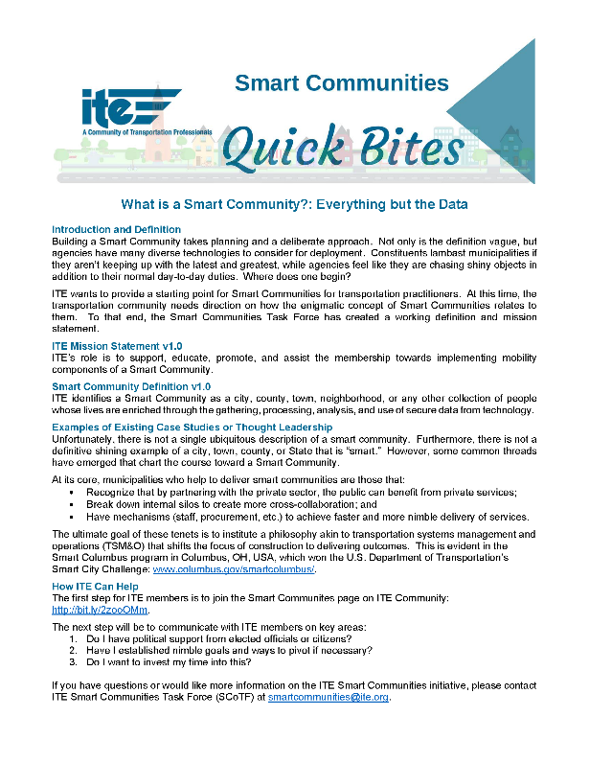
Develop your Career: Check out “ITE Quick BITEs”
Everything But the Data
All About the Data
More than Big Cities
Social Equity
Public Health
Forming Start Teams
Shared Mobility
How Does a Community Become “Smart”

Slide 14
Develop your Career: ITE Community
Online Community Page
Discussions
Blog Posts
Resources
Member Engagement

Slide 15
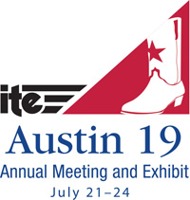
Develop your Career: Attend 2019 ITE Annual Meeting
Submit an Abstract!
And while you’re there:
Attend the ITE TSMO Council Meeting to connect with Leadership

Slide 16
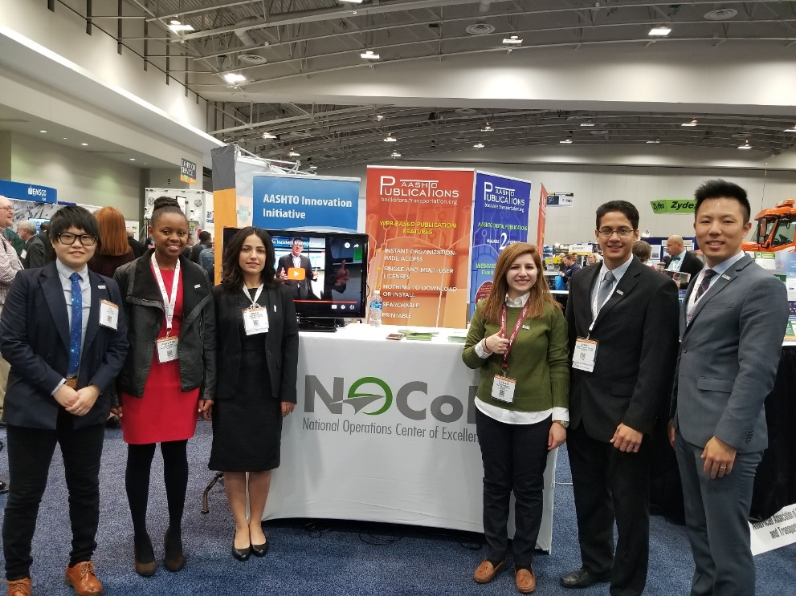
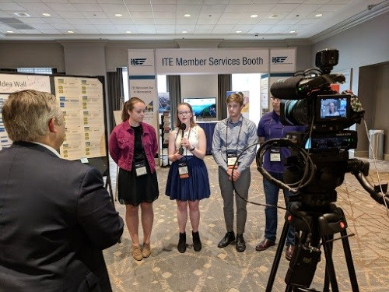
Develop your Career: Student Competitions
TRB ePortfolio competition
Travel to DC in January
Opportunity to meet one-on-one with TSMO leaders
ITSPCB/NOCoE/ITE Transportation Tech Tournament
Free travel to ITE meeting (Austin, TX in 2019
Compete in Shark Tank 6-minute pitch
16

Slide 17
Develop your Career: Get Involved Now – and Later!
Follow TSMO Hashtags:
#TSMO, #V2I, #SmartCommunities, #SelfDrivingCars
@NOCoEOps
https://ops.fhwa.dot.gov/plan4ops/focus_areas/integrating/transportation_sys.htm
Participate in the upcoming NOCoE contests: https://transportationops.org/transportation-technology-tournament
Register for the newsletter for updated information: https://www.transportationops.org/newsletter

Slide 18
Thanks!
Anthony Castellone, PE, PTOE
acastellone@pennoni.com
(770) 594-6209
Kris Milster
ITE TSMO Council Chair
kris.milster@traffictechservices.com
(971) 330-9094

