Slide 1
Incorporating ITS into Planning Process
Planning
ITS
Cheng Yan, Transportation Specialist
FHWA Office of Planning

Slide 2
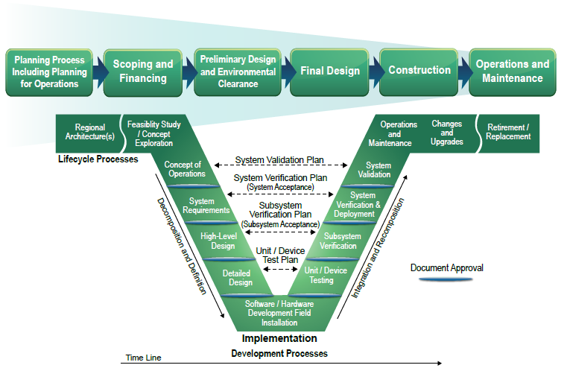

Slide 3
Opportunities within the 3-Cs Process

Slide 4
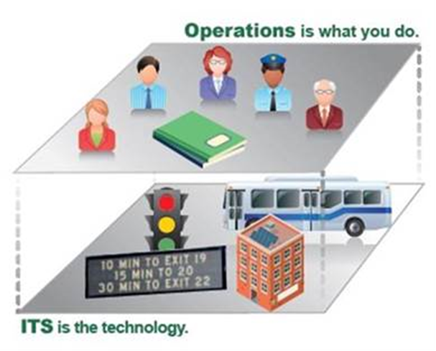
Planning is a Process

Slide 5
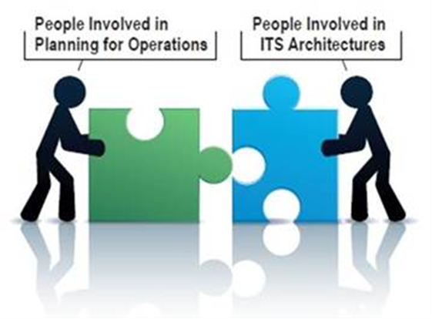
Collaboration

Slide 6
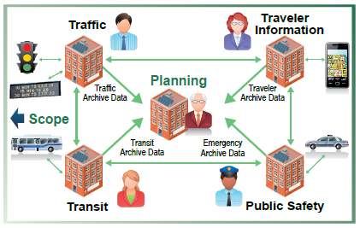
Collaboration

Slide 7
Planning For Operation

Slide 8
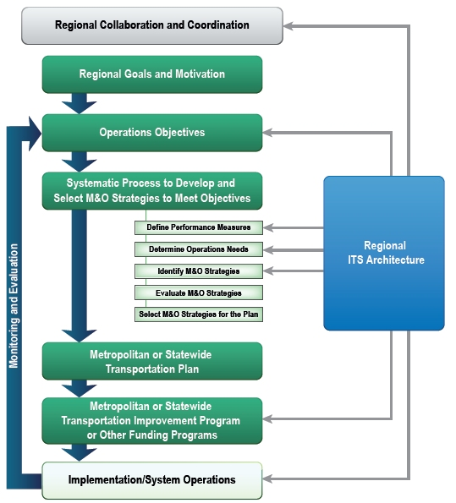
Planning For Operation
Coordination and Consultation
Congestion Management Process
Performance-Based Approach

Slide 9

Performance-Based Planning

Slide 10

Federal Assist, State Manage, Locally Driven
Headquarter Office of Planning
Coordinate between offices
Develop Guidebooks
Host Workshops/Peer Exchanges
Transportation Planning Excellent Awards
Advance Innovation through Research
FHWA Division Offices
Provide guidance and technical assistance
Review State DOT and MPOs planning process
Promote best practices

Slide 11
Resources
FHWA Office of Planning:
  https://www.fhwa.dot.gov/planning/
  https://planning.dot.gov/focus_congestion.asp
Planning for operation:
  https://ops.fhwa.dot.gov/plan4ops/resources/all_resources.htm

Slide 12
Thank You
Cheng J. Yan
Transportation Specialist
Email: cheng.yan@dot.gov
Phone: (202)366-9206

