Slide 1
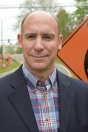
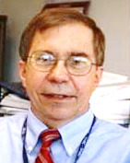
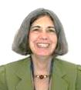
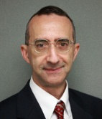
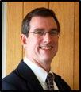
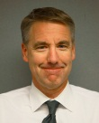
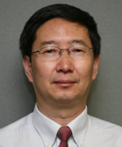
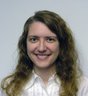
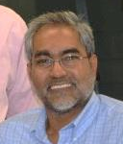
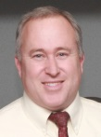
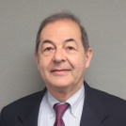
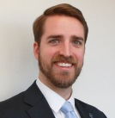
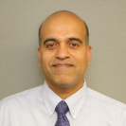
Turner-Fairbank Highway Research Center Office of Operations Research & Development
Director
Brian Cronin
“Driving Future Highways”
Technical Director
Robert Ferlis
HRDO-02
Administrative Assistant
Janet Klein
Transportation Enabling
Technologies Team
Transportation Operations
Concepts and Analysis Team
Transportation Operations
Applications Team
Team Leader
Dale Thompson
HRDO-10
Team Leader
Joe Bared
HRDO-20
Team Leader
Gene McHale
HRDO-30
Jon Obenberger
Peter Huang
Deborah Curtis
Mohammed Yousuf
Randy VanGorder
Osman Altan
Taylor Lochrane
Chris Melson
Govind Vadakpat
Rachel James
As of 08/10/2016
Notes:
A corporate/national R&T resource
60 years of highway research
24 indoor and outdoor laboratories
5 buildings on 44 acres
300 Federal employees and contractors onsite
Student/ professional development opportunities
At the heart of what we are, are the researchers
Skill level
FHWA Engineer of the Year 3 out of 4 years
Research Center as educational site – college and above
PDP
STIPDG
GRFs
Volunteer students

Slide 2
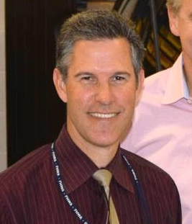
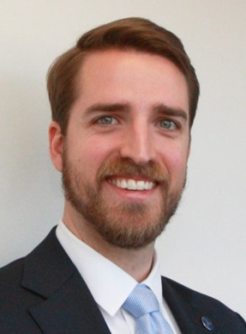
Turner-Fairbank Highway Research Center Office of Operations Research & Development
Transportation Enabling Technologies Team
“Technologies To Enable the Future”
Dale Thompson
Team Leader
Mohammed Yousuf
Jon Obenberger
As of 10/30/15
Taylor Lochrane
Notes:
A corporate/national R&T resource
60 years of highway research
24 indoor and outdoor laboratories
5 buildings on 44 acres
300 Federal employees and contractors onsite
Student/ professional development opportunities
At the heart of what we are, are the researchers
Skill level
FHWA Engineer of the Year 3 out of 4 years
Research Center as educational site – college and above
PDP
STIPDG
GRFs
Volunteer students

Slide 3
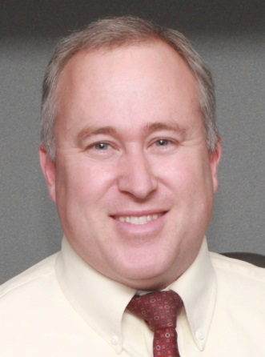
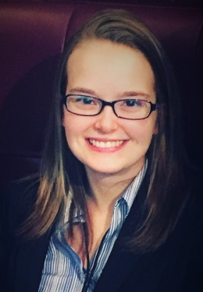
Turner-Fairbank Highway Research Center Office of Operations Research & Development
Transportation Concepts and Analysis Team
“Turning “What Ifs” into “Here’s How”
Randy VanGorder
Joe Bared
Team Leader
Peter Huang
As of 08/10/2016
Chris Melson
Rachel James
Notes:
A corporate/national R&T resource
60 years of highway research
24 indoor and outdoor laboratories
5 buildings on 44 acres
300 Federal employees and contractors onsite
Student/ professional development opportunities
At the heart of what we are, are the researchers
Skill level
FHWA Engineer of the Year 3 out of 4 years
Research Center as educational site – college and above
PDP
STIPDG
GRFs
Volunteer students

Slide 4
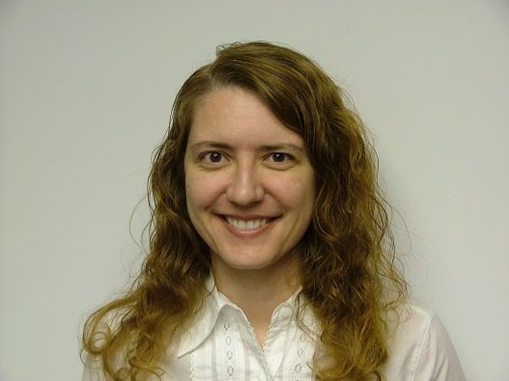
Turner-Fairbank Highway Research Center Office of Operations Research & Development
Transportation Operations Applications Team
“From The Laboratory to Deployment”
Gene McHale
Team Leader
Deborah Curtis
Osman Altan
Govind Vadakpat
As of 10/30/15
Notes:
A corporate/national R&T resource
60 years of highway research
24 indoor and outdoor laboratories
5 buildings on 44 acres
300 Federal employees and contractors onsite
Student/ professional development opportunities
At the heart of what we are, are the researchers
Skill level
FHWA Engineer of the Year 3 out of 4 years
Research Center as educational site – college and above
PDP
STIPDG
GRFs
Volunteer students

Slide 5
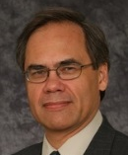
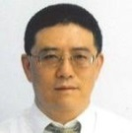
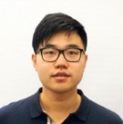
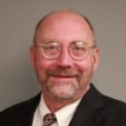
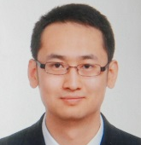
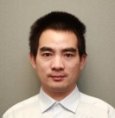
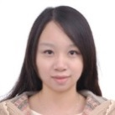
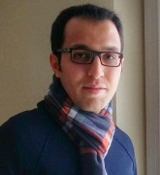
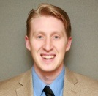
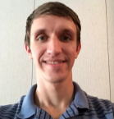
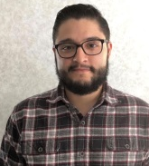
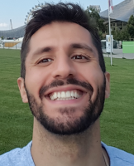
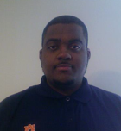
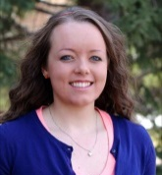
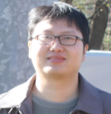
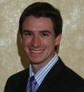
Visiting Researchers (IPA; Rotational Assignments; NRC Fellow; Graduate Research Fellow)
Past Researchers
FY 2016 Researchers
Jeremy Raw
Transportation Planner
FHWA Office of Planning
(Jan– March 2015, HRDO-02)
Li Zhang
Visiting Professor
Mississippi State University
(Jan 2014 – August 2016)
Jia Hu
NRC Post Doc Research Associate
University of Virginia
(Oct 2014 – Present)
Dan Dailey
IPA
University of Washington
(July 2015– July 2016)
Lei Zhang
Graduate Student
Mississippi State University
(Jan 2014 – August 2016)
Yi Zhao
NRC Post Doc Research Associate
Beijing Jiaotong University
(December 2015 – Present)
Ximiao Jiang
NRC Post Doc Research Associate
(Oct 2013 – Oct 2015)
Fang Zhou
Graduate Student
Mississippi State University
(Jan 2014 – August 2016)
Mehdi Zamanipour
NRC Post Doc Research Associate
University of Arizona
(September 2016 – Present)
Cory Krause
University of Maryland
Pathways Program
(July 2013 – June 2015)
Grant Apperson
Graduate Student
Auburn University
(May – Aug 2015)
Austin Angulo
Graduate Research Fellow (GRF)
University of Maryland
(August 2016 – Present)
Rob Kluger
University of Virginia
Eisenhower Research Fellow
(Sep 2014 – Sep 2015)
Xialong Cao
Graduate Student
Auburn University
(May – Aug 2015)
Pavle Bujanovic
Graduate Research Fellow (GRF)
The University of Texas at Austin
(August 2016 – Present )
David Kari
Graduate Student
University of California Riverside
(May – Aug 2015)
Mikhail Gordon
Graduate Student
Auburn University
(May – Aug 2015)
Guchan Ozbilgin
Graduate Student
Ohio State University
(May – Aug 2015)
Terrill (TJ) Jackson
STIPDG
University of Central Florida
(May – Aug 2016)
Britton Hammit
Graduate Research Fellow (GRF)
University of Wyoming
(October 2016 – Present)
Zhitong Huang
Eisenhower Research Fellow
Mississippi State University
(Jan 2014 – August 2016t)
Sean Laffey
Graduate Research Fellow (GRF)
University of Virginia
(August 2016 – Present)

