Slide 1

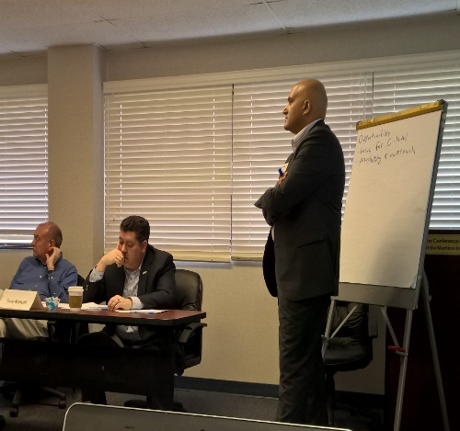
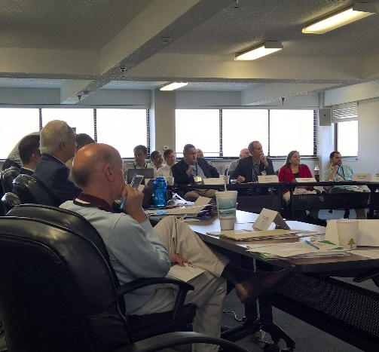

National Operations
Center of
Excellence
Patrick Son, P.E.
Managing Director
Steven Lavrenz, Ph.D.
Technical Services Manager

Slide 2
Our Vision & Mission
Vision: Provide exceptional services to the transportation systems management and operations (TSM&O) community to save lives, reduce congestion, and enhance economic vitality
Mission: Empower the TSM&O community to succeed by enhancing knowledge, skills, and abilities

Slide 3
Genesis of the Summit
Workforce capabilities are recognized as an increasingly crucial component of realizing the potential of new ITS technology and TSMO applications
September 2015: NOCoE charged with focusing on TSMO workforce development as the centerpiece of its first strategic work program and Annual summit

Slide 4
Current State of the Industry
Three White Papers in advance of the Summit addressed the following areas:
  Institutional context for TSMO in transportation agencies
  Professional Capacity Building Needs vs. Available Resources
  Recruitment, Retention and Career Development

Slide 5
Issues for the Summit to Address
Competencies, Education and Training:
  1. Pre-employment education aimed at producing TSMO generalists
  2. Pre-employment education aimed at producing key TSMO-related technical specialists
  3. Position and qualifications specifications (KSAs)
  4. Employment training programs
Recruitment, Retention and Career Development:
  5. Keeping pace with emerging trends in technology/skills
  6. Recruitment
  7. Career development
  8. Retaining top performers

Slide 6
TSMO Workforce Implementation Plan
  Develop a repository of Position Descriptions, KSA and Best Practices for TSMO workforce recruitment, retention and career development
  Pre-employment education aimed at producing both TSMO generalists and specialists with key support capabilities
  Post-hiring education aimed at producing TSMO professionals with key support capabilities
  Develop a strategy to elevate TSMO as a core transportation function (Institutionalization of TSMO)

Slide 7
TSMO Workforce Implementation Plan
NCHRP 20-7 Project 408
  Transportation System Management and Operations (TSMO) Workforce: Skills, Positions, Recruitment, Retention, and Career Development
  Panel selected consultant in July, work scheduled to start soon
  15 month project, completion fall 2018
  Project Scope
    Existing education programs and best practices for recruiting & retention
    Position descriptions
    KSA development
    Strategic Management Framework for recruitment & retention
    TSMO Workforce Guidebook

Slide 8
TSMO Workforce Implementation Plan
  Pre-employment education aimed at producing both TSMO generalists and specialists with key support capabilities
  Convene a forum of transportation agencies, private sector and educators
    What are the key constraints facing educators in offering TSMO related material and successes in overcoming
    What has been the experience of university-based entities providing technical support to DOTs?
    Identify key opportunities for community college, undergraduate and graduate professional education to support content both for TSMO generalists (interdisciplinary) and TSM&O-related specialist disciplines
    Identify pilot efforts that NOCoE engage in to support and promote examples of effective per-employment/hiring TSMO education and training
  November 8th: VTTI, Cal Berkley/PATH, Florida International, U of M, South Florida, Washtenaw Community College, University of Memphis & Oregon State as participants

Slide 9
TSMO Workforce Implementation Plan
Post-hiring education for producing TSMO Professionals
    Review current practices for TSMO training
    Define an appropriate training “program” and identify elements for all KSAs for both hard and soft skills
    Inventory and create a repository in the NOCOE EKTS for all existing training materials by topic and identify key gaps in available training for function/position function KSAs
    Develop a modular model training program that addresses any gaps
Develop project approach that coordinates and avoids duplication
    ITS JPO, FHWA, 20-7 (408)

Slide 10
2018 TRB Student Competition
Joint NOCoE & TRB competition leading up to TRB Annual Meeting
Students submit an ePortfolio around recent projects/examples of work in TSMO
Portfolios should be dynamic, engaging, reflect current and future areas of TSMO work/research
Two winning individuals will receive funding for travel to TRB Annual Meeting
Submittal deadline: November 1st, 2017

Slide 11
ITS-JPO Student Competition
Student ITS competition, a la “Shark Tank” TV show
Students are asked to solve real-world problems from DOTs
Live competition at 2018 ITE Annual Meeting (Minneapolis)
Task force organized by ITS PCB Academic Team
  NOCoE: competition information host, provide materials, coordinate judging
  ITE: host live competition, assist in judging, advertisement
  ITS America: Assist in judging, advertisement
  State/Local DOTs: Assist in judging, provide problem statements

Slide 12
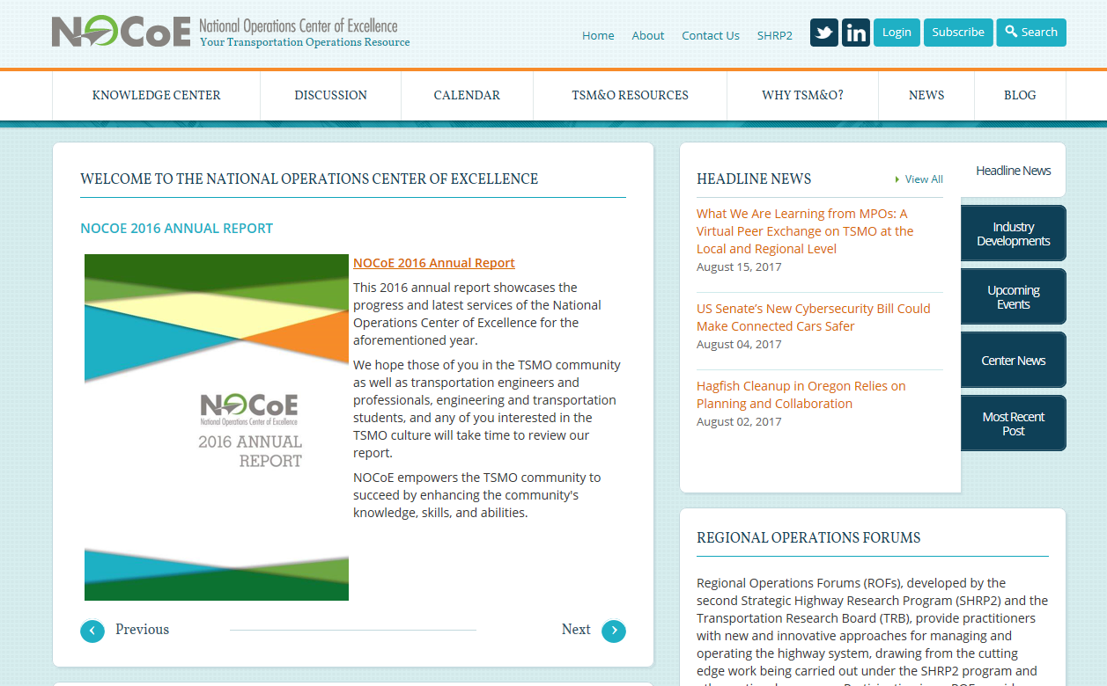

Questions?
Patrick Son, P.E., Managing Director
pson@transportationops.org
Steven Lavrenz, Ph.D., Technical Services Manager
slavrenz@transportationops.org
www.transportationops.org

