Slide 1
ITS PCB Community College Workshop
September 20, 2017
Lou Sanders, Senior Director, Engineering Services
American Public Transportation Association

Slide 2
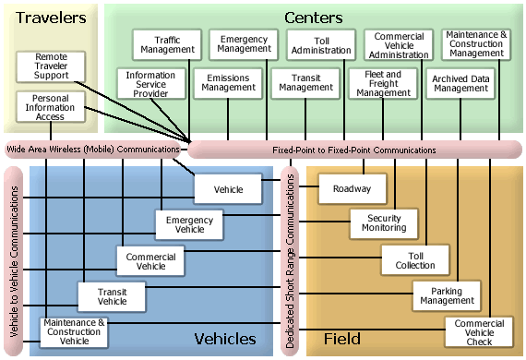

Slide 3
