Slide 1
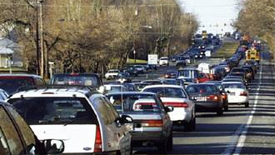
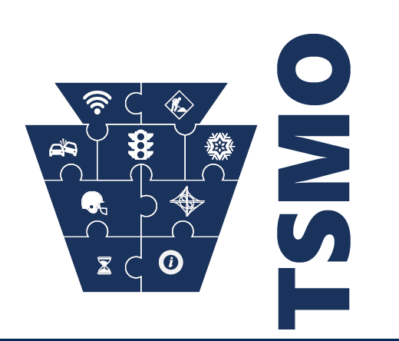
Pennsylvania DOT Perspective
ITS Community College Workshop
September 20, 2017

Slide 2
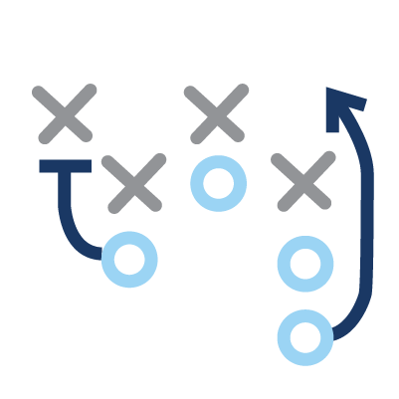
Overview
Transportation Systems Management & Operations
TSMO Purpose
A way to address reliability, mobility, and congestion by using various strategies rather than just trying to build our way out.
TSMO Mission
Move people and goods, from Point A to Point B, as efficiently, safely, and reliably as possible.

Slide 3
Overview (Project Life Cycle – Reality)
Design
Maintenance
Construction
Planning
Operations

Slide 4
Overview (Capability Maturity for TSMO)
Self-Assessment
Elements | Level 1 Performed | Level 2 Managed | Level 3 Integrated | Level 4 Optimizing
Planning & Programming
Systems & Technology
Performance
Culture
Organization & Staffing
Collaboration

Slide 5
Overview (Capability Maturity for TSMO)
Target
Elements | Level 1 Performed | Level 2 Managed | Level 3 Integrated | Level 4 Optimizing
Planning & Programming
Systems & Technology
Performance
Culture
Organization & Staffing
Collaboration

Slide 6
Key TSMO Activities
TSMO Strategic Framework and Program Plan
Performance Metrics Program
TSMO Implementation Guidebook
Regional Operations Plans
Statewide TMC / 4 Regional TMCs
Connected and Automated Vehicles
Traffic Signal Ownership

Slide 7
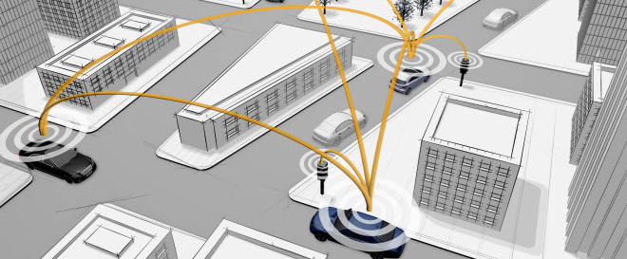
Needed Job Skills
Traffic Operations
IT / Communications
Data analytics
Advanced Vehicle Technologies

Slide 8
Needed Job Skills
Traffic Operations
IT / Communications
Data analytics
Advanced Vehicle Technologies

Slide 9
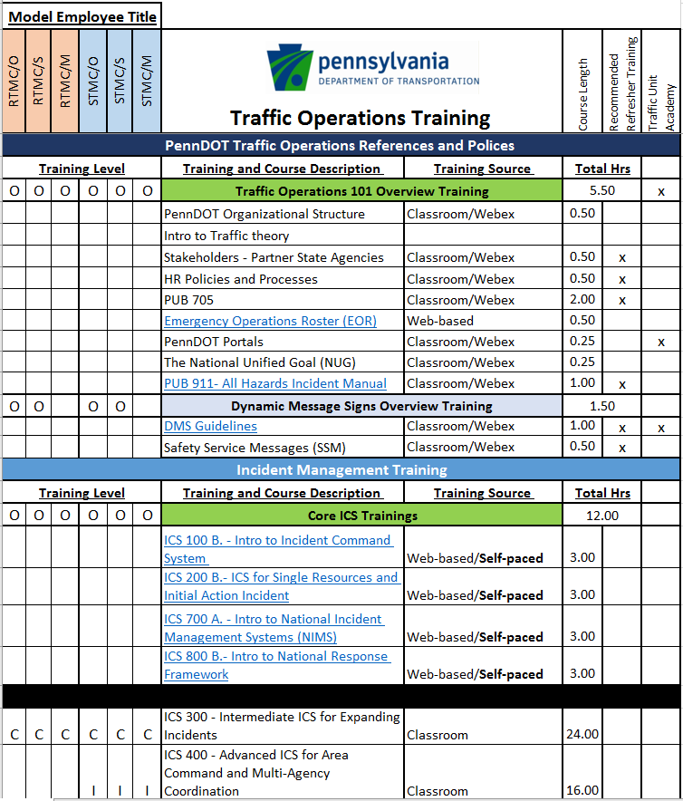
PennDOT Training Program
Traffic Management Centers
TSMO
Advanced Vehicle
Technologies

Slide 10
Finding Qualified Personnel
PA Civil Service Commission
Limited to existing classifications
“Fit” classifications into needed skills

