Slide 1
ITS PCB Program Resources (8:45-10:00 am)
ITS PCB Program Background
ITS Case Studies
T3 Webinars
T3e Webinars
ITS Curriculum Webpage
ITS Standards and Transit Standards
ITS ePrimer
CITE Courses & Products
NHI Courses

Slide 2
The USDOT Offers Free ITS Training
The USDOT’s Professional Capacity Building (PCB) Program:
Established by congressional legislation to build and sustain a capable and technically proficient ITS workforce
Provides comprehensive, accessible, flexible ITS learning for the transportation industry
Focused on transportation professionals - develop their knowledge, skills, and abilities while furthering career paths
Increase your knowledge of ITS technologies
Excel at your career
Advance the mission of your organization
Source: ThinkStock
Achieve your ITS learning goals. Visit:
www.pcb.its.dot.gov/training.aspx

Slide 3
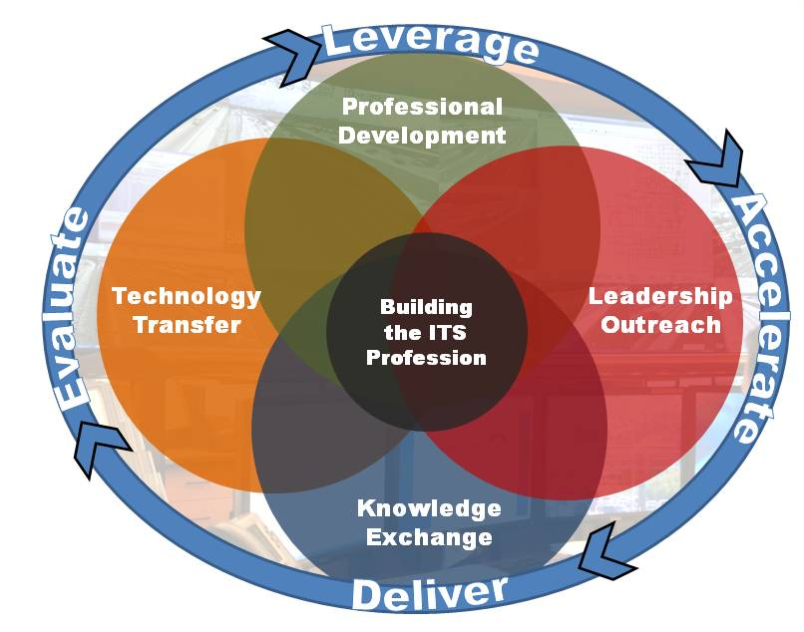
ITS PCB Program Background
Part of U.S. DOT ITS Joint Program Office (ITS JPO)
Authorized by Congress in 1996 to develop the workforce competencies to transform the transportation infrastructure through ITS
Reauthorized by the 2012 Moving Ahead for Progress in the 21st Century (MAP-21) & reaffirmed by the 2016 Fixing America's Surface Transportation Act (FAST Act)
In 2010 embarked on new strategic direction:
Develop new ITS content and fill gaps in existing content.
Build partnerships to direct learning to the right audiences.
Move to cost-effective, engaging delivery methods.
Ever increasing effort to expand coordination with wider (non-Federal) partners: Academia & Professional Associations

Slide 4
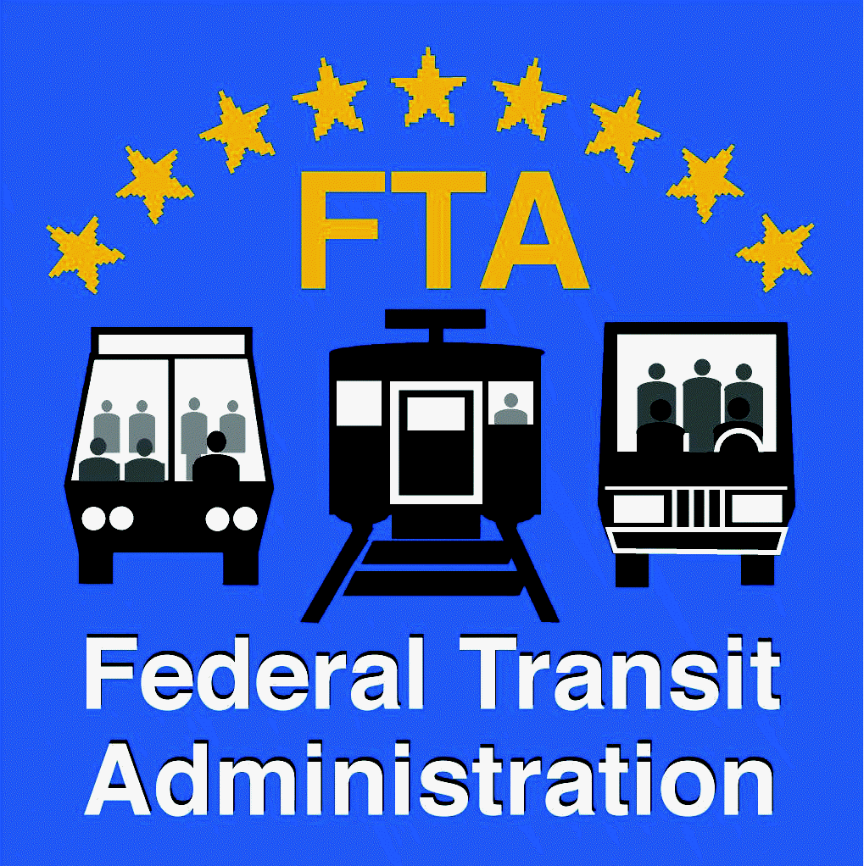
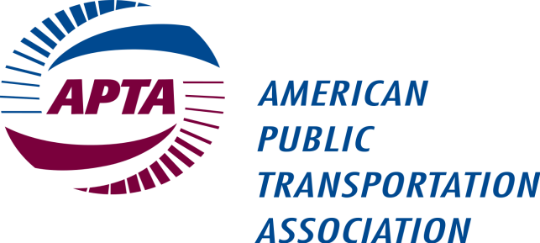
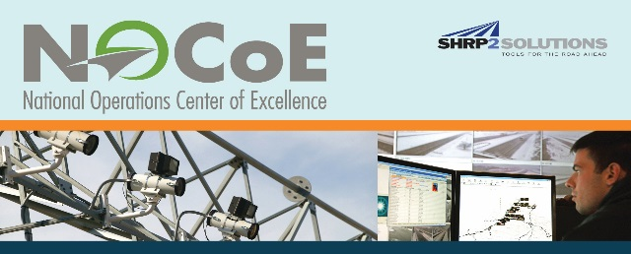
ITS PCB Partners
FUTURE PARTNERS
SAE International
IEEE
NACo
AMPO
MARAD
International Road Federation
Transportation Workforce Centers
USDOT FMCSA

Slide 5
ITS PCB Program Content
Tier 1: Emerging Technologies
Connected Vehicle:
Tier 2: Current Research
Short-term Intermodal Research
Research Initiatives
Tier 3: Existing Technologies
Adaptive Signal Control
Freeway Management
Crash Prevention & Safety
Road Weather Management
Tier 4: Foundational/Cross-Cutting Topics
And more…
Standards
ITS Architecture
Systems Engineering
Vehicle to Vehicle (V2V)
Vehicle to Infrastructure (V2I)
DSRC (for Transportation
Technology
Policy
ICM
Smart Roadside
Telecommunications
DSRC
Data Collection & Mgmt.
Security
Data Communications
Arterial Management
Driver Assistance
Automated Vehicles
AERIS
Procurement
CVRIA
Smart Cities
MOD/ATTRI
Targeted delivery, through strategic use of partners:
T3 Webinars
CITE Courses
ITS America State Chapter Workshops
Academic Case Studies
T3 Webinars
P2P
ePrimer
CITE Courses
ITS Video Library
ITS Knowledge Resources
CITE Courses
Standards Modules
NHI Courses

Slide 6
Partnering with Higher Education
The USDOT looks to colleges and universities as partners in educating the next generation of leaders in Connected Vehicles
Priority Audiences
Over the Next 1 to 3 Years
Anticipated Audiences
Over the Next 3 to 5 Years
Federal Agencies
Transportation Executives and General Managers
Transportation Practitioners (including Engineers and Planners)
Manufacturing/Industry
IT/Communications
Data Aggregators
Automobile Manufacturers
Insurance and Privacy Audiences
Public Safety/Law Enforcement
Freight/Commercial Vehicle Owners and Operators
Media
Advocacy Organizations

Slide 7
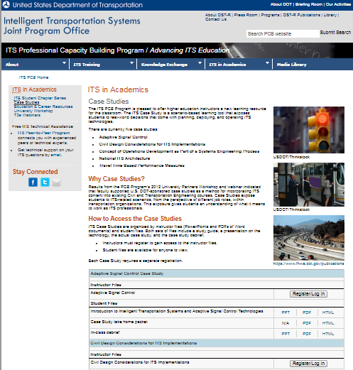
ITS Case Studies
Case Study developed from input from University Workshops
6 Case Studies
Adaptive Signal Control
National ITS Architecture
ITS Concept of Operations
Civil Design Considerations for ITS Implementation
Travel Time Based Performance Measures
Transit Service (online soon)
Case Studies can be found online at https:// www.pcb.its.dot.gov/casestudies/default.aspx

Slide 8
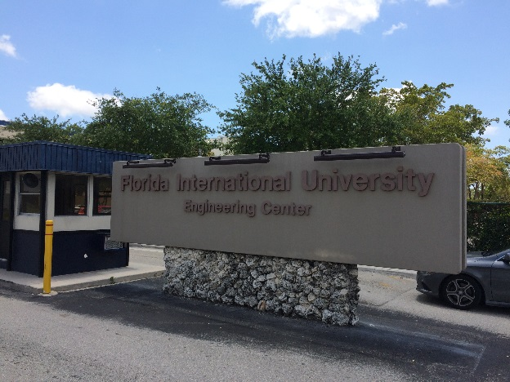
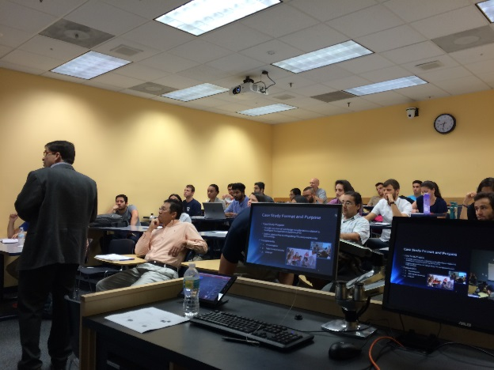
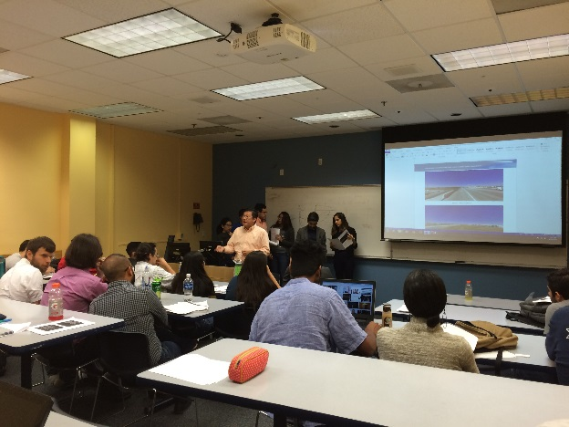
ITS Case Studies – 2016 Pilots
Civil Design Considerations for ITS Implementation
Gonzaga University (Undergraduate)
Florida International University (Undergraduate & Graduate)
ITS Concept of Operations at University of Massachusetts (Undergraduate)
Transit Service and ITS by TSI at Oklahoma University

Slide 9
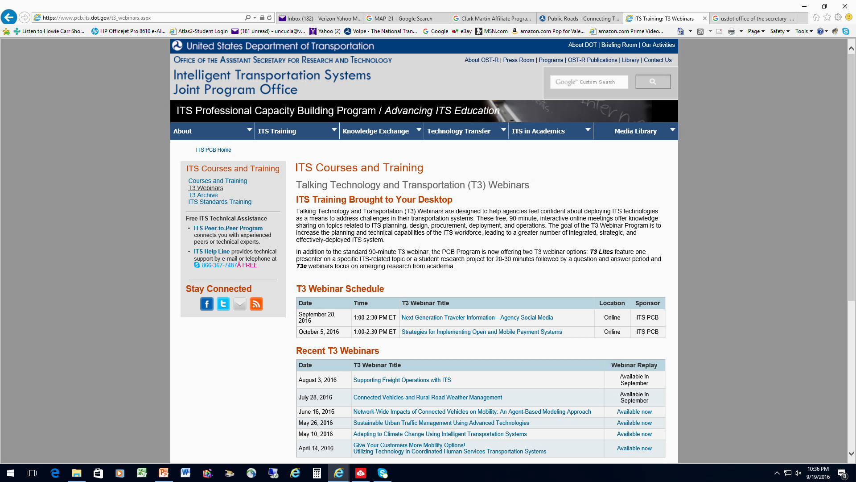
Talking Technology and Transportation (T3) Webinars
(https://www.pcb.its.dot.gov/t3_webinars.aspx)

Slide 10
T3 Webinars and Archive
Online, 90 minute, interactive seminars
FREE by ITS PCB Program
Past webinars available through T3 archive (3-4 weeks after live event)
Professional Development Hours (PDHs) eligible
Invite T3 Webinars proposal:
Highlight an ITS related case study, problem solving challenge, or topic
To join announcement list:
Send email to T3@dot.gov with the subject line "Add to Email List."
Register at: https://www.pcb.its.dot.gov
T3 Webinar Series:
Automated Vehicle Awareness Series (2015-2017)
Open Payment Series (2016-2017)
Mobility On Demand Series (2017-2019)
Smart Cities Awareness Series (2017-2020)
Recent T3s (available now in archive):
Traffic Incident Management - What’s New?
Variable Speed Limits Systems: Are They for Everyone?

Slide 11
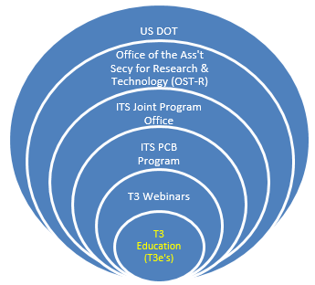
Talking Technology and Transportation in Education (T3e) Webinars
Purpose
T3e’s are envisioned as a forum to bridge academic research with the larger transportation community. The goals are multifaceted and aim to:
Allow transportation professionals to learn about emerging trends and interact with academia.
Provide students an opportunity to present their work to the professional community and perfect their presentation skills.
Offer an opportunity for academic institutions to showcase their programs and labs to a national audience.
Provide those in all sectors with an opportunity to network and find synergy, potentially forming partnerships for deployment, operations, or new research topics.

Slide 12
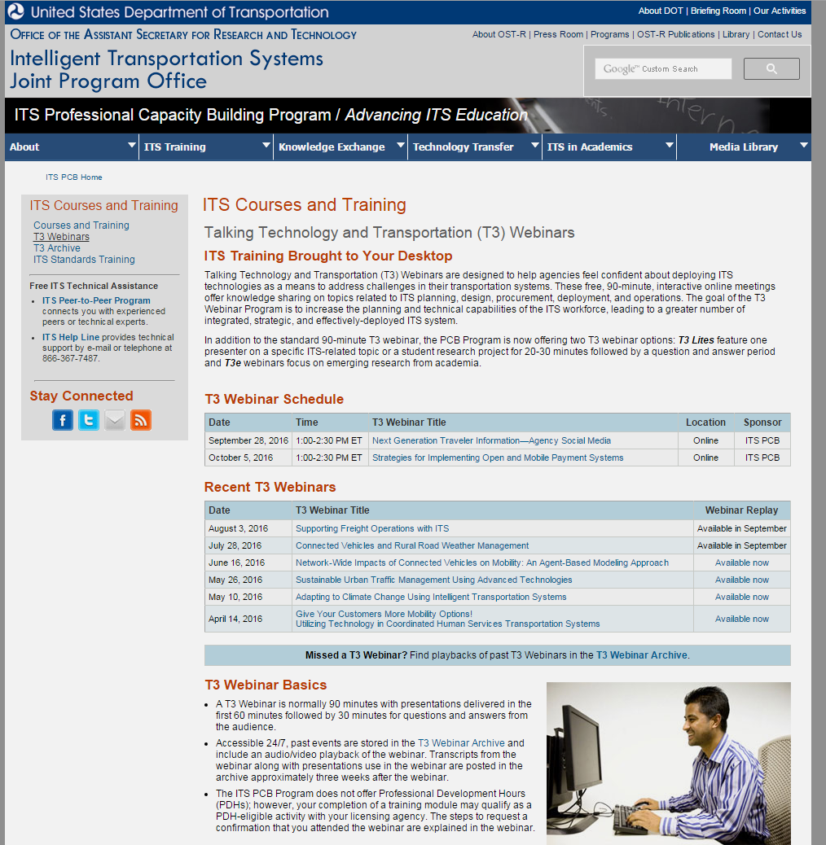
T3e (education) Webinars
Format
Focus on a specific ITS topic, theme, or subject area
Up to 60-minutes in length--the first 25-40 minutes is devoted to presentations on relevant research, while the remaining time is set aside for an interactive question and answer discussion.
Presenters may be university students, staff members, researchers, or professors but usually includes multiple presenters.
T3e’s present a unique forum for exchange between academia, government, and industry.
https://www.pcb.its.dot.gov/t3_webinars.aspx?selectedTab=2

Slide 13
T3e (education) Webinars
Process
Because the T3e’s are focused on academic research, unlike other T3 webinars, T3e presenters come exclusively from academia.
In contrast to traditional T3’s which are hosted by a federal DOT staff member, a professor will serve as the host on a T3e webinar.
The T3e Webinar content is developed by the professor and presenters, who determine the topic(s) and learning objectives.
All T3e’s are produced by the Volpe Center T3 team who works with professors and students throughout.
All T3e webinars are archived and available for viewing on the T3 website which presenters and can access and share freely.
Spaces are available on the calendar for 2018!
Please speak to Jaime if you are interested.

Slide 14
T3e (education) Webinars
Sample of Past T3e’s
Network-Wide Impacts of Connected Vehicles on Mobility: An Agent-Based Modeling Approach | Oregon State University
Connected Vehicles and Rural Road Weather Management | Univ of Wyoming
Solar-powered Automated Transit Networks: The Future of Sustainable Urban Transportation | San Jose State University
Upcoming T3e’s
Analysis of Freight Crashes along the I-10 Corridor: Potential ITS Countermeasures | Northern Arizona University – September 26, 2017
Title | University of Tennessee, October 11, 2017

Slide 15
ITS Curriculum Webpage
Purpose
To publish information about ITS courses in order to provide:
Prospective graduate & undergraduate students interested in ITS with a “one-stop-shop” resource with information on university ITS programs & courses; and
Educators with a platform to feature their ITS courses and an opportunity to informally network with other educators, exchanging lesson plans and best practices.
You can help develop this into a meaningful resource by providing us with:
A list of your ITS courses, along with one or two web links to course descriptions/information
A two-to-three sentence description that sums up ITS-related initiatives at your institution
A university point of contact, and
A university logo that we can publish on our website.

Slide 16
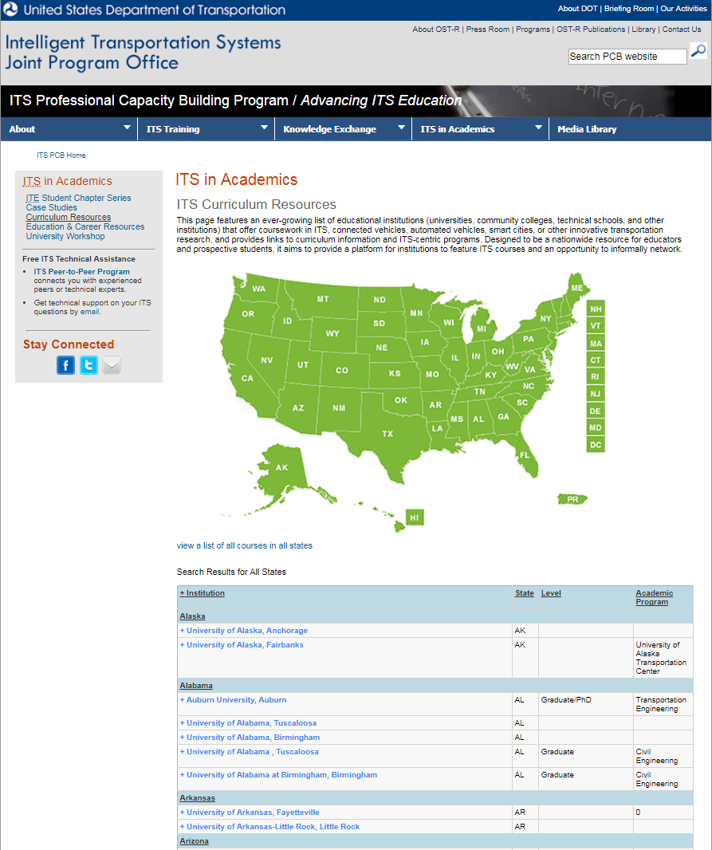
ITS Curriculum Webpage
Found at: www.pcb.its.dot.gov
Within ITS in Academics:
https://www.pcb.its.dot.gov/academics.aspx
The webpage will ultimately feature a comprehensive list of educational institutions that offer coursework in ITS, connected vehicles, automated vehicles, smart cities, or other innovative transportation research, and provide links to curriculum information and ITS-centric programs.

Slide 17
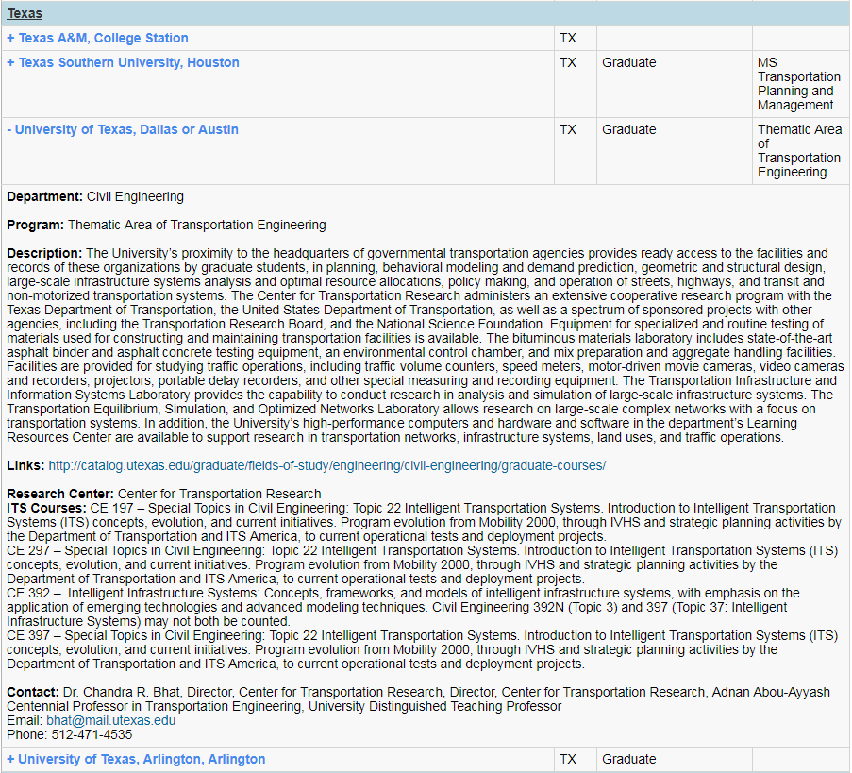
ITS Curriculum Webpage
Organized by state, clicking on a school listed expands to show details about the program that offers ITS coursework.
This is envisioned as a resource for all levels of higher education, and aims to incorporate community colleges, tech, and trade schools.

Slide 18
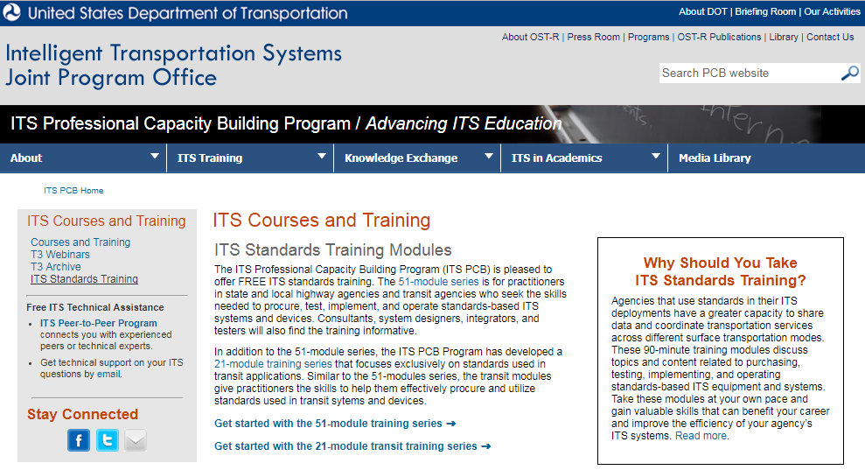
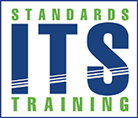
ITS Standards / ITS Transit Standards
FREE, 1.5-2 hour modules that teach how to procure, implement, and operate ITS standards-based devices
First posted 2013
56 general ITS Standards Training Modules online
21 ITS Transit Standards Training online
New as of this year
8 ITS Standards
10 ITS Transit Standards
8 ITS Standards updated
(https://www.pcb.its.dot.gov/stds_training.aspx)

Slide 19
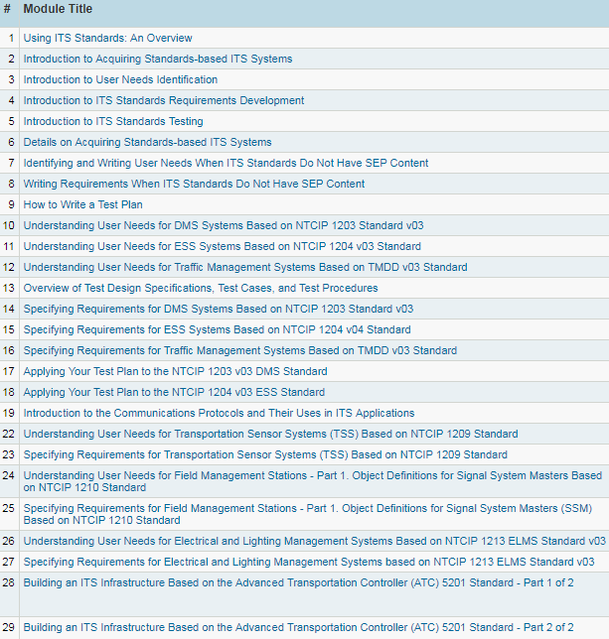
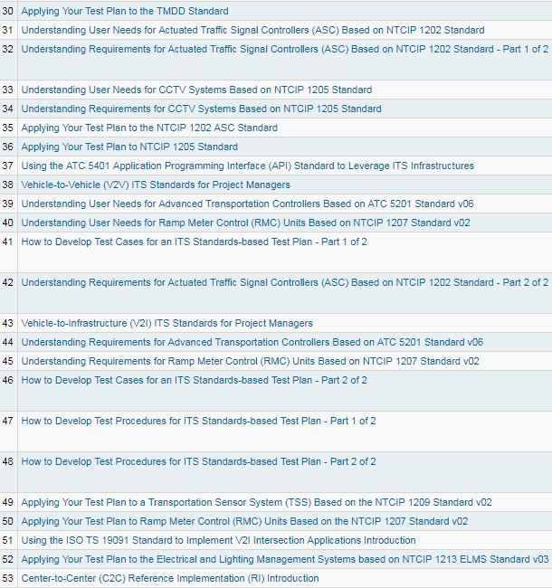
General ITS Standards Training Modules

Slide 20
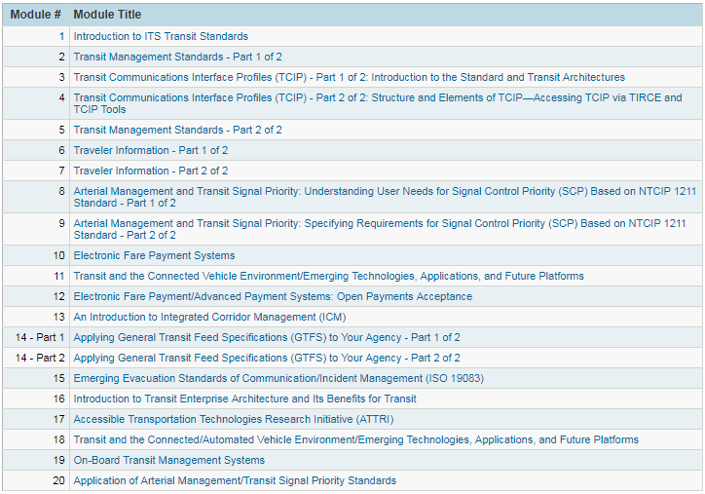
ITS Transit Standards Training Modules

Slide 21
ITS ePrimer
Collaboration among ITE, APTA and ITS America
14 online modules, with multi-medial examples
Key elements include:
Technical content
Navigation to individual modules
Links to video and interactive material
Training and resource links
Feedback links
Posted 2014
Updates 2018

Slide 22
ITS ePrimer
2018 Update
2018 Update
2018 Update
2018 Update
2018 Update
2018 Update
2018 Update
(https://www.pcb.its.dot.gov/eprimer.aspx)

Slide 23
What is CITE?
Consortium for ITS Training and Education
A unique consortium of over 100 university and industry partners
Provide interactive online advanced transportation courses
Types of offerings
Certificate Programs
Independent Study Courses
Blended Courses
Full Semester Courses

Slide 24
CITE’S AUDIENCE
College/University Students
Courses taken from University Partners
College credit given for completion through partners
Industry professionals
Courses taken directly through CITE
CEU’s given for completion

Slide 25
NEWEST COURSES AVAILABLE
Archived Data for Planning, Operations and Safety
Connected Vehicles 101
Cyber Security
Performance Measurement
Intro to Operations Performance Measures and Management
Nuts and Bolts of Operations Performance Measurement
Operations Performance Management: Real-time Operations to Long Term Planning
Travel Time (Vehicle Probe Data)

Slide 26
National Highway Institute (NHI) Courses
Background
Established by Congress in 1970
Training and education arm of the Federal Highway Administration (FHWA)
Hundreds of trainings in more than 18 transportation industry-related program areas
Course Offerings
Instructor-led training from short, 1-day courses to multi-week sessions
Web-Conference trainings—live, online learning taught by remote instructors
Web-based trainings that are available online 24/7 (over 160 in catalog)

Slide 27
National Highway Institute (NHI) Courses
Course Topic Areas
Asset Management
Communications
Construction and Maintenance
Freight and Transportation Logistics
Geotechnical
Highway Safety
Hydraulics
Intelligent Transportation Systems
Structures
Transportation Performance Management
Transportation Planning
Search courses at: https://www.nhi.fhwa.dot.gov/home.aspx

